Slide 1

WELCOME TO ONLINE CLASS
CLASS : LKG
SUBJECT : CONVERSATION
CHAPTER : 5
TOPIC : COLOURS

Slide 2



COLOURS
THE COLOUR OF THE GRASS IS
THE COLOUR OF THE SUN IS
Notes:
THE COLOUR OF THE SUN IS

Slide 3



THE COLOUR OF THE SKY IS
THE ROSE IS OF
THE COLOUR OF THE BRANCHES OF TREES IS
Notes:
THE COLOUR OF THE BRANCHES OF TREES IS

Slide 4

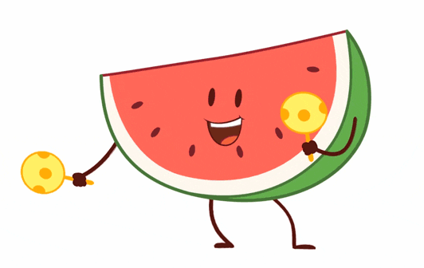
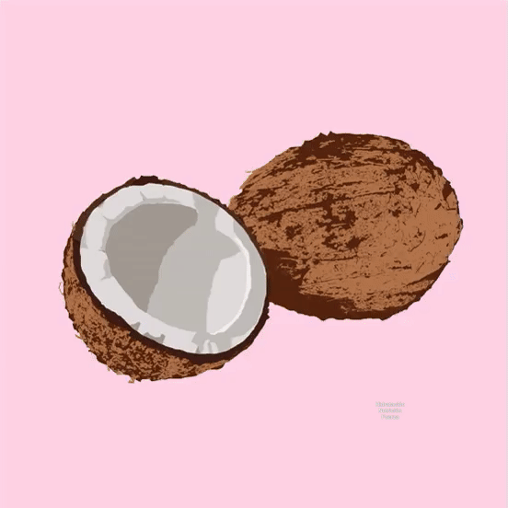
NAME A FRUIT WHICH IS OF THE GIVEN COLOUR AND WE PEEL IT BEFRORE WE EAT, IT IS THE FAVOURITE FRUIT OF MONKEY?
I AM A
I AM A WATERMELON. CAN YOU TELL ME WHAT COLOUR DO I HAVE INSIDE ME.
RED COLOUR
MY NAME IS COCONUT, I HAVE A HARD SHELL OUTSIDE WHICH IS BROWN IN COLOUR AND, INSIDE I HAVE SOME WATER, CAN YOU SAY WHAT COLOUR DO YOU SEE WHEN Y0U BREAK ME?
Notes:
MY NAME IS COCONUT, I HAVE A HARD SHELL OUTSIDE WHICH IS BROWN IN COLOUR AND, INSIDE I HAVE SOME WATER, CAN YOU SAY WHAT COLOUR DO YOU SEE WHEN Y0U BREAK ME?

Slide 5
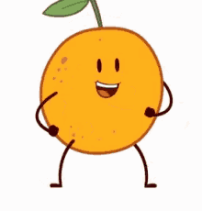
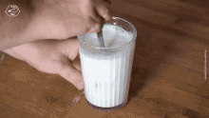
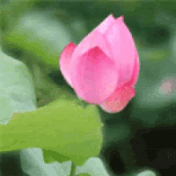

I AM A FRUIT , MY NAME IS THE NAME OF A COLOUR. I TASTES SWEET AND SOUR BOTH. GUESS MY COLOUR AND NAME.
I AM A COW. I GIVE YOU THE ENERGY DRINK TO BECOME HEALTHY, CAN YOU GUESS THE COLOUR OF THE DRINK.
WHAT IS THE COLOUR OF THIS FLOWER
Notes:
WHAT IS THE COLOUR OF THIS FLOWER

Slide 6

THANKING YOU
ODM EDUCATIONAL GROUP

