Slide 1


TOPIC- HUMAN EVOLUTION PERIOD- 8
CHAPTER NUMBER- 10
CHAPTER: HEREDITY AND EVOLUTION
CLASS: X
SUBJECT: BIOLOGY

Slide 2

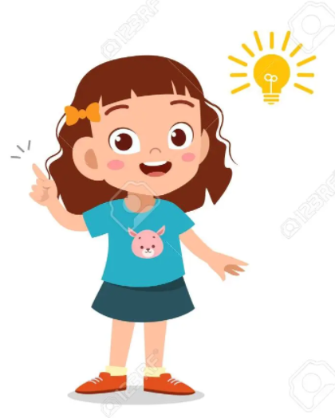
LEARNING OBJECTIVE
Students will –
Learn the basis of inheritance of characters from one generation to other.
Know the evolution of humans from apes.
Analyze the gradual changes leading to evolution.

Slide 3
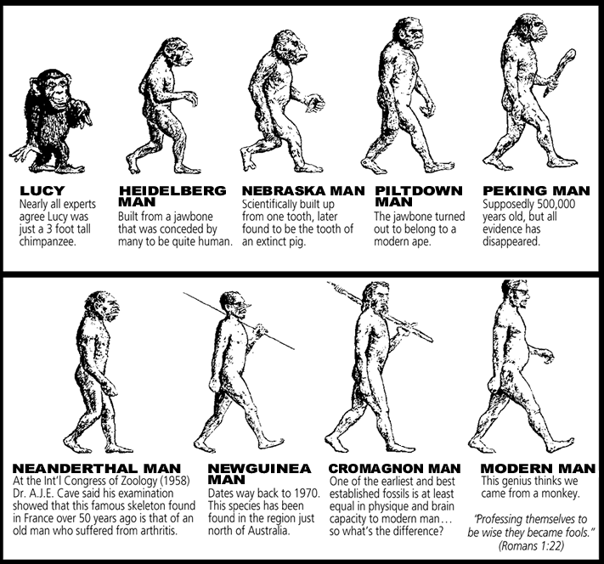
Human evolution :- (Homo sapiens)
There is a great diversity among human beings in their form and
features around the world. Human beings evolved in Africa.
Some of them stayed there and others migrated to different parts of the world.
Then due to genetic variations and the environmental changes in
different geographical regions they developed changes in their forms and features.

Slide 4
Human evolution :- (Homo sapiens)

Slide 5
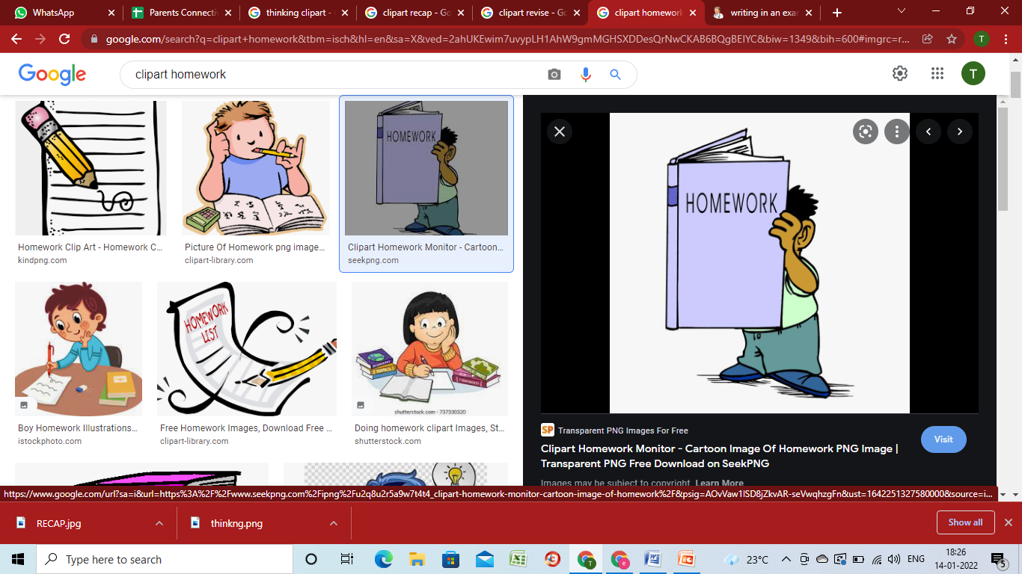
HOME ASSIGNMENT
Write short note on human evolution.
What is the scientific name of human.
Why is evolution not always progressive in nature? Give an example in support of your answer.
Why there is no human species parallel to sapiens.

Slide 6
THANKING YOU
ODM EDUCATIONAL GROUP

