Slide 1


TOPIC- EVOLUTION BY STAGES PERIOD- 7
CHAPTER NUMBER- 10
CHAPTER: HEREDITY AND EVOLUTION
CLASS: X
SUBJECT: BIOLOGY

Slide 2

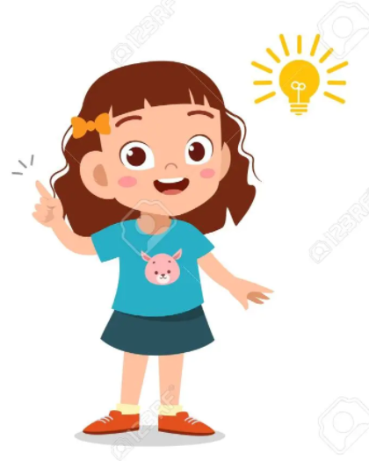
LEARNING OBJECTIVE
Students will –
Learn the basis of inheritance of characters from one generation to other.
Understand the mechanism or pattern of inheritance and occurrence of variation.
Analyze the patterns in their surrounding and family.
Be able to derive the inheritance pattern of genetic disorder or traits.

Slide 3
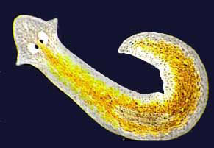
Evolution by stages :-
Complex organisms and its organs developed from simpler organisms gradually over generations.
i) Evolution of eyes :- The eyes of planaria are just eye spots to detect light. It developed gradually into a complex organ in higher animals.

Slide 4
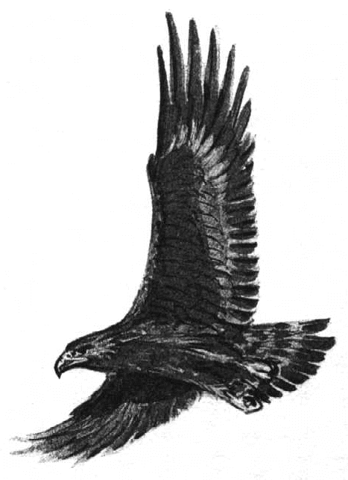
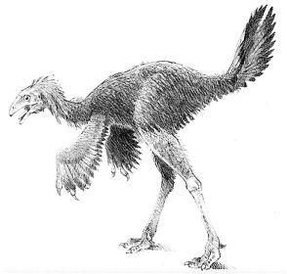
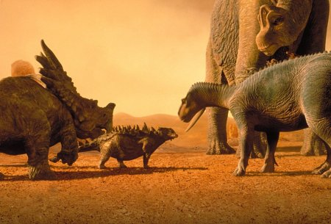
Evolution by stages :-
Complex organisms and its organs developed from simpler organisms gradually over generations.
ii) Evolution of feathers :- Feathers were first developed in dinosaurs and used for protection from cold. Later birds used them for flying.

Slide 5
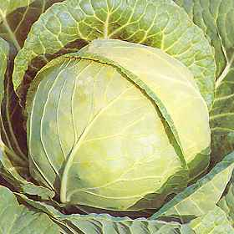
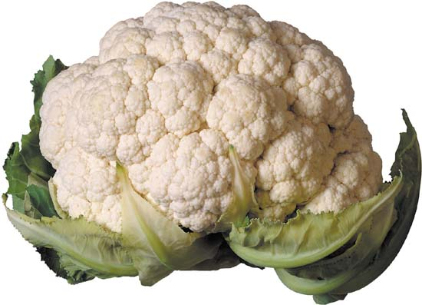
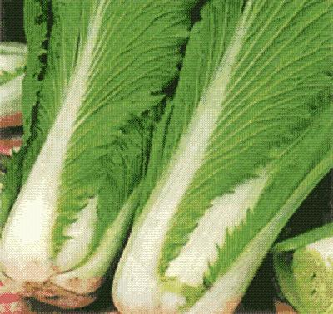
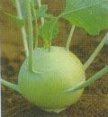
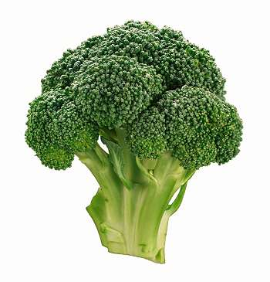
Evolution by stages :-
Complex organisms and its organs developed from simpler organisms gradually over generations.
iii) Evolution by artificial selection :- Humans cultivated wild cabbage for over 2000 years and produced different vegetables from it by artificial selection.
Eg :- Cabbage – by selecting short distance between the leaves.
Cauliflower – by selecting sterile flowers.
Kale – by selecting large leaves
Kholrabi – by selecting the swollen stem
Broccoli – by arresting flower growth

Slide 6

HOME ASSIGNMENT
Complex organisms and its organs developed from simpler organisms gradually over generations. Justify the statement in reference to cabbage, kale, kohlrabi and broccoli.
How organisms evolve in reference to development of eyes?

Slide 7
THANKING YOU
ODM EDUCATIONAL GROUP

