Slide 1


TOPIC- EVIDENCES OF EVOLUTION
PERIOD- 6
CHAPTER NUMBER- 10
CHAPTER: HEREDITY AND EVOLUTION
CLASS: X
SUBJECT: BIOLOGY

Slide 2

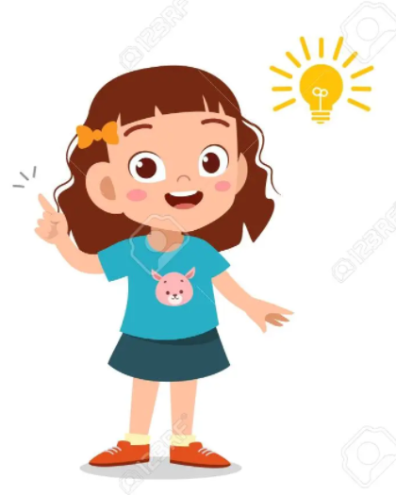
LEARNING OBJECTIVE
Students will –
Learn the basis of inheritance of characters from one generation to other.
Understand the mechanism or pattern of inheritance and occurrence of variation.
Analyze the patterns in their surrounding and family.
Be able to derive the inheritance pattern of genetic disorder or traits.

Slide 3
Evolution :-
The gradual changes taking place in living organisms giving rise to new organisms due to changes in their genetic composition is called evolution.
Evidences of evolution :-
There are a number of common features in different organisms which provide evidence to show evolutionary relationship. The main evidences of evolution are from the study of :-
HOMOLOGOUS ORGANS
ANALOGOUS ORGANS
FOSSILS
EMBRYOLOGICAL EVIDENCES

Slide 4
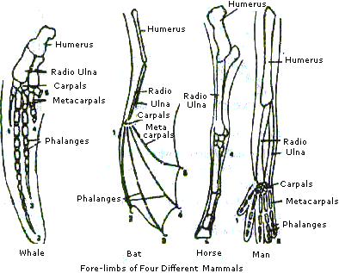
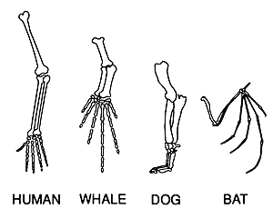
a) Homologous organs :- are organs which are similar in structure but different in functions.
Eg :- The fore limbs of amphibians, reptiles, birds, and mammals have similar structures but different functions. Frog (amphibian) uses its fore limb to raise the front of the body. Lizard (reptile) uses its fore limb for walking and running. Birds fore limbs are modified as wings for flying. Mammals use the fore limbs for grasping, walking, running, swimming, flying etc. This shows evolutionary relationship.

Slide 5
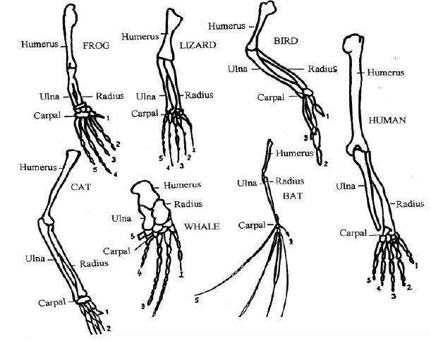
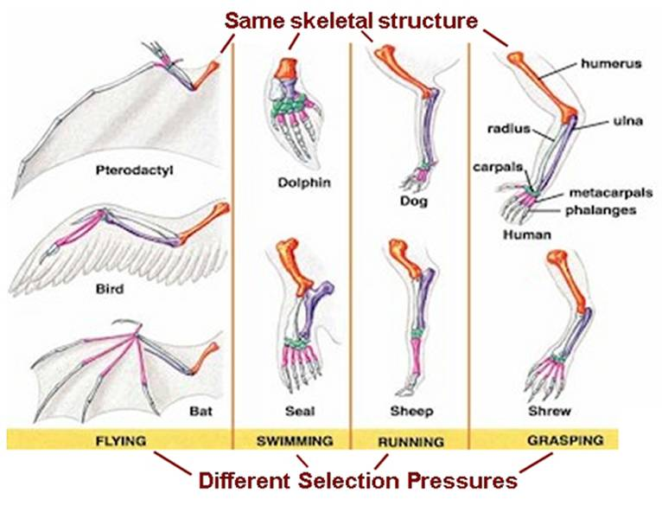
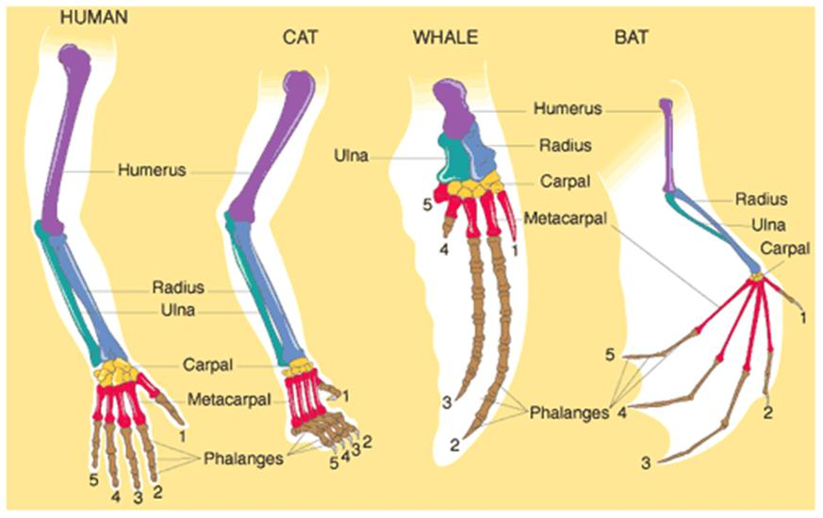

Slide 6
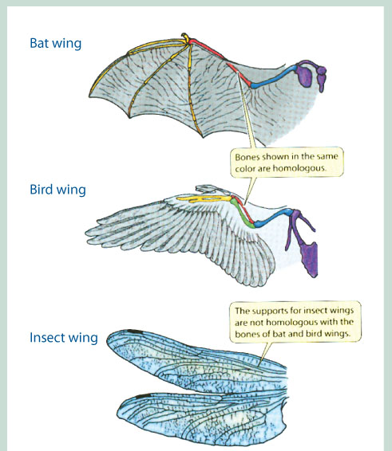
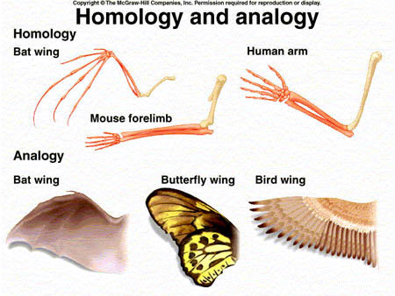
b) Analogous organs :- are organs which are different in structures but similar in functions.
Eg :- The wings of butterfly, bird and bat have different structures but similar functions. This shows evolutionary relationship.

Slide 7
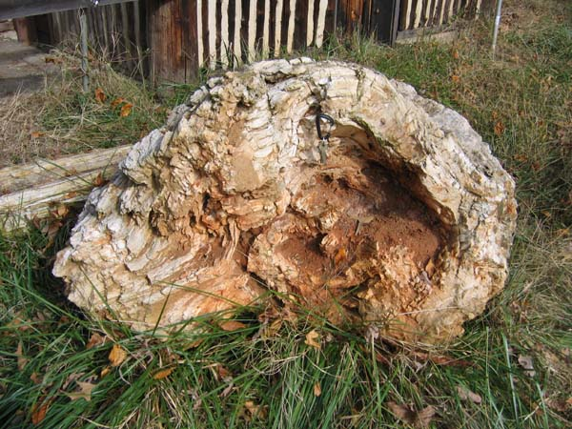
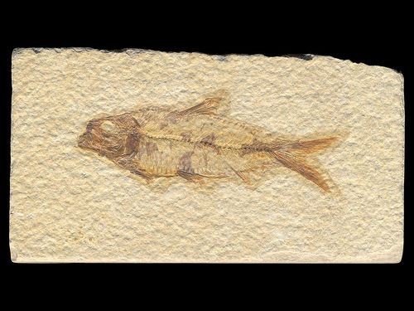
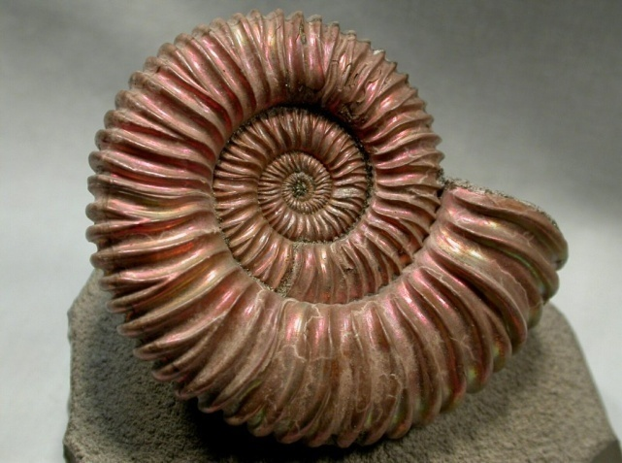
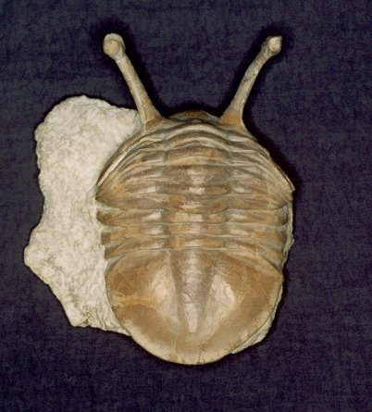
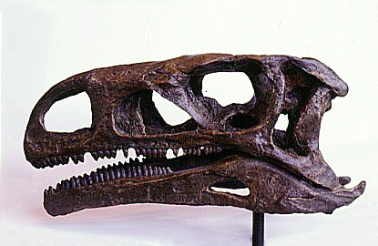
c) Fossils :- are the remains of organisms which lived long ago.
From the study of fossils we can know their structures and the time period in which they lived. The fossils of complex and recent organisms are found closer to the surface of the earth and the fossils of simpler organisms are found deeper inside the earth. The age of fossils can be determined by Radio Carbon Dating. The study of fossils show evolution of simpler forms into complex forms and their evolutionary relationship.
Tree trunk fossil Fish fossil (Knightia)
Ammonite – Invertebrate Trilobite – Invertebrate Dinosaur skull - Rajasaurus

Slide 8
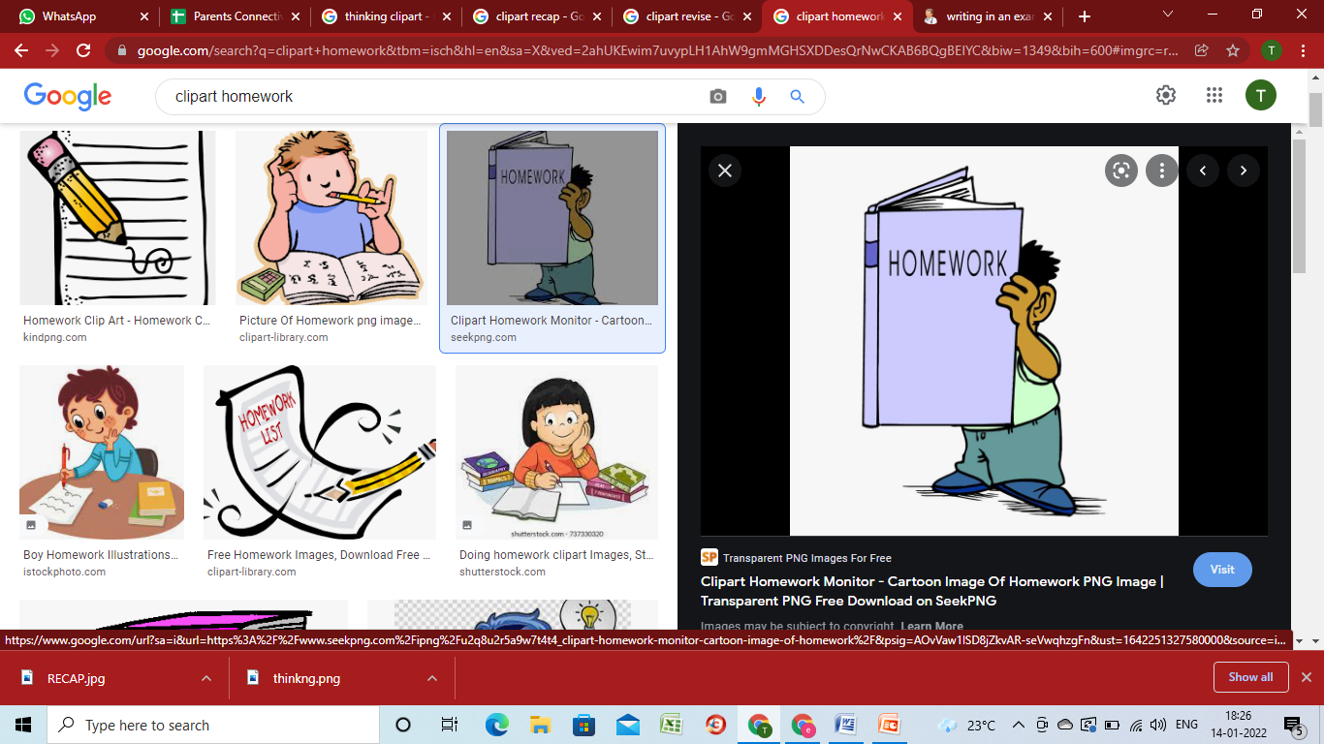
HOME ASSIGNMENT
How does the following evidences support evolution?
a) Homologous organs
b) Fossils
c) Embryology.
Explain the Terms Analogous and Homologous Organs?
How are fossils evidence of evolution?
What are connecting and missing links?

Slide 9
THANKING YOU
ODM EDUCATIONAL GROUP

