Slide 1


TOPIC- VARIATION PERIOD- 5
CHAPTER NUMBER- 10
CHAPTER: HEREDITY AND EVOLUTION
CLASS: X
SUBJECT: BIOLOGY

Slide 2

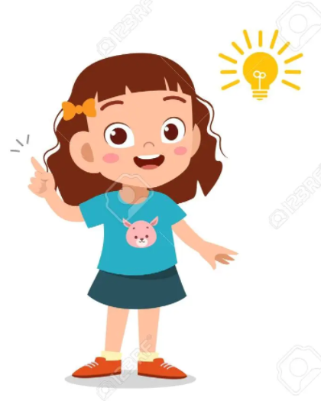
LEARNING OBJECTIVE
Students will –
Learn the basis of variation of characters from one generation to other.
Understand the mechanism or pattern of inheritance and occurrence of variation.
Be able to understand the significance o fvariation in evolution.

Slide 3
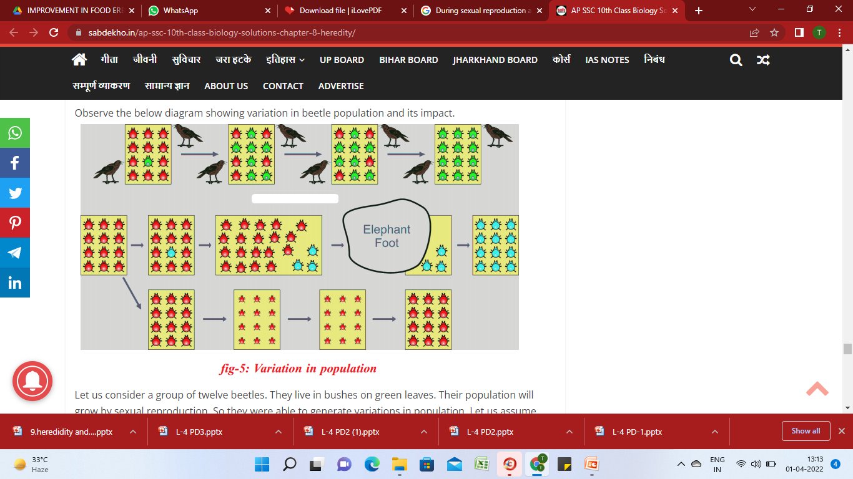
Variations may or may not help organisms to survive :-
a) Some variations help organisms to survive :-
Eg :- There are some beetles living in green bushes. They increase their numbers by reproduction. Crows can easily see the red beetles and they are eaten by the crows. During reproduction due to some variation some green beetles are produced instead of red beetles. The green beetles are not visible to crows and are not eaten by them. Then gradually the population of the red beetles decreases and the population of the green beetles increases.
This variation has helped the organisms to survive.

Slide 4
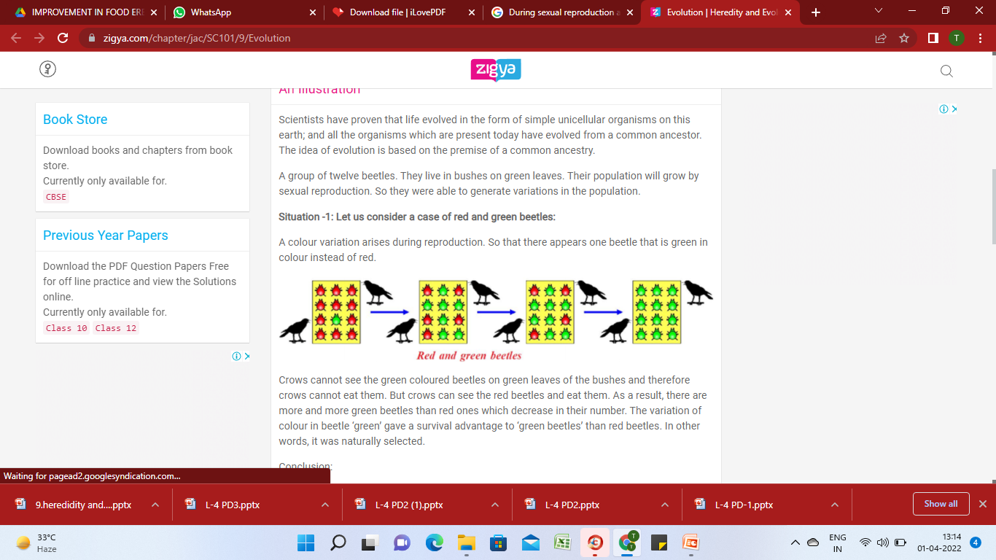
Variations may or may not help organisms to survive :-
b) Some variations do not help organisms to survive :-
Eg :- During sexual reproduction a colour variation occurs in red beetles and some blue beetles are produced instead of red beetles. Both the red and blue beetles are visible to crows and are eaten by them. Then the population of both red and blue beetles decreases.
This variation has not helped the organisms to survive.

Slide 5
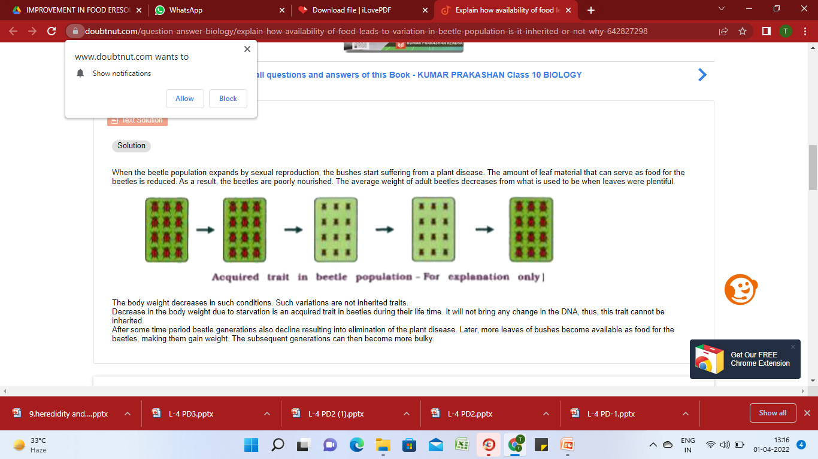
Variations may or may not help organisms to survive :-
c) Aquired traits cannot be passed from one generation to the next :-
Eg :- If the population of beetles increases and plants are affected by diseases, then the food available for the beetles decreases and their body weight also decreases. If after a few years the availability of food increases then the body weight of the beetles also increases. This acquired trait cannot be passed from one generation to the next because there is no change in their genetic composition.

Slide 6
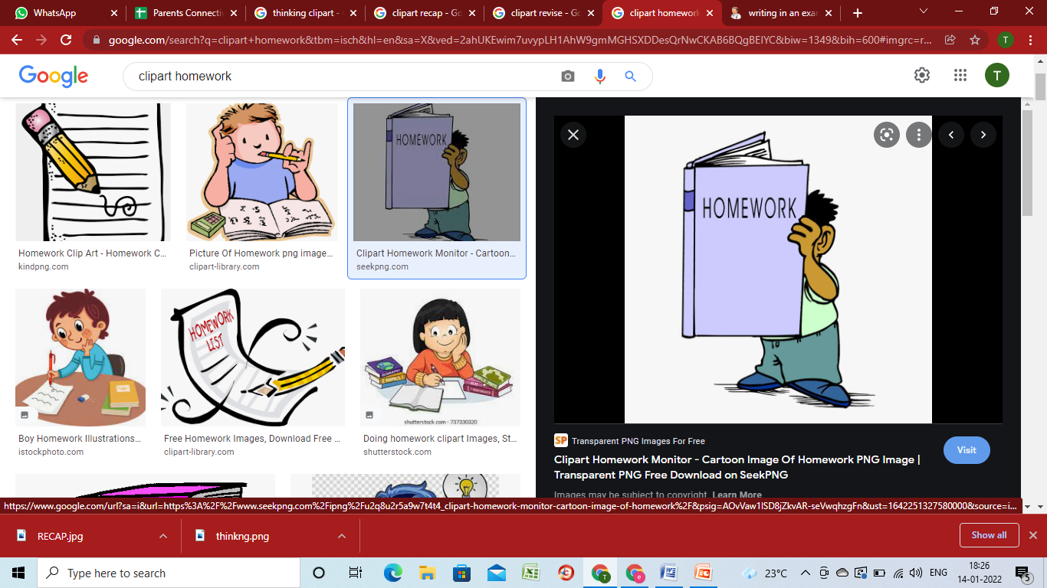
HOME ASSIGNMENT
Aquired traits cannot be passed from one generation to the next. Justify the statement.
Differentiate between inherited and acquired traits with an example of each.
Variations may or may not help organisms to survive. Explain the given statement with evidences.

Slide 7
THANKING YOU
ODM EDUCATIONAL GROUP

