Slide 1

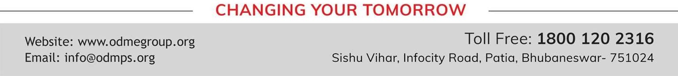
TOPIC- PRINCIPLES OF INHERITANCE
PERIOD- 2
CHAPTER NUMBER- 10
CHAPTER: HEREDITY AND EVOLUTION
CLASS: X
SUBJECT: BIOLOGY

Slide 2

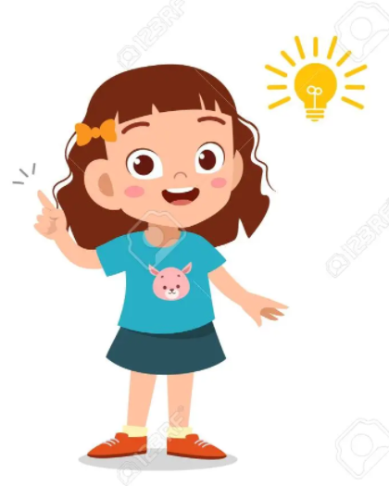
LEARNING OBJECTIVE
Students will –
Learn the basis of inheritance of characters from one generation to other.
Understand the mechanism or pattern of inheritance and occurrence of variation.
Be sable to study the inehritance pattern of two traits in a dihybrid cross.
Identify the new characters formed in F2 generation.

Slide 3
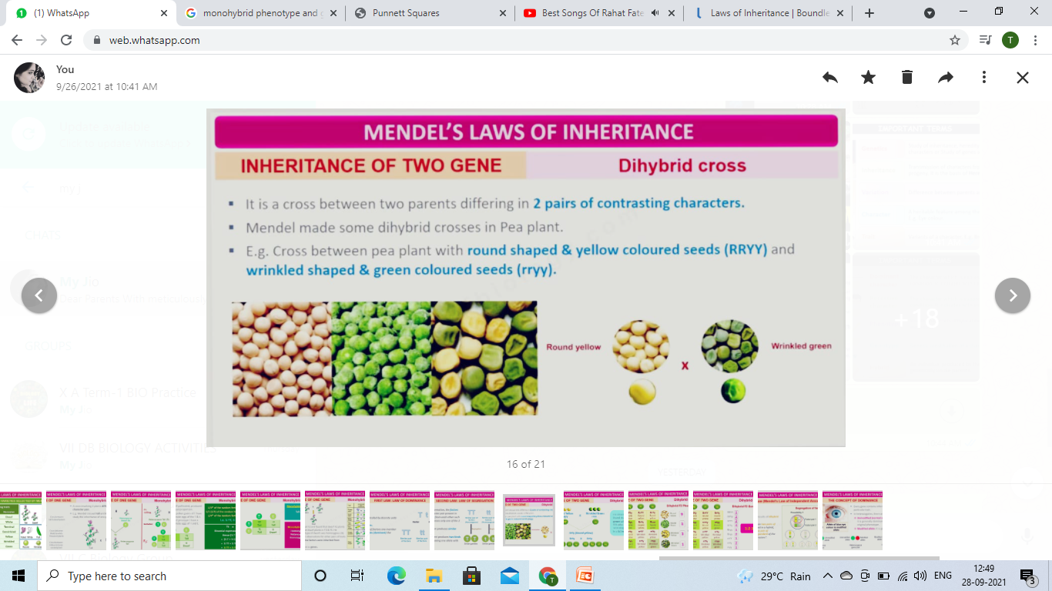
INHERITANCE OF TWO GENE- DIHYBRID CROSS
It is a cross between two parents differing in 2 pairs of contrasting characters.
Mendel made some Dihybrid crosses in Pea Plant.
E.g. Cross between pea plant with round shaped & yellow colored seeds (RRYY) and wrinkled shaped & green colored seeds (rryy).

Slide 4
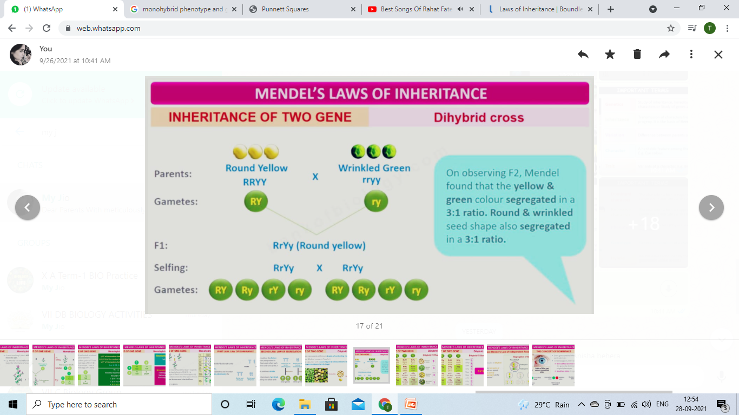
Dihybrid Cross
On observing F2, Mendel found that:
Yellow & Green color segregated in a 3:1 ratio.
Round & Wrinkled seed segregated in a 3:1 ratio.

Slide 5
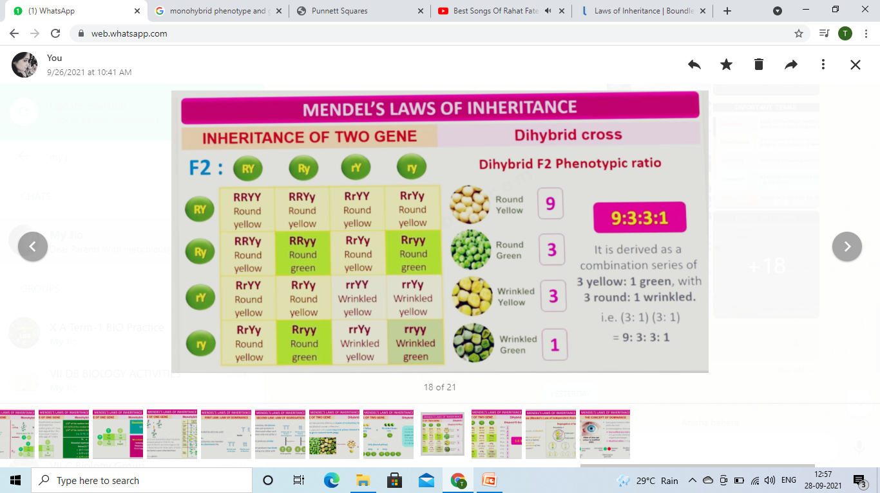
Dihybrid Cross: Phenotypic Ratio
It is derived as a combination series of
3 yellow: 1 green, with
3 round : 1 wrinkled.
i.e.
(3:1), (3:1) = 9:3:3:1

Slide 6
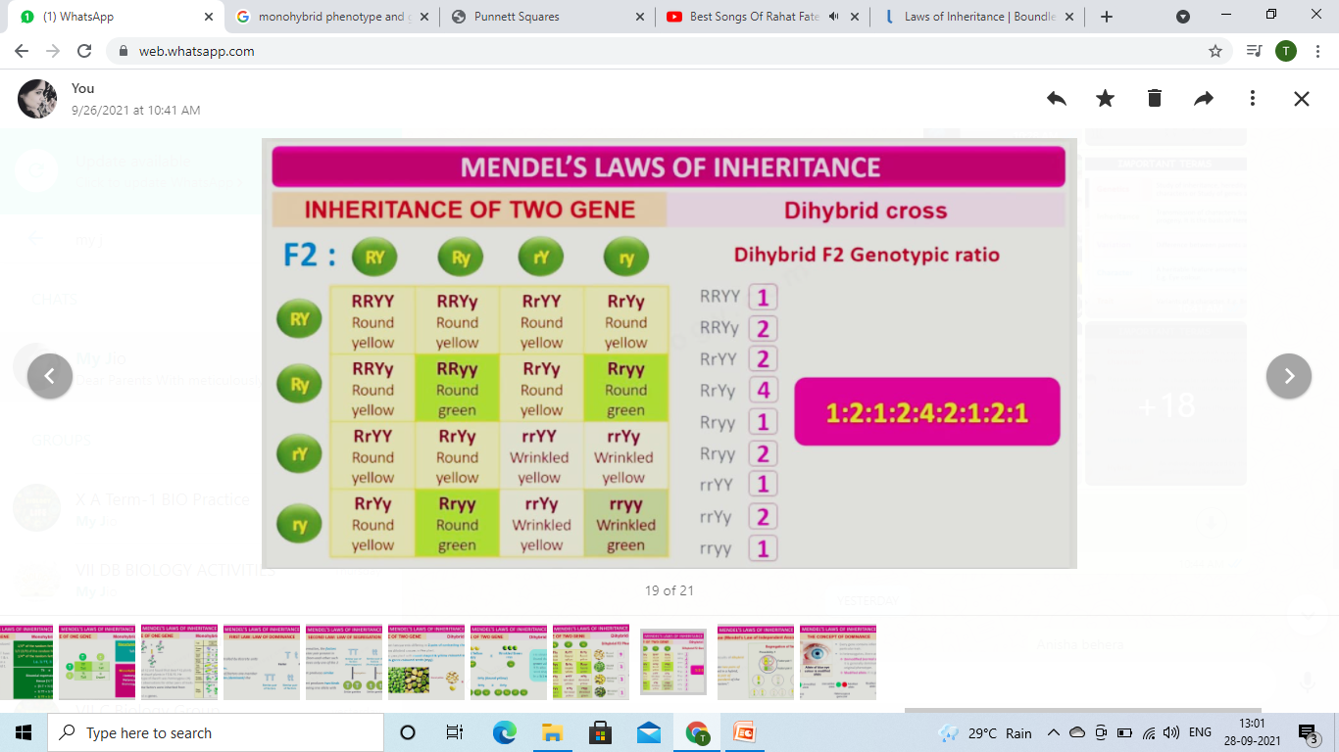
Dihybrid Cross: Genotypic Ratio

Slide 7
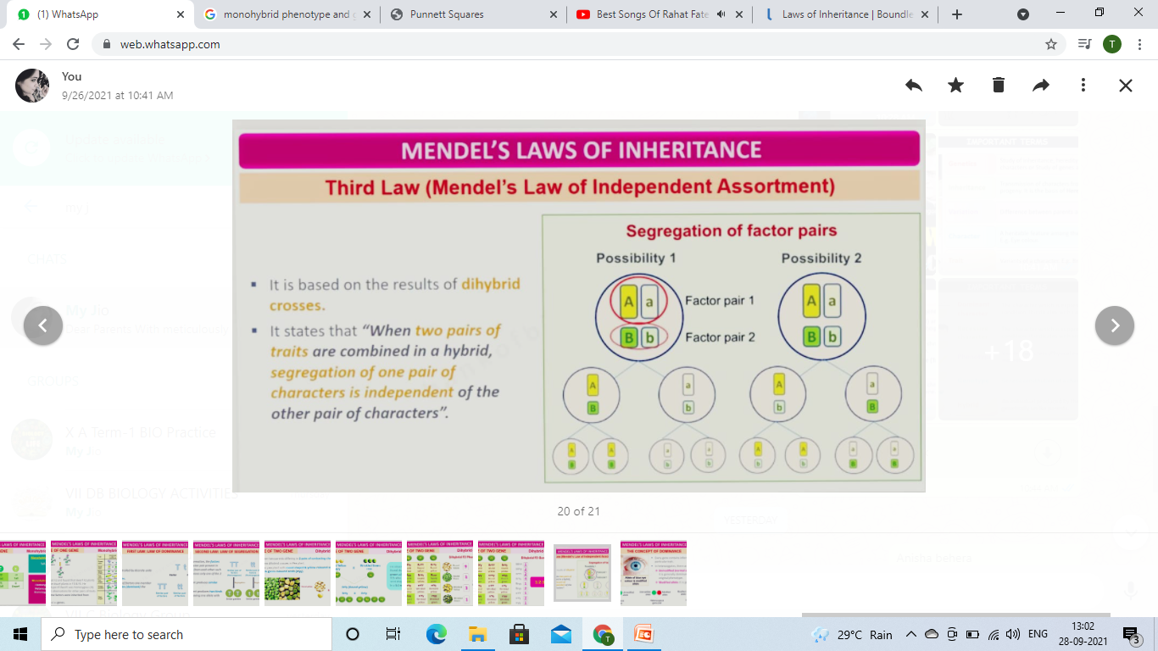
Dihybrid Cross: Genotypic Ratio
Mendel’s Law of Independent Assortment states that When two pairs of traits combined in a hybrid, segregation of one pair of characters is independent of the other pair of characters.
It is based on the results of Dihybrid crosses.

Slide 8
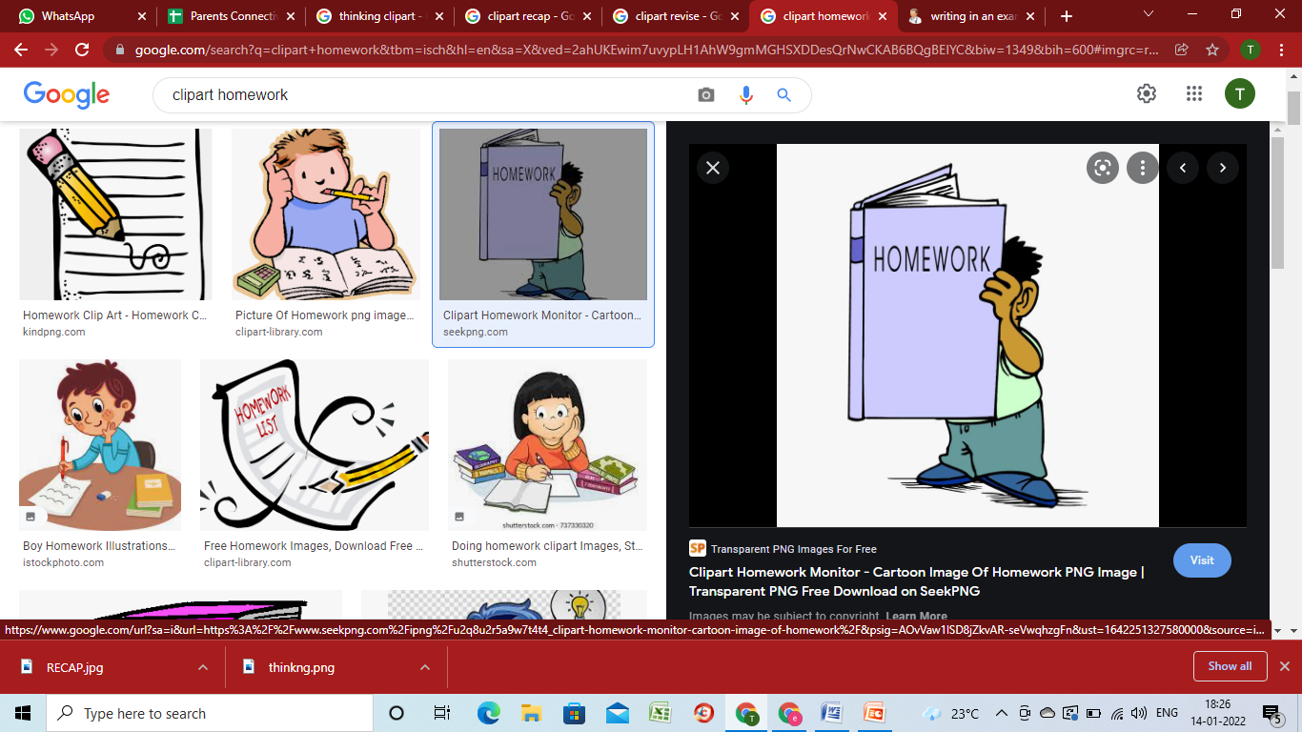
HOME ASSIGNMENT
What is a dihybrid cross?
How is F1 generation different than F2 generation in a dihybrid cross?
What is meant by punett square?
What will be the result of selfing the F₁ generation in a cross when round and yellow seeded pea plants (YYRR) are crossed with green and wrinkled (yyrr) seeded pea plant?
A pure breeding pea plant producing violet and axial flowers was crossed with a pea plant producing white and terminal flowers.
Give the phenotype of F1 generation.
Mention the gametes formed by F1 plants in selfing.
Give the phenotypes of F2 generation. What will be the phenotype ratio of F2 generation.
Which law of inheritance is explained in this cross. Explain.

Slide 9
THANKING YOU
ODM EDUCATIONAL GROUP

