Slide 1


TOPIC- PRINCIPLES OF INHERITANCE PERIOD- 1
CHAPTER NUMBER- 10
CHAPTER: HEREDITY AND EVOLUTION
CLASS: X
SUBJECT: BIOLOGY

Slide 2


LEARNING OBJECTIVE
Students will –
Learn the basis of inheritance of characters from one generation to other.
Know the characters studied by Mendel in pea plant.
Understand the experiment conducted by Mendel to study pattern of inheritance.
Be able to solve monohybrid cross.
Be able to find out the phenotype and genotype ratio of monohybrid cross.

Slide 3
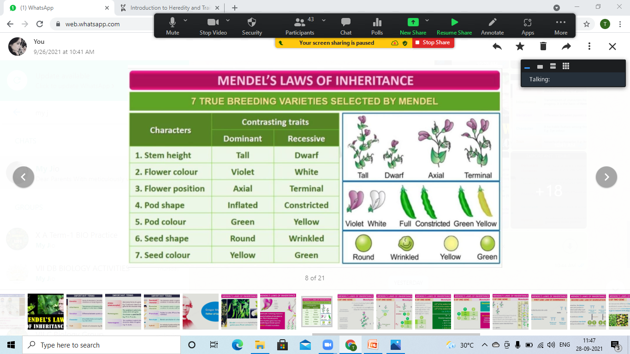
7 Contrasting Pairs of Traits In Pea

Slide 4
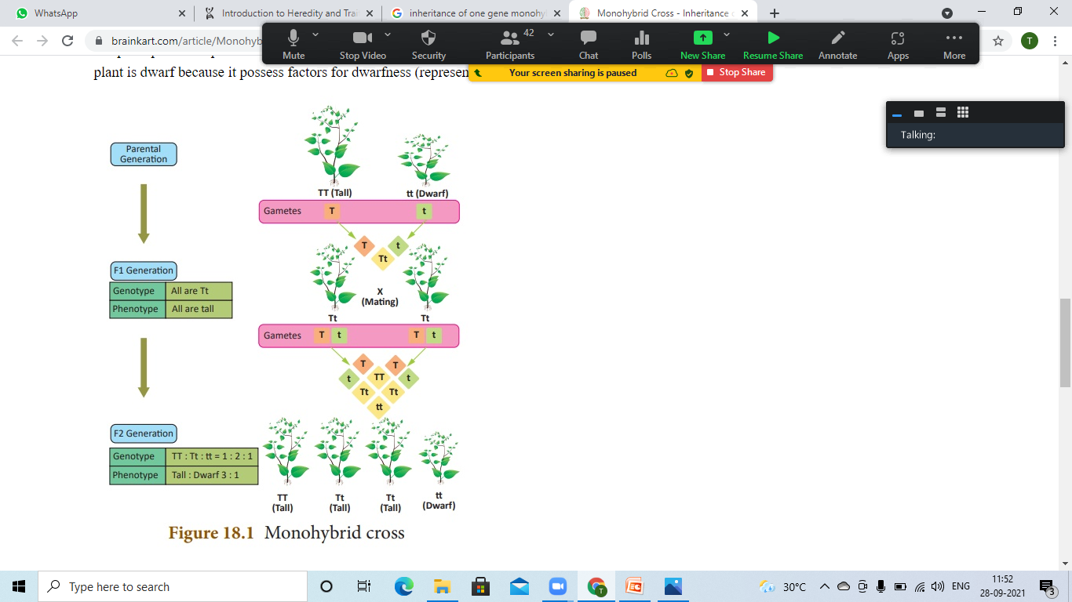
INHERITANCE OF ONE GENE-MONOHYBRID CROSS
Monohybrid Cross:
A cross between two plants differing in one character pair.
e.g.- Height of the Plant- Tall (TT) and Dwarf (tt).

Slide 5
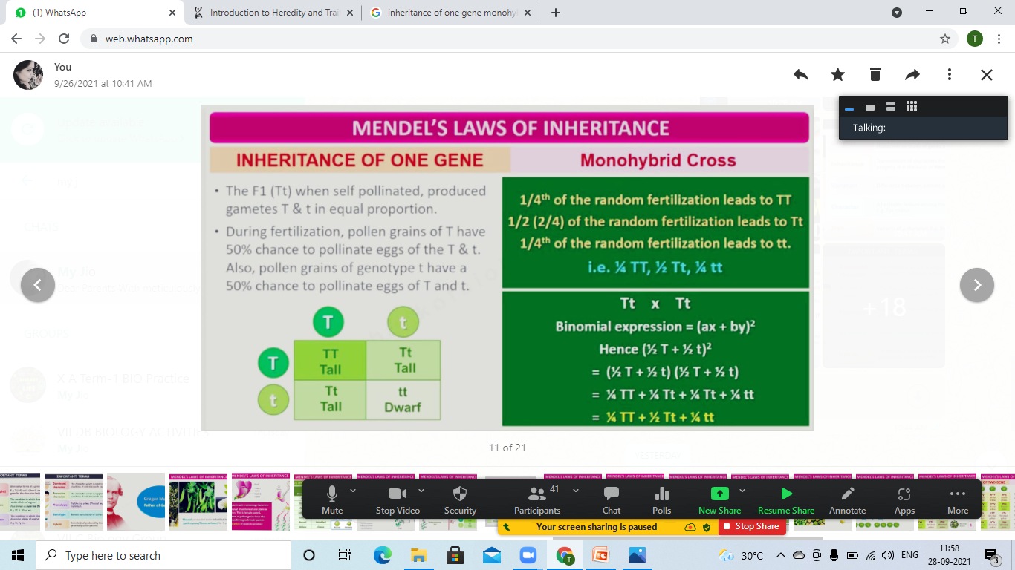
Mathematical Expression of Monohybrid Cross
The F1 (Tt) when self pollinated, produced gametes T and T in equal proportion.
During fertilization, pollen grains of T have 50% chance to pollinate eggs of the T & t.
Also pollen grains of genotype t have a 50% chance to pollinate eggs of T and t.

Slide 6
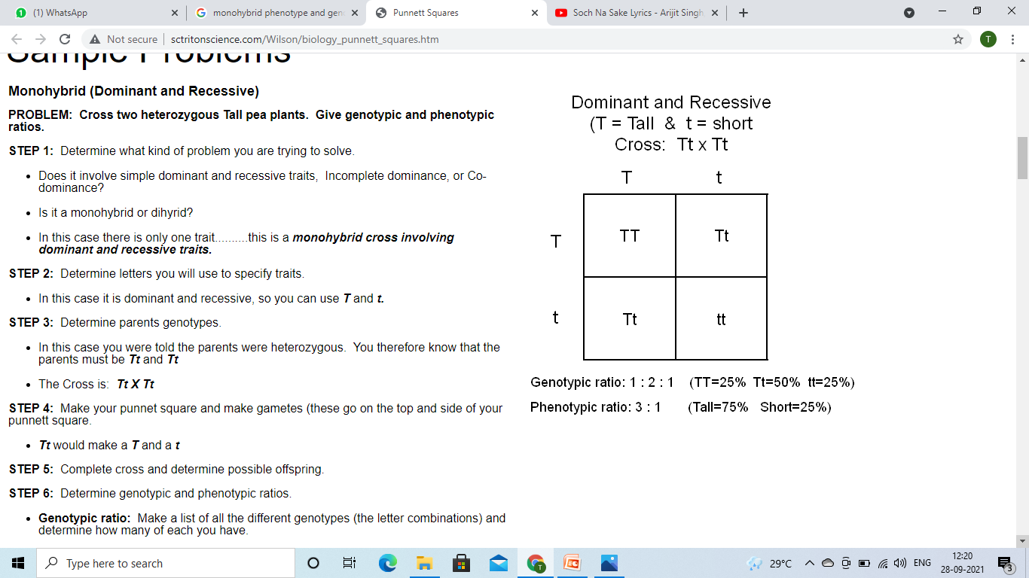
Monohybrid Cross- Phenotypic & Genotypic Ratio

Slide 7
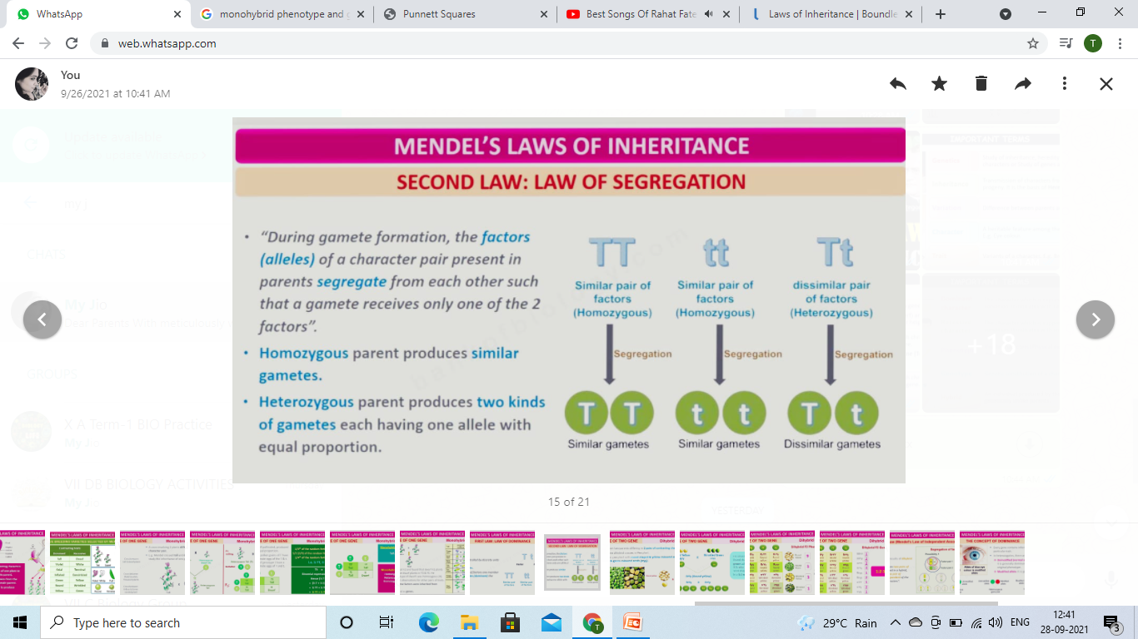
LAW OF SEGREGATION
Mendel’s Law of Segregation states that a diploid organism passes
a randomly selected allele for a trait during gamete production
to its offspring, such that the offspring receives one allele from each parent.
During gamete formation, the factors (alleles) of a character pair present in parents segregate from each other such that a gamete receives only one of the 2 factors.
Homozygous parent produces similar gametes.
Heterozygous parent produces two kinds of gametes each having one allele with equal proportion.

Slide 8
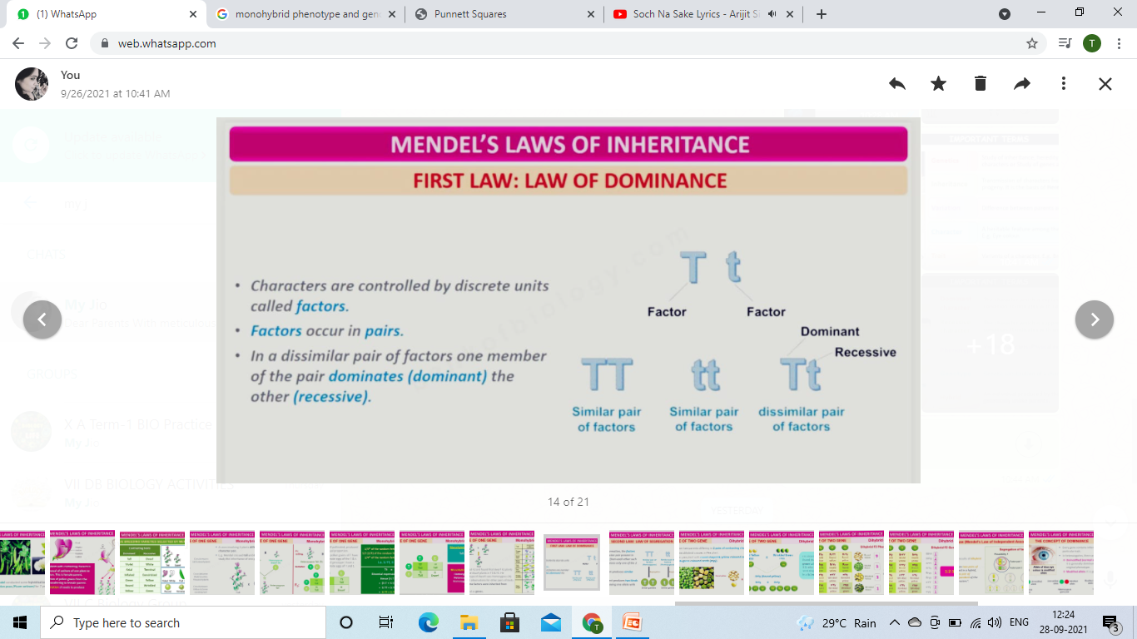
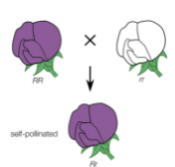
LAW OF DOMINANCE
Mendel’s law of dominance states that one of the pairs of inherited traits will be dominant and the others recessive unless both the factors are recessive.
Characters are controlled by discrete units called Factors.
Factors occur in pairs.
In a dissimilar pair of factors one member of the pair dominates (dominant) the other (recessive).

Slide 9

HOME ASSIGNMENT
Q.1. What will be the appearance of (a) F₁ and (b) F₂ progenies when a pure (homozygous) tall pea plant is crossed with a pure (homozygous) dwarf pea plant?
Q.2. When a plant homozygous for tall is crossed with a plant homozygous for dwarf, what will be the appearance of the offsprings of a cross of F₁ with its tall parent.
Q.3. When a plant homozygous for tall is crossed with a plant homozygous for dwarf, what will be the appearance of the off-springs of a cross of F₁ with its dwarf parent?
Q.4. Work out for the genotypes of the parents of the cross between a tall and a dwarf pea plant which result into about one half of the tall and one half of dwarf off-springs.
Q.5. Work out the probabilities of the off-springs in a case when heterozygous tall hybrids of F₁ generation are self-fertilized.
Q.6. How do Mendel’s experiments show that traits may be dominant or recessive ?

Slide 10
THANKING YOU
ODM EDUCATIONAL GROUP

