Slide 1

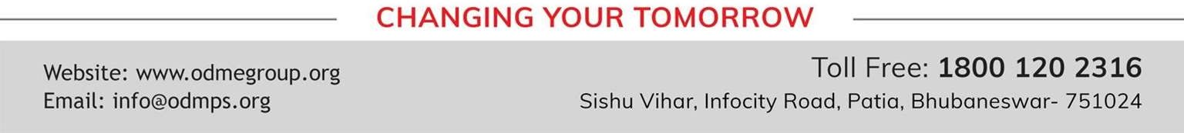
TOPIC- PRINCIPLES OF INHERITANCE PERIOD- 1
CHAPTER NUMBER- 10
CHAPTER: HEREDITY AND EVOLUTION
CLASS: X
SUBJECT: BIOLOGY

Slide 2

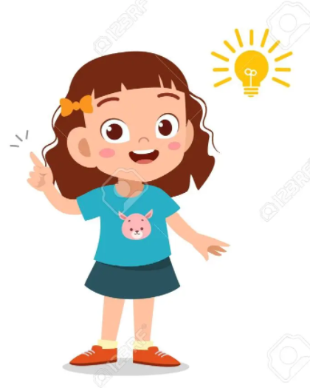
LEARNING OBJECTIVE
Students will –
Learn the basis of inheritance of characters from one generation to other.
Understand the mechanism or pattern of inheritance and occurrence of variation.
Analyze the patterns in their surrounding and family.
Be able to derive the inheritance pattern of genetic disorder or traits.

Slide 3
PRE KNOWLEDGE DISCUSSION
What is the role of nucleus in cell division?
What are chromosomes?
Discuss the functiosn of DNA, Genes and chromosomes.
Discovery of Genes.

Slide 4
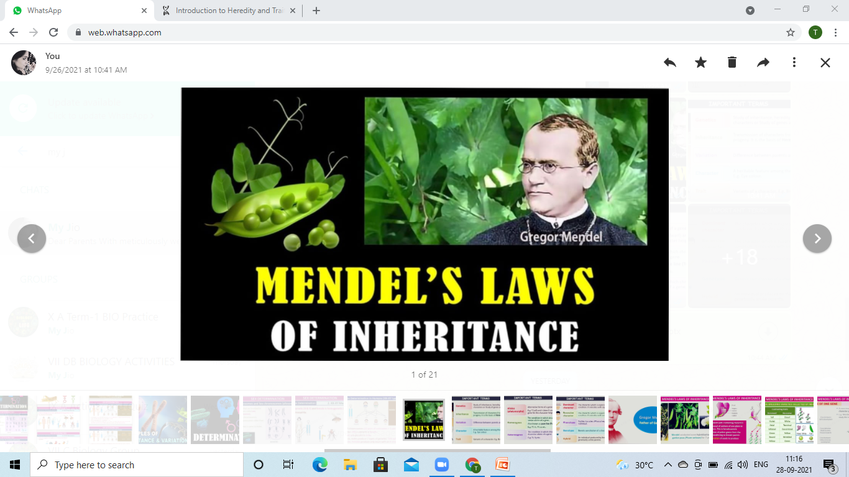
LAWS OF INHERITANCE

Slide 5
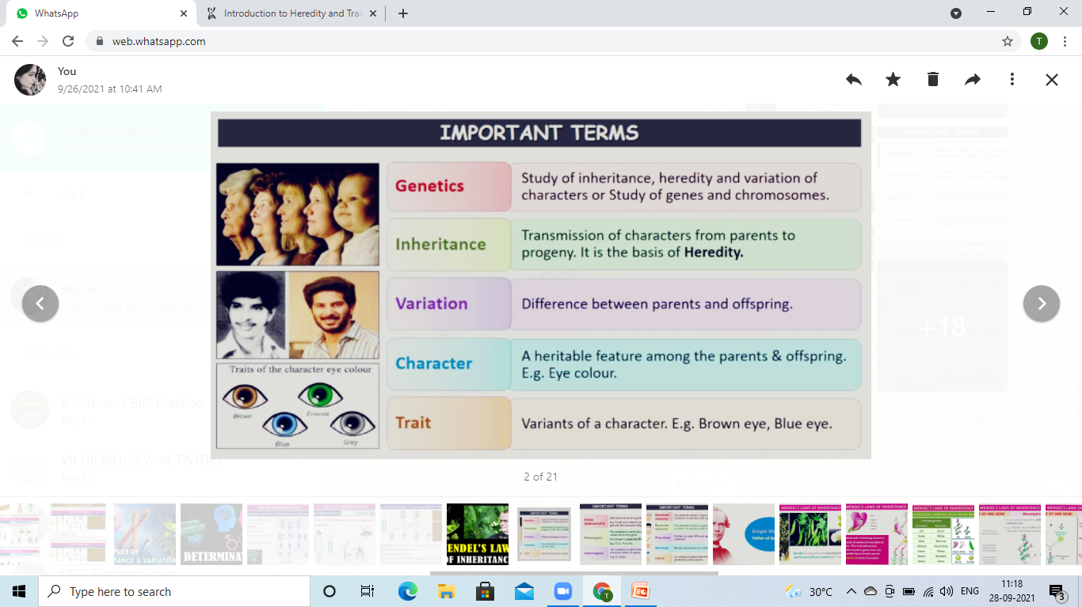
GENETICS - TERMINOLOGY

Slide 6
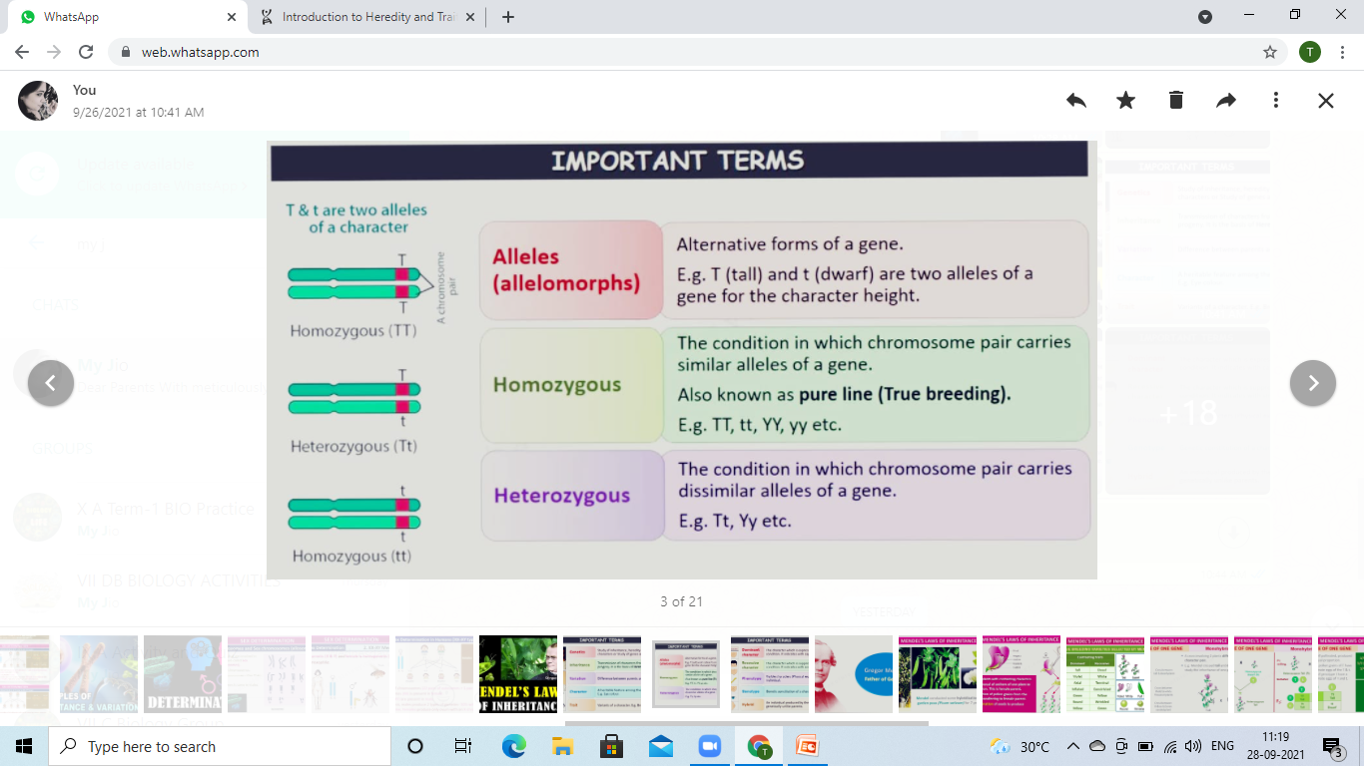

Slide 7
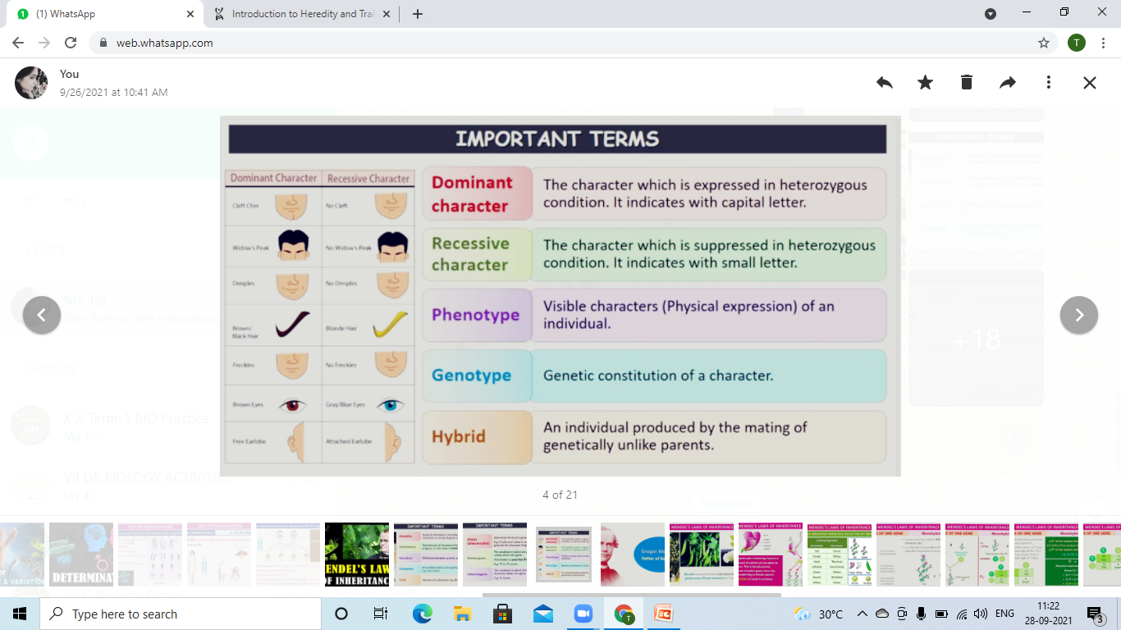

Slide 8
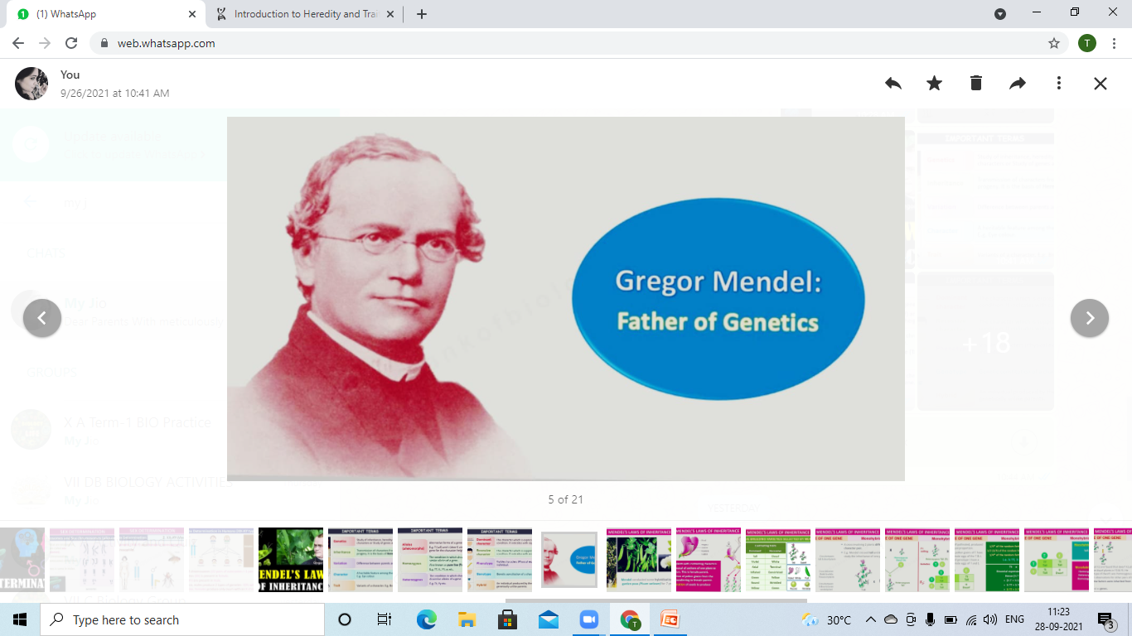
FATHER OF GENETICS
Gregor Johann Mendel
(born July 22, 1822, Silesia, Austrian Empire—died January 6, 1884,
botanist, teacher, the first person to lay the mathematical foundation of the science of genetics, in what came to be called Mendelism.

Slide 9
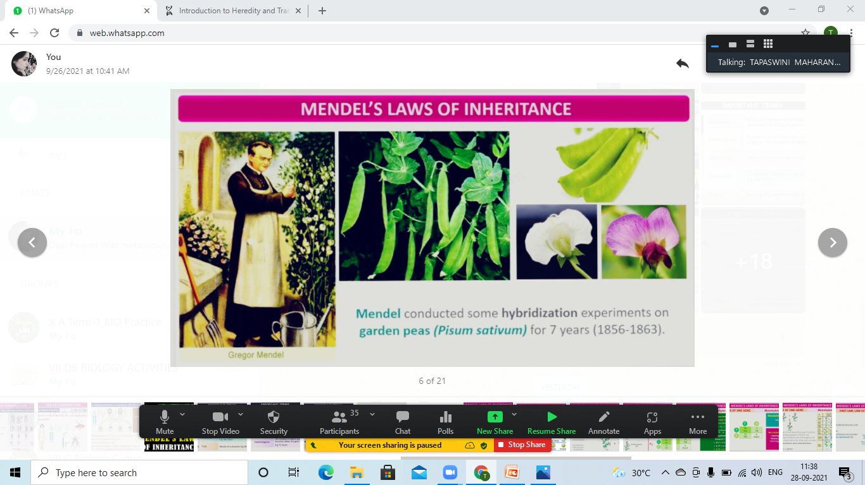
MENDELIAN LAWS OF INHERITANCE
Mendel conducted some Hybridization experiments on Garden Peas ( Pisum sativum) for 7 years (1856-1863).
Question is why only Garden Pea plant and not
a Mango Tree or a Human????

Slide 10
RECAPITULATION

Slide 11
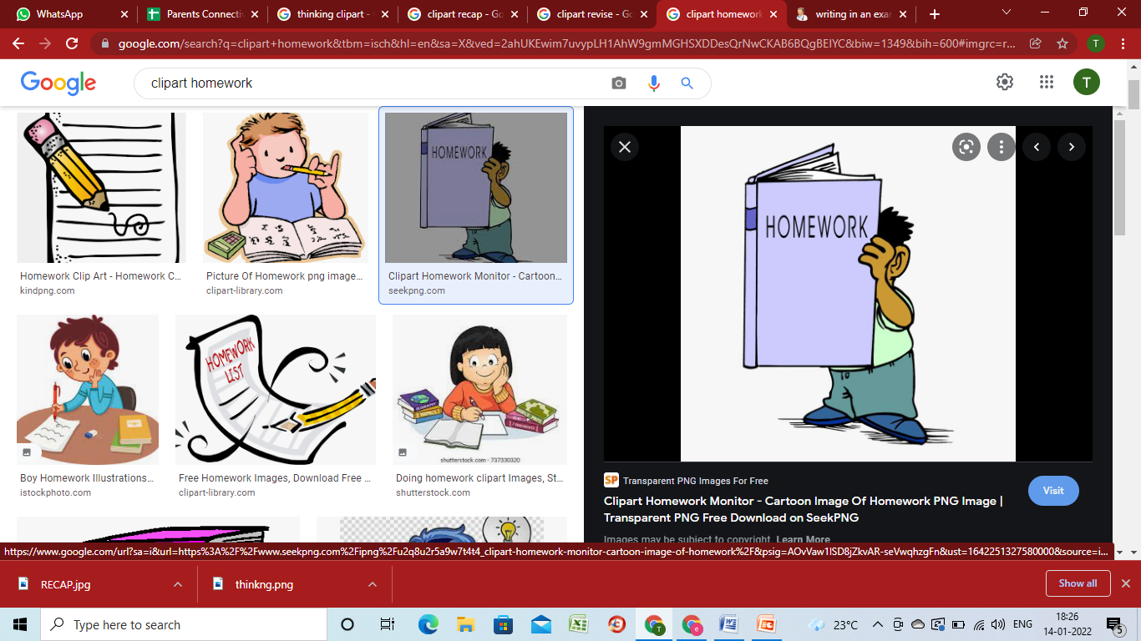
HOME ASSIGNMENT
Who Is Considered As The ‘ Father Of Genetics’?
How Many Types Of Chromosomes Are Present In A Human Cell?
Explain Diploid And Haploid Set.
What Is The Difference Between Homozygous And Heterozygous Condition Of Alleles?
Define The Following Terms-
Allele
Variation
Heredity
Trait
Inheritance

Slide 12
THANKING YOU
ODM EDUCATIONAL GROUP

