Slide 1


SESSION : 6
CLASS : V
SUBJECT : ENGLISH GRAMMAR
CHAPTER NUMBER: 5
CHAPTER NAME : TRANSITIVE AND INTRANSITIVE VERBS
SUBTOPIC : INTRODUCTION, Q. 1

Slide 2
LEARNING OBJECTIVE :
Enable the students to
To be able to recognize whether a verb is used transitively or intransitively in a sentence.
To identify the direct object of the transitive verb in a sentence
Correctly differentiate between transitive and intransitive verbs. Know about different rules of transitive

Slide 3





What’s going on…???

Slide 4
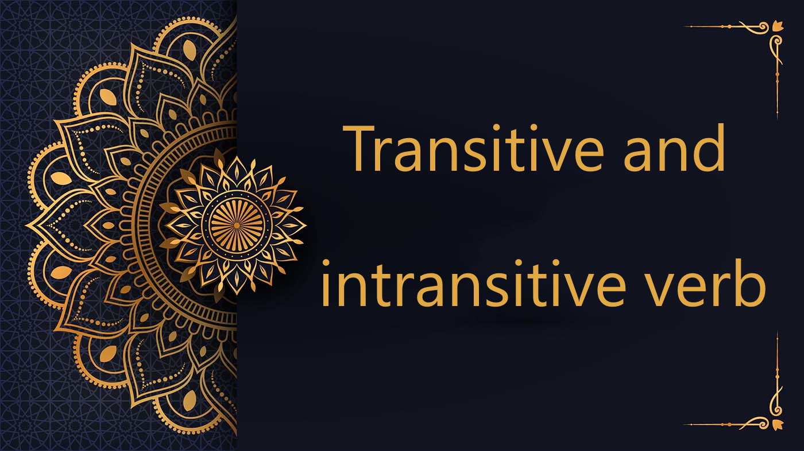
The activities performed are called as verbs.
Types of verbs -

Slide 5
Let’s read the following sentences
Sanjana likes
Rohit wastes
I love
The Principal praised
Are they giving a complete sense to the sentences??

Slide 6
Let’s read again
Sanjana likes mangoes.
Rohit wastes food.
I love my mother.
The Principal praised the child.
The verbs in these sentences require/needs objects to complete their sense.
A verb that requires an object to complete its sense is called a transitive verb.

Slide 7
Points to remember and apply –
In a sentence there can be more than two objects.
Ex- Riya gave her friends a few books
transitive verb object
gave what ? – a few books (object)
2. We can find the direct object by answering this question :
verb + what ? = direct object

Slide 8
Now let’s look at these sentences
Manish walked. quite meaningful
The child cried
Kavita smiled
The river flowed
The verbs in these sentences do not require/needs objects to complete their sense.
A verb that does not requires an object to complete its sense but makes good sense by itself is called an intransitive verb.

Slide 9


Slide 10
1.Circle the transitive verbs and underline their objects in the following sentences.
a. He opened the door.
b. I submitted the assignment on time.
c. He picked up the fruits.
d. The naughty kids broke the window.
e. They quickly crossed the street.
f. I do not eat spicy food.
g. He paints houses for a living.
h. Kishore won a scholarship for a course in Sweden.

Slide 11
ANSWERS
a. He opened the door.
b. I submitted the assignment on time.
c. He picked up the fruits.
d. The naughty kids broke the window.
e. They quickly crossed the street.
f. I do not eat spicy food.
g. He paints houses for a living.
h. Kishore won a scholarship for a course in Sweden.

Slide 12
Learning Outcome
Students can now recognize that
A transitive verb, used with a direct object, transmits action to an object and may also have an indirect object, which indicates to or for whom the action is done.
In contrast, an intransitive verb never takes an object.

Slide 13

ODM EDUCATIONAL GROUP

