Slide 1


Education and British Rule
SUBJECT : SOCIAL SCIENCE CHAPTER NUMBER: 8
CHAPTER NAME : Education and British Rule
1

Slide 2
RECAPITULATION
1.What were the important provisions of Wood’s Dispatch?
2. What was the aim of the British in educating Indians?
3. What were the important demerits of Wood’s Dispatch?
4 . Name the cities where universities were established after Wood’s Dispatch?

Slide 3
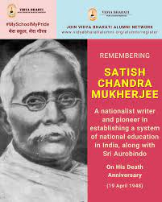
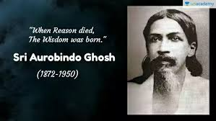
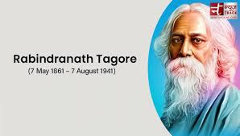
NATIONAL EDUCATION
Eminent personalities like Satish Chandra Mukherjee, Aurobindo Ghosh and Rabindranath Tagore met in 1905 and decided to form a National Council of Education to start a system of education on a National Scale. Under the new system of education, many Indians were educated in English medium schools and colleges.. A nationalistic spirit grew in the minds of the educated Indians.
2

Slide 4
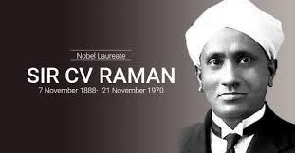
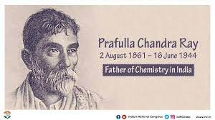
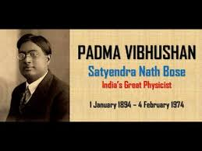


NATIONAL EDUCATION
As modern education spread, Indian universities produced outstanding scientists, like
C. V Raman, P.C Ray, S.N Bose, Meghnad Saha and D.N Wadia.

Slide 5
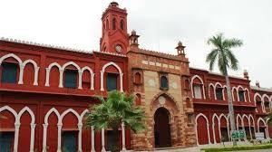
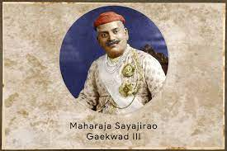
BARODA COLLEGE OF SCIENCE
3

Slide 6
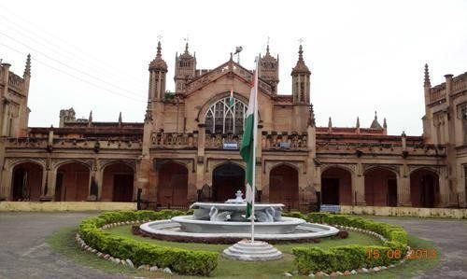
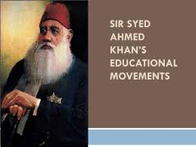
MOHAMMEDAN ANGLO-ORIENTAL COLLEGE
ALIGARH MUSLIM UNIVERSITY.
4

Slide 7
Home Assignments
1. Who were the eminent persons behind the National Council of Education?
2. Why did they decide to form National Council of Education?
3. Who was Maharaja Sayajirao III and name the college which he laid the foundation?
4. Who started Mohammedan Anglo-Oriental College in 1920 and why?

Slide 8
THANKING YOU
ODM EDUCATIONAL GROUP

