Slide 1


Education and British Rule
SUBJECT : SOCIAL SCIENCE CHAPTER NUMBER: 8
CHAPTER NAME : Education and British Rule
1

Slide 2
RECAPITULATION
1. Who recommended the western system of education in India?
2. What was the opinion of Lord Macaulay regarding Indian Education?
3.What do mean by Gurukul education of ancient time?
4.Who established The Calcutta Madrasa?
5. Who established The Banaras Sanskrit College ?
6. Who was Sir Charles Wood?
7.Name the Governor –general of India who received Wood’s Dispatch ?
8 . What do you mean by Wood’s Dispatch?

Slide 3



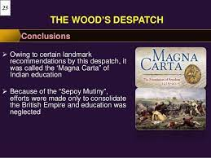
The important provisions of Wood’s Dispatch
1.A systematic method of education from the primary level to the university level.
2.An education department was to be set up in all the provisions.
3.Every district was to have one
government school
4.In Bombay , Madras, and Calcutta
universities were to be opened along the
lines of London Universities
5. Indians were to be taught their mother
tongue as well.
2

Slide 4

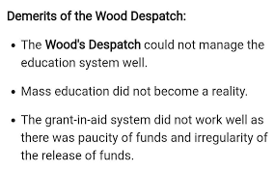
The Demerits of the modern system
Though the middle schools which taught in English were opened,
primary education was neglected.
There was a decline in the indigenous system of Education
. Indian language schools lost support and students,
and were forced to close.
No attention was paid to the education of women. Scientific and technical education was not taken care of.
.
https://youtu.be/RbDqBLsYE0Q
3

Slide 5
HOME ASSIGNMENTS
1.What were the important provisions of Wood’s Dispatch?
2. What was the aim of the British in educating Indians?
3. What were the important demerits of Wood’s Dispatch?
4 . Name the cities where universities were established after Wood’s Dispatch?

Slide 6
THANKING YOU
ODM EDUCATIONAL GROUP

