Slide 1


Education and British Rule
SUBJECT : SOCIAL SCIENCE CHAPTER NUMBER: 8
CHAPTER NAME : Education and British Rule
1

Slide 2
Learning outcome
Students start to compare the Gurukul education with modern education.
They extract the advantages of modern education.
They realize the facilities they are getting in the modern education system.
They came to know the western education is the most important benefit of colonialism.
They start to admire the work of Rabindra Nath Tagore and other eminent people for starting the National education system in India.

Slide 3
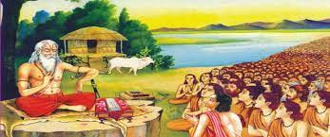
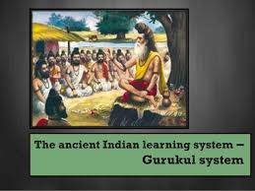
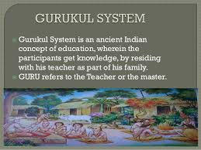
Introduction– DISCUSSION METHOD
Before the coming of the British, there were pathshalas and maktabas for elementary education in tols and madrasas for higher education. The elementary education made the students just literate enough to maintain accounts. Learning was based on old books. Education was neither organised nor supported by the state.
https://youtu.be/VRDsfv56_B4
How Gurukul Education is Different From Modern Education System?

Slide 4

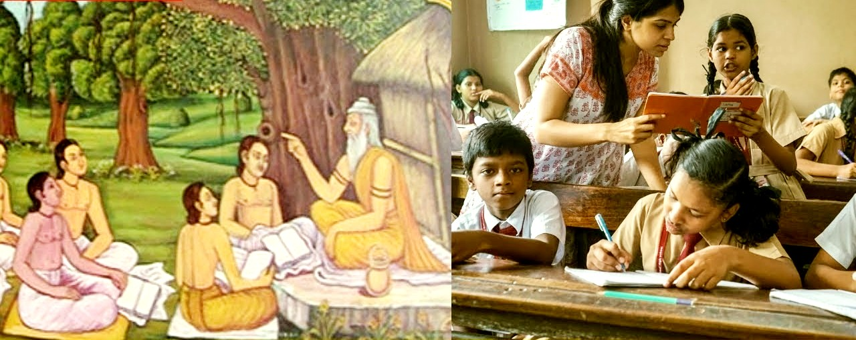
Introduction
MODERN EDUCATION SYSTEM

Slide 5
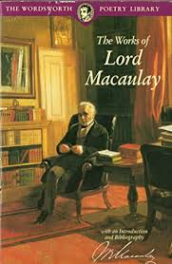
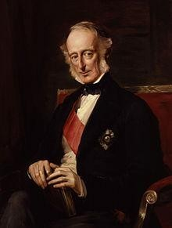
Modern System of Education
I
When British started ruling India, they realised that they needed educated Indians at some levels to help them run the country. The British appointed Lord Macaulay to decide whether they continue the existing system of education or English education
‘’ Lord Macaulay strongly believed that Oriental learning was completely inferior to European learning’s” he recommended the western system as it encouraged rational thinking and scientific research.
Wood’s Dispatch
Sir Charles Wood, the president of the Board of Control in England, sent a Dispatch to Governor – General Lord Dalhousie with his recommendations on the system of education to be followed in India came to known as Wood’s Dispatch.
3
This Dispatch was to become the blueprint for Education in India for long time to come.

Slide 6
HOME ASSIGNMENTS
Who recommended the western system of education in India?
2. What was the opinion of Lord Macaulay regarding Indian Education?
3.What do mean by Gurukul education of ancient time?
4.Who established The Calcutta Madrasa?
5. Who established The Banaras Sanskrit College ?
6. Who was Sir Charles Wood?
7.Name the Governor –general of India who received Wood’s Dispatch ?
8 . What do you mean by Wood’s Dispatch?

