Slide 1

CLASS-VIII CHEMISTRY
TOPIC- ELEMENTS COMPOUNDS AND MIXTURE
CHAPTER-03
SUBTOPIC- DISTILLATION AND FRACTIONAL DISTILLATION METHODS

Slide 2
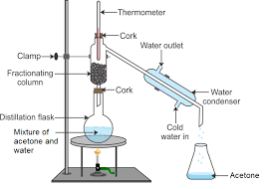
DISTILLATION METHOD
The technique by which we heat a liquid from its solution to gaseous state and further by condensing to obtain the same from its soluion mixture with the help of a Distillating tube or Retort.
Ex : separating water and alcohol :
https://youtu.be/mP4Hgui-g6U
https://www.youtube.com/watch?v=AVrtNRtLpsM

Slide 3
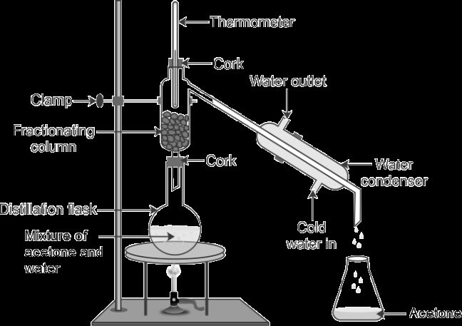
Method of Fractional Distillation
To separate the different soluble liquids from their mixture solution by heating and further cooling which depends upon their difference in BPs . [ having very less difference in their BPs i.e. around 25K/25C]
Ex- separating solution of acetone , benzene and alcohol.

Slide 4
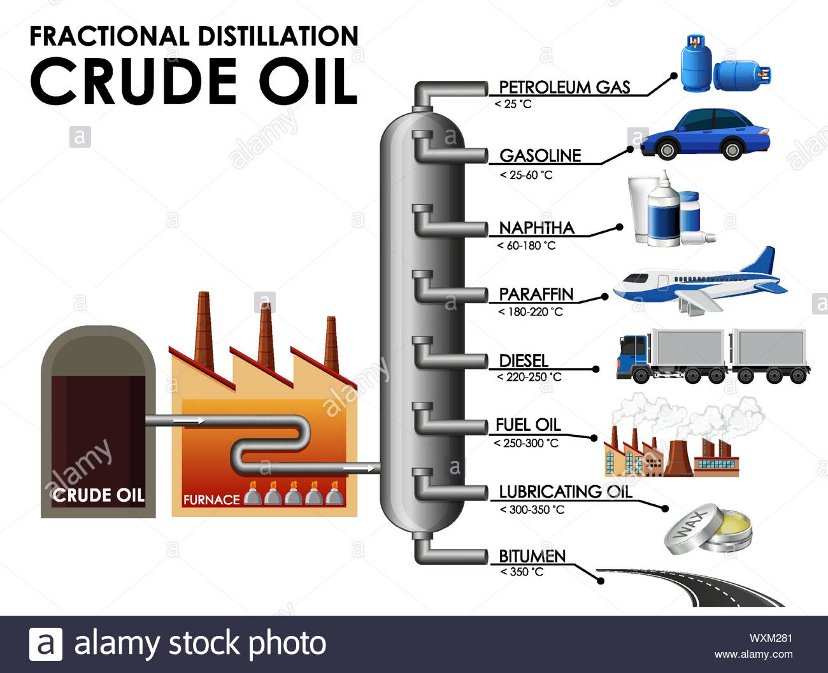
Applications of Fractional Distillation
Separating different components from crude oil :
(it is due to their very less difference in their BPs)
Separating different components from Air.

Slide 5
THANK U
ODM EDUCATIONAL GROUP

