Slide 1

CLASS-VIII
CHEMISTRY
TOPIC- ELEMENTS COMPOUNDS AND MIXTURE
CHAPTER-03
SUB TOPIC- SOME SPECIFIC METHODS OF SEPARATION OF MIXTURE

Slide 2
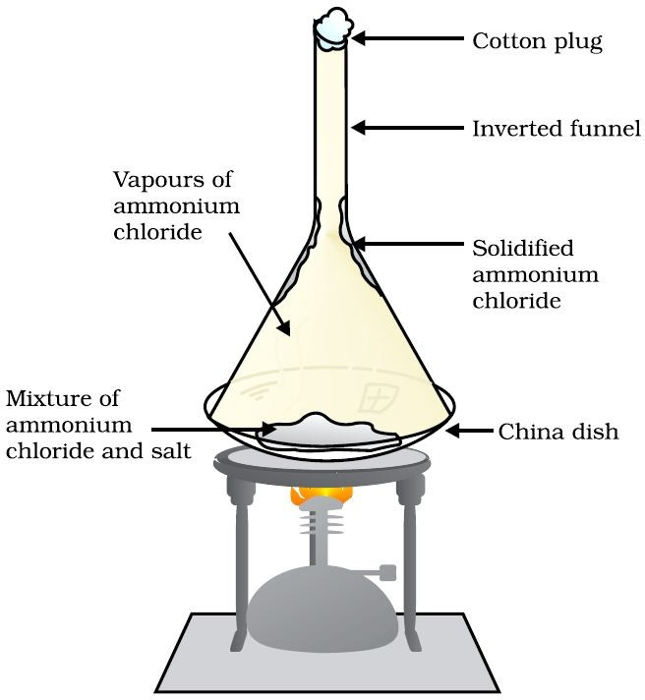
Method of Sublimation
Sublimation : The process by which a solid substance is directly changes into gas by heating and vice versa.
  (some sublimable substances :iodine, camphor, naphthalene etc...)
  How to separate Ammonium Chloride from a mixture of it with common salt, charcoal and Ammonium Chloride.
  https://youtu.be/Oo1_13OIgjo

Slide 3
Method of Centrifugation
It is a process to separate different soluble components from a colloidal mixture by the help of a churner or mixture.
By which the light material particles come to the top where as solid heavy particles remain at the buttom.
Ex : separating cream from milk
https://youtu.be/ncr-9iMEzwU

Slide 4
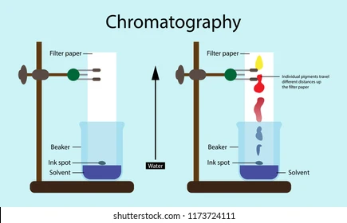
Method of Chromatography
Technique of separating different soluble components from a solvent by adsoption through a blotting paper or soaking paper due to their differnt rate of absorptions called Paper Chromatography.
Ex: separating different colors from a color mixture dye.
https://youtu.be/1LdYvgy94fg

Slide 5
Applications of all above methods
Centrifugation : separating cream from milk, separating different drug particles from blood.
Sublimation : separating any sublimable substance from an other components by heating.
Paper Chromatography : separating different components from water if dissolved in and different color pigments from chlorphyll color dye, reaction monitoring and qualitative analysis.

Slide 6
THANK U
  ODM EDUCATIONAL GROUP

