Slide 1

CLASS-VIII
CHEMISTRY
TOPIC- ELEMENTS COMPOUNDS AND MIXTURE
CHAPTER-03
SUB TOPIC- MIXTURES AND SEPARATION METHODS

Slide 2
MIXTURES : PROPERTIES
MIXTURES : When two or more elements and compounds mix together at any proportion without chemically reacting with each other, they form a mixture.
    Ex- sand and salt., water and alcohol, milk and air
    They are of two types : Homogeneous and Heterogeneous. i.e. uniform composition throughout and non-uniform.
    Homogeneous – alloy, air and sugar solution….
    Heterogeneous – sand and chips, rice and saw dust…

Slide 3
Properties
Mixture is – regular or irregular
      No chemical reaction in between
      Can be separated by some physical means
      Components retain their won properties
      They have no definite MP/BP.
      They don’t have any definite MF.
      Ex- Mixture of Iron (Fe) and sulphur (S)

Slide 4
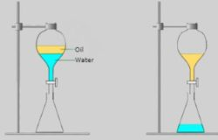
Different Methods of Separation of Components of Mixture
Evaporation
Filtration
Magnetic Separation
Separating Funnel
(with description and diagram of all demonstration)

Slide 5
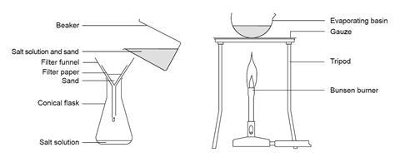
SOME OTHER IMAGES OF SEPARATION

Slide 6
            THANK U
            ODM EDUCATIONAL GROUP

