Slide 1

CLASS-VIII CHEMISTRY [PPT-1]
TOPIC- ATOMIC STRUCTURE
SUB TOPIC – DALTON’S ATOMIC THEORY AND DISCOVERY OF CATHODE RAYS

Slide 2
DALTON’S ATOMIC THEORY
An atom is the simplest indivisible particle of matter
Atoms of similar elements are alike in mass and chemical properties.
Atoms of different elements have different atomic masses and chemical properties.
Atoms always combine in simple whole number to form compounds.
The relative no of atoms of different elements in a compound always remain same.
Achievement and Limitations of Dalton’s Atomic Theory :
https://youtu.be/ZbSsvBZEOx0
https://youtu.be/ZbSsvBZEOx0

Slide 3
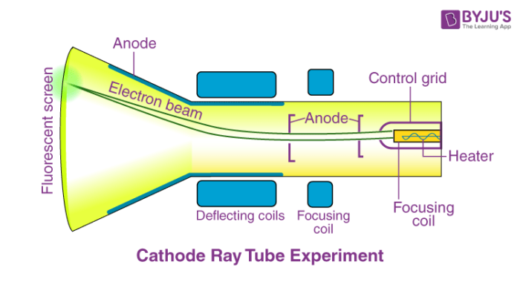
Cathode ray Experiment
https://www.youtube.com/watch?v=D9Nad2JxkNw

Slide 4
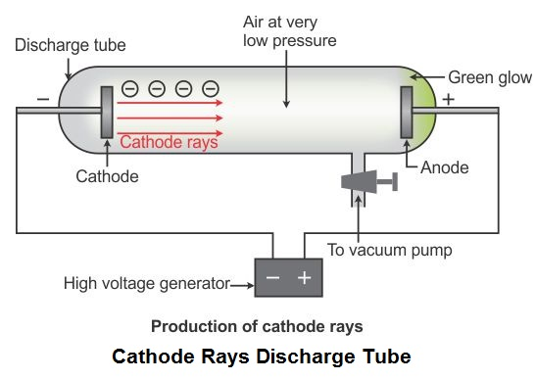
Image of CRT

Slide 5
Properties of Cathode Rays (Electrons)
After completing the experiment J.J. Thomson concluded that rays were and are basically negatively charged particles present or moving around in a set of a positive charge. This theory further helped physicists in understanding the structure of an atom. And the significant observation that he made was that the characteristics of cathode rays or electrons did not depend on the material of electrodes or the nature of the gas present in the cathode ray tube. All in all, form all this we learn that the electrons are in fact the basic constituent of all the atoms.
Most of the mass of the atom and all of its positive charge are contained in a small nucleus, called a nucleus. The particle which is positively charged is called a proton. The greater part of an atom’s volume is empty space.
The number of electrons that are dispersed outside the nucleus is the same as the number of positively charged protons in the nucleus. This explains the electrical neutrality of an atom as a whole.

Slide 6
THANK YOU
ODM EDUCATIONAL GROUP

Slide 7
CLASS-VIII CHEMISTRY [PPT-2]
TOPIC – ATOMIC STRUCTURE
SUB TOPIC – DISCOVERY OF PROTONS, THOMSON’S ATOMIC MODEL, RUTHERFORD’S EXPERIMENT, RUTHERFORD’S ATOMIC MODEL.

Slide 8
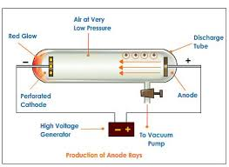
DISCOVERY OF PROTONS
Instead of normal cathode E. Goldstein took a perforated Cathode.

Slide 9
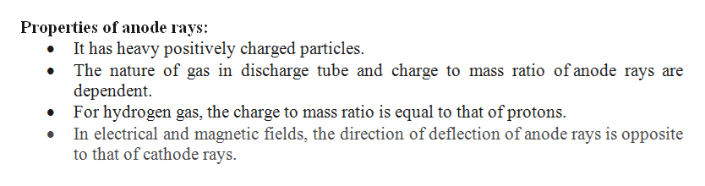
Properties of Anode Rays

Slide 10
Thomson’s Atomic Model and Limitations
Thomson atomic model, earliest theoretical description of the inner structure of atoms, proposed about 1900 by William Thomson (Lord Kelvin) and strongly supported by Sir Joseph John Thomson, who had discovered (1897) the electron, a negatively charged part of every atom. Though several alternative models were advanced in the 1900s by Kelvin and others, Thomson held that atoms are uniform spheres of positively charged matter in which electrons are embedded. Popularly known as the plum pudding model, it had to be abandoned (1911) on both theoretical and experimental grounds in favour of the Rutherford atomic model, in which the electrons describe orbits about a tiny positive nucleus.

Slide 11
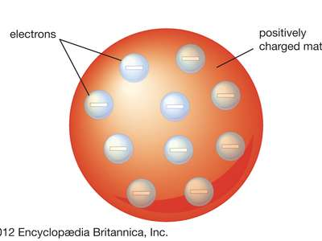
Image showing Thomson’s Model of Atom

Slide 12
Limitations of Thomson’s Model
PLUM PUDDING MODEL OR WATER MELON MODEL
Negatively charged electrons can’t remain in a sphere of positively charged protons rather they should collapse with each other which proves instability of an atom.

Slide 13
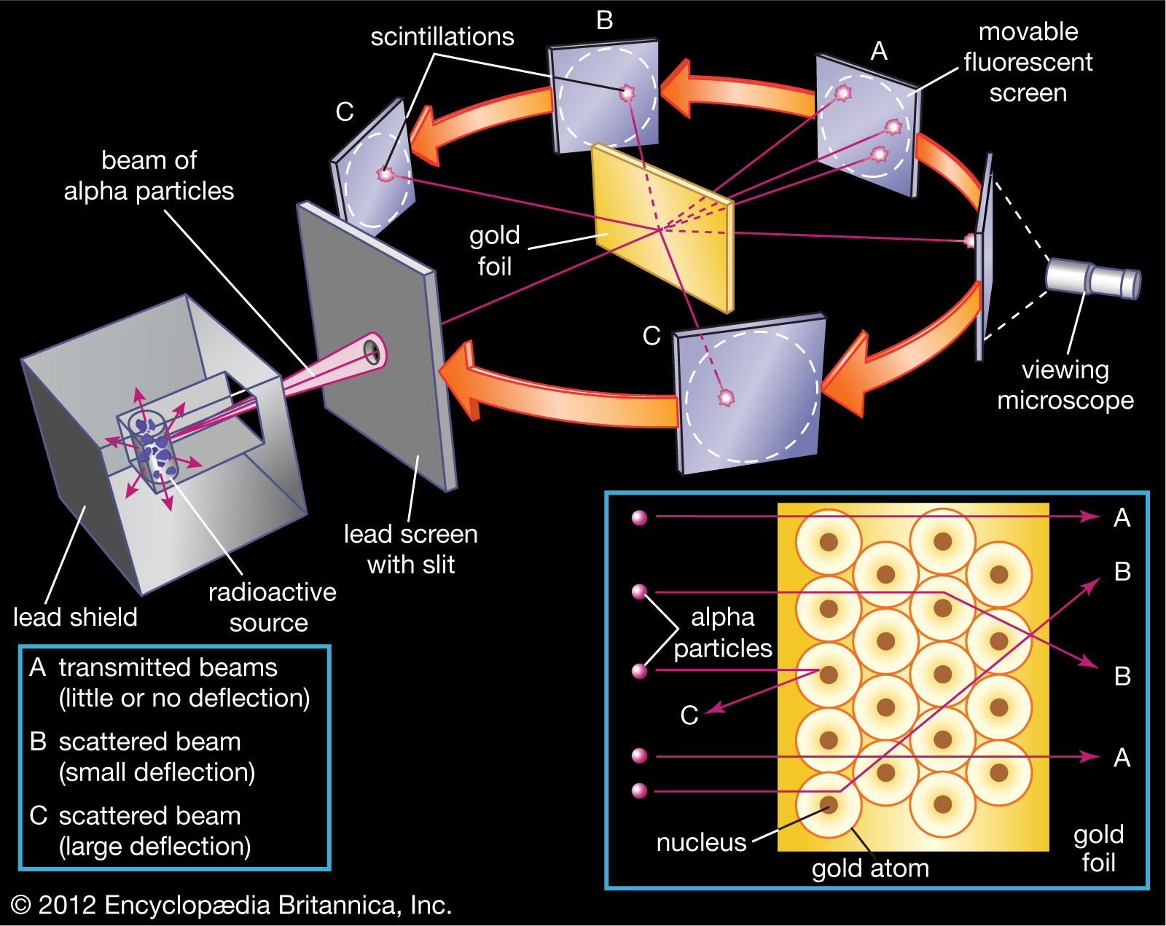
Rutherford’s Alpha-Particle scattering Expt.
He bombarded a stream of fast moving alpha-particle on a very thin gold foil and kept a hemispherical reflector of coated ZnS as shown :

Slide 14
Observation and Conclusion
Rutherford gold-foil experimentIn 1909 Rutherford disproved Sir J.J. Thomson's model of the atom as a uniformly distributed substance. Because only very few of the alpha particles in his beam were scattered by large angles after striking the gold foil while most passed completely through, Rutherford knew that the gold atom's mass must be concentrated in a tiny dense nucleus.
Rutherford’s Atomic model : An consists of a heavy nucleus at its centre and all –vely charged electrons revolve around it with very high speed which don’t help them in falling inward just like a solar system revolution of planets.

Slide 15
Limitations of Rutherford’s Atomic Model
Once a charge moves around another oppositely charged particle with very high speed it must be accelerating for which it must have to radiate Energy according to Maxwell’s Theory so, here electrons must be radiating energy and gradually being dragged inward it must come close to th nucleus and eventually fall into it moving in a spiral path; which proves instability of an atom.

Slide 16
THANK YOU
ODM EDUCATIONL GROUP

Slide 17
CLASS-VIII CHEMISTRY [PPT-3]
TOPIC – ATOMIC STRUCTURE
SUB TOPIC – BOHR’S ATOMIC MODEL, ATOMIC NO, MASS NO, ELECTRONIC CONFIGURATION

Slide 18
BOHR’S ATOMIC MODEL
Bohr’s Model of Atom (By Neil’s Bohr in 1913)
This model of atom states that:
→ An atom consists of heavy positively charged nucleus. The whole mass of the atom is concentrated in the nucleus.
→ The electrons in an atom revolve around the nucleus in definite circular paths called orbits or energy level.
→ Each energy level is associated with a definite amount of energy.
→ The change in energy takes place when electron jumps from one energy level to another energy level.

Slide 19
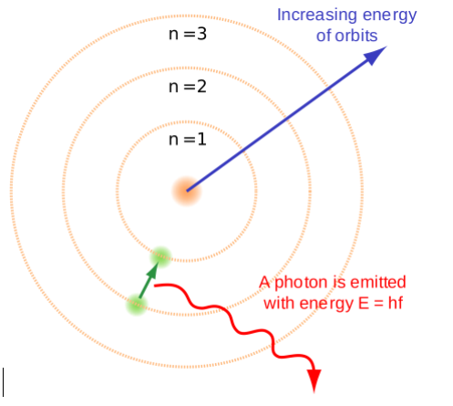
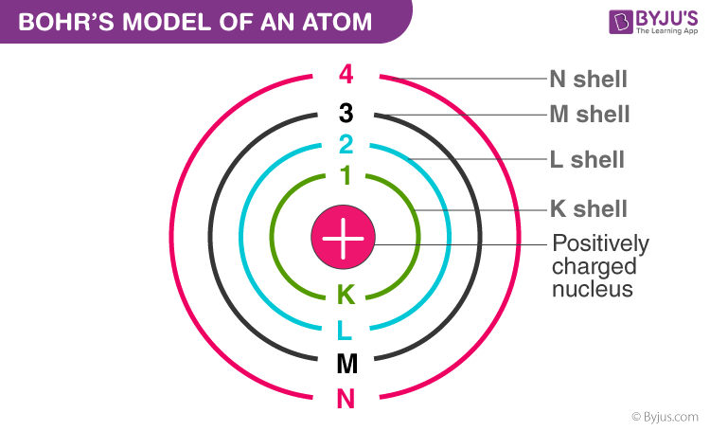
SHOWING MODELS OF DIFFERENT ATOMS

Slide 20
Postulates of Bohr’s Atomic Model
In an atom, electrons (negatively charged) revolve around the positively charged nucleus in a definite circular path called orbits or shells.
Each orbit or shell has a fixed energy and these circular orbits are known as orbital shells.
The energy levels are represented by an integer (n=1, 2, 3…) known as the quantum number. This range of quantum number starts from nucleus side with n=1 having the lowest energy level. The orbits n=1, 2, 3, 4… are assigned as K, L, M, N…. shells and when an electron attains the lowest energy level, it is said to be in the ground state.
The electrons in an atom move from a lower energy level to a higher energy level by gaining the required energy and an electron moves from a higher energy level to lower energy level by losing energy.

Slide 21
Limitation
Limitations of Bohr’s Model of an Atom
Bohr’s model of an atom failed to explain the Zeeman Effect (effect of magnetic field on the spectra of atoms).
It also failed to explain the Stark effect (effect of electric field on the spectra of atoms).
It violates the Heisenberg Uncertainty Principle.
It could not explain the spectra obtained from larger atoms.

Slide 22
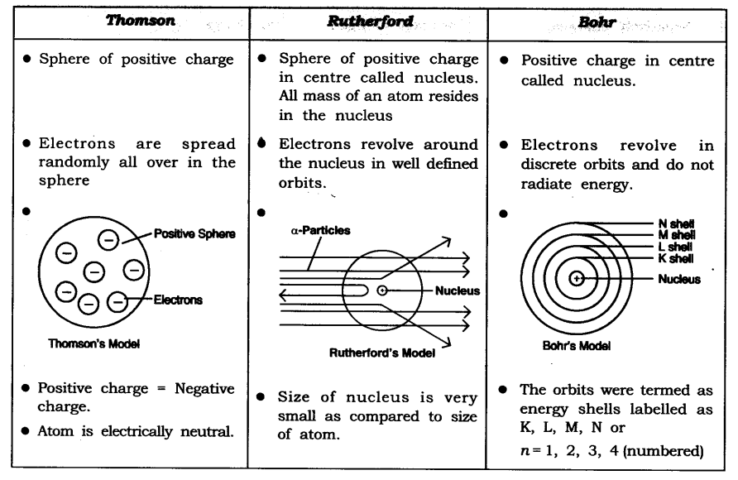
comparision among all three
https://youtu.be/fm2C0ovz-3M

Slide 23
atomic no and mass no
The atomic no of an element is the no of protons, or electrons present in an neutral atom. Denoted by letter ‘Z’.
Mass No : total no of protons and neutrons present in the nucleus of an atom. It is denoted by letter A.
At no of Mg is =12
Mass no of Mg is= 24 (total no of protons and neutron)
A particular At No refers to a particular atom but Mass No can vary.
Atoms having different At masss are known as Isotopes.

Slide 24
Difference between Isotopes and isobars
Isobars | Isotopes
Chemical elements have a different atomic number. | Chemical elements have the same atomic number
Chemical elements have the same atomic mass number. | Chemical elements have a different atomic mass number.
Chemical elements exhibit different chemical properties. | Chemical elements exhibit the same chemical properties.
Chemical elements have different positions in the periodic table. | Chemical elements have the same positions in the periodic table.
Chemical elements have a different number of protons and neutrons. | Chemical elements have a different number of neutrons.

Slide 25
Electronic Configuration
Electron Configuration of Oxygen
The atomic number of oxygen is 8, implying that an oxygen atom holds 8 electrons. Its electrons are filled in the following order:
K shell – 2 electrons
L shell – 6 electrons
Therefore, the electron configuration of oxygen is 1s² 2s² 2p⁴, as shown in the illustration provided belo

Slide 26


More configurations of atoms
Chlorine Electronic Configuration
Chlorine has an atomic number of 17. Therefore, its 17 electrons are distributed in the following manner:
K shell – 2 electrons
L shell – 8 electrons
M shell – 7 electrons

Slide 27
THANK YOU
ODM EDUCATIONAL GROUP

Slide 28
CLASS-VIII CHEMISTRY [PPT-5]
TOPIC – ATOMIC STRUCTURE
SUB TOPIC – VALENCY AND MOLECULAR FORMULA

Slide 29
Valence electrons and Valency
It refers to the No of (e-s) found in the outermost shell of an Atom :
ex. [Na] = 2, 8, 1 V e-s -> 1
[Ca} = 2, 8, 8, 2 V e-s -> 2
[Cl} = 2, 8, 7 V e-s -> 7
Valency – It is the combining capacity of an atom./ No of e-s of an atom take part in chemical bonding. (either Co-valent or Ionic)
Which can be determined from its V e-s.
Just to occupy a stable Electronic Config. Every atom loses or gains or shares some of its e-s with other atom, that no refers to Valency.

Slide 30
Determining Valency
Stable configuration means either Octet state or if simple Duplet state
N’ has V e-s = 5 but Valency =8-5=3
Al’ has V e-s = 3 and Valency =3
It is of two types :covalency and electro-valency.
covalency : by sharing no of electrons
electro-valency : by transferring electrons [+/-]
like wise monovalent, divalent and trivalent - ( Na+, Mg2+, and NH4+…) or, ( Cl-, S2-, CO3 2-…)

Slide 31
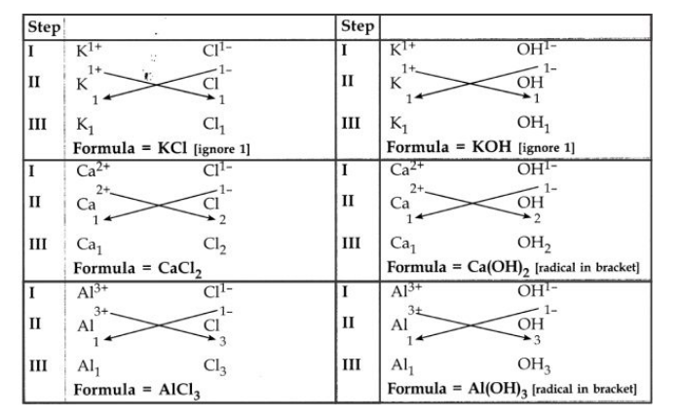
Writing Chemical Formula

Slide 32
Write the Chemical Formula of following compounds :
a) Sodium Bicarbonate
b) Zinc Sulphate
c) Potassium Dichromate
d) Ammonium Phosphate
e) Aluminum Zincate
f) Calcium Acetate
all above you write in Criss-Cross method.

Slide 33
THANK YOU
ODM EDUCATIONAL GROUP

