Slide 1

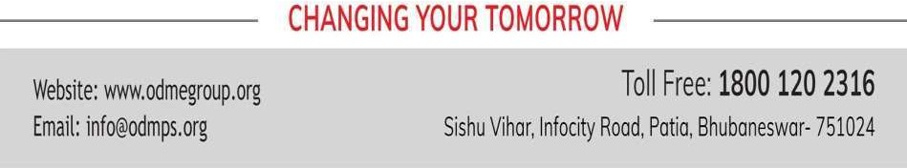
[Class-VIII] CHEMISTRY CHAPTER-1 [MATTER] PPT-1 SUB TOPIC – Composition and properties of matter

Slide 2
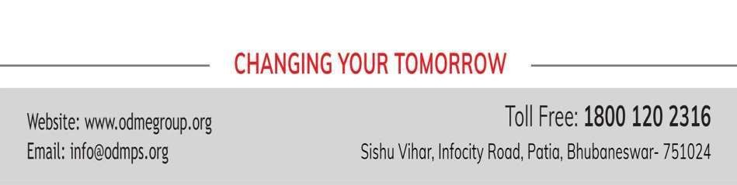
LEARNING OUTCOMES
STUDENTS WILL BE ABLE TO :
Learn about the composition of Matter
Properties of particles of matter.
Through different activities they could able to understand the concept of different properties
Know the concept of diffusibility property of particles in particular.Knowing the terminology.

Slide 3
Points to Remember
Introduction
Matter is made up of very tiny particles.
Properties of particles of matter.
States of matter.
Conversion of states of matter.
Factors affecting during Conversion.

Slide 4

Introduction
Every object is composed of matter which again is composed of tiny particles. Nature of particles of matter :
-> Particles have spaces among them
-> Particles have strong forces of attraction among them.
-> They always remain in ceaseless motion
-> They can diffuse among each other.
Some activities are followed to clarify each concept.

Slide 5
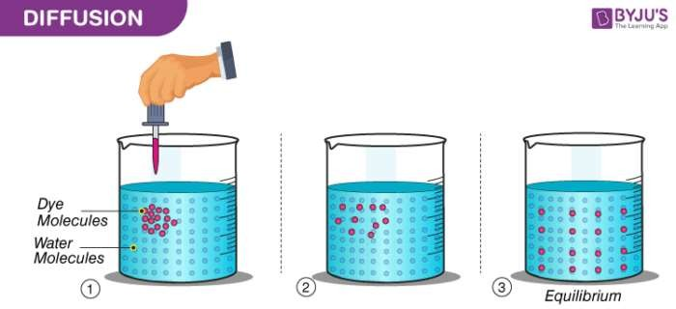
Diffusion of particles

Slide 6
Continious motion of Particles of Matter
A video on above activity :
https://youtu.be/mhHo7bKbANE
Forces of Particles of matter :
https://youtu.be/_ab-IAF1kYU

Slide 7
EVALUATION
1. why can you able to smell the aroma of hot sizzling food from distant but not the cold one.
2. A white haze is formed when you keep NH3 gas and HCl gas at two different corners of a room ?

Slide 8
THANKING YOU
ODM EDUCATIONAL GROUP

Slide 9
CLASS-VIII CHEMISTRY
TOPIC- MATTER PPT-2
SUB TOPIC- DIFFERENT STATES OF MATTER AND INTERCONVERSION

Slide 10
States of Matter
There are three major states of Matter : solid, liquid and gas.Beyond that there are two other states of matter as well : [Plasma and BEC]
Properties Shape and Vol
Forces of attraction Inter-particular spaces
Diffusibility Compressibility
Density Fluidity
solid liquid gas

Slide 11
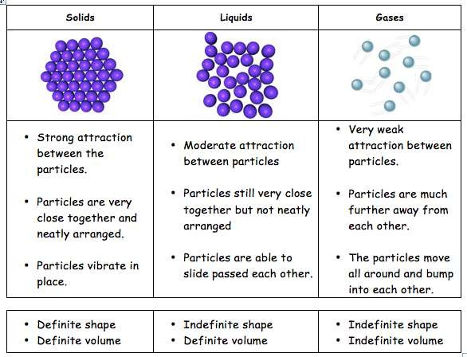
Comparison among all states

Slide 12
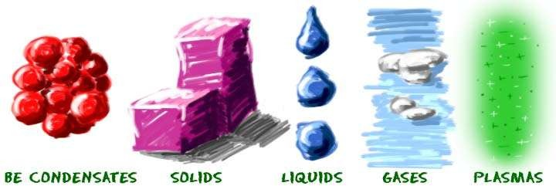
Inclusive two other States

Slide 13
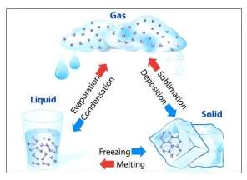
Inter-conversion of States

Slide 14
SUB TOPIC - FACTORS AFFECTING INTERCONVERSION OF STATES OF MATTER and defining the terms of conversion of states
SUBJECT – CHEMISTRY
CLASS – VIII PPT-3

Slide 15
Learning Outcome
After going through the topic students can able to understand:
- how temperature and pressure plays a vital role in changing the states of matter
- how impurities affect the melting and boiling of substances.
- they could able to define the terms like melting, boiling and condensation etc.

Slide 16
Factors affecting in Inter-conversion
Temperature
Pressure * some impurities
of States
How pressure and impurities affect in changing the Boiling point and Melting point of substances.
-> higher the pressure higher is the boiling point of liquid and vice-versa.
-> Impurities can increase the boiling point of water and decrease the melting point of Ice.

Slide 17
Defining the terminology
- Melting: solid→ liquid at a constant temperature.
- Boiling : liquid → gas at a constant temperature
- Sublimation : solid→ gas and vice-versa and the corresponding temperatures are known as their Melting Pt, Boiling Pt, Sublimation Pt respectively.

Slide 18
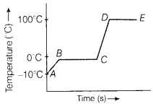
Determination of different Temp ranges for following changes.
Melting Point, Boiling Point, Freezing Point, Condensation Point, Sublimation Point. Here the graph showing the ranges
Latent Heat determination.
Latent Heat of Fusion and Latent Heat of Vaporization.
These are the extra concepts to understand.
Lf of Ice = 80 cal/kg
Lv of Water = 540cal/kg

Slide 19
THANKING YOU
ODM EDUCATIONAL GROUP

Slide 20
SUBJECT –CHEMISTRY CLASS-VIII PPT-4
TOPIC – MATTER
SUB TOPIC – Law of conservation of Mass

Slide 21
Learning Outcome
After going through this lesson students could able to
- understand the importance of this Law and it’s application in all chemical reactions.
- know why a chemical reaction needs to get balanced.

Slide 22
Law of Conservation of Mass
According to Antonie Lavoisier the law states that:
“Matter can neither be created nor destroyed in a chemical reaction but it can only change from one form to another”.

Slide 23
Activities followed for verificaion of this law
Procedure followed:Materials required, Experimental set-up,reaction procedure
Observation : (estmation of reactants and products)
Verification: weighing mass of reactants and products

Slide 24
Here the reaction followed is BaCl2 + Na2SO4 → BaSO4 + 2NaCl m1 m2 m3 m4 m1 + m2 = m3 + m4 m(reactants) = m (products) Which verifies the Law of Conservation of Mass

Slide 25
Evaluation
1. Estimate the amount of AgCl should form when 15.5g of AgNO3 solution reacting with 20.1g of NaCl form AgCl and 20.46g of NaNO3 solution.
2. Is the law valid for both physical and chemical change if so, clear this concept giving one favorable example.

Slide 26
THANK YOU ODM EDUCATIONAL GROUP

