Slide 1


MATTER IN OUR SURROUNDING
SUBJECT-CHEMISTRY
CHAPTER NO-01
CHAPTER NAME-MATTER IN OUR SURROUNDING
PERIOD-7

Slide 2
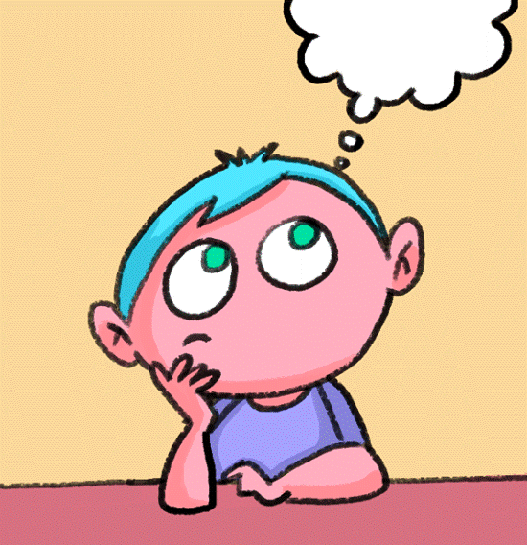

LEARNING OBJECTIVE
Students will be able to
Familiarise with the concept of evaporation.
Get aware of the factors affecting the rate of evaporation.

Slide 3
EVAPORATION AND ITS FACTORS
EVAPORATION IS DEFINED AS THE CHANGE OF LIQUID TO THE VAPOUR STATE AT ANY TEMPERATURE BELOW ITS BOILING POINT.
FACTORS AFFECTING EVAPORATION ARE-------
1) TEMPERATURE
2) SURFACE AREA
3) HUMIDITY
4) SPEED OF WIND
5) NATURE OF LIQUID

Slide 4
EVAPORATION CAUSES COOLING
EVAPORATION IS A SURFACE PHENOMENA IN WHICH A LOT OF ENERGY IS LOST.
ENERGY IS NEEDED TO OVERCOME THE ATTRACTIVE FORCES AMONG THE LIQUID MOLECULES SO THAT THEY MAY CHANGE TO THE VAPOURS.
THIS REQUIRED ENERGY IS ABSORBED FROM THE SURROUNDING AND THUS THE TEMPERATUR LOWERS DOWN AND BECOMES COOL.
SOME OF THE APPLICATION OF COOLING EFFECT OF EVAPORATION ARE:------
WE FEEL COOL WHEN SITTING UNDER FAN.
WE SPRINKLE WATER ON THE ROOF DURING SUMMER EVENING.
WATER REMAIN COOL IN THE EARTHEN POT.

Slide 5
DIFFERENCE BETWEEN BOILING AND EVAPORATION
BOILING OCCURS AT 100 DEGREE CELSIUS BUT EVAPORATION AT ALL TEMPERATURE.
BOILING IS A BULK PHENOMENA WHEREAS EVAPORATION IS A SURFACE PHENOMENA.
BOILING DOES NOT CAUSES COOLING BUT EVAPORATION CAUSES.
BOILING IS NOT AFFECTED BY THE PHYSICAL CONDITION BUT EVAPORATION IS INFLUENCED BY THE PHYSICAL CONDITIONS.

Slide 6
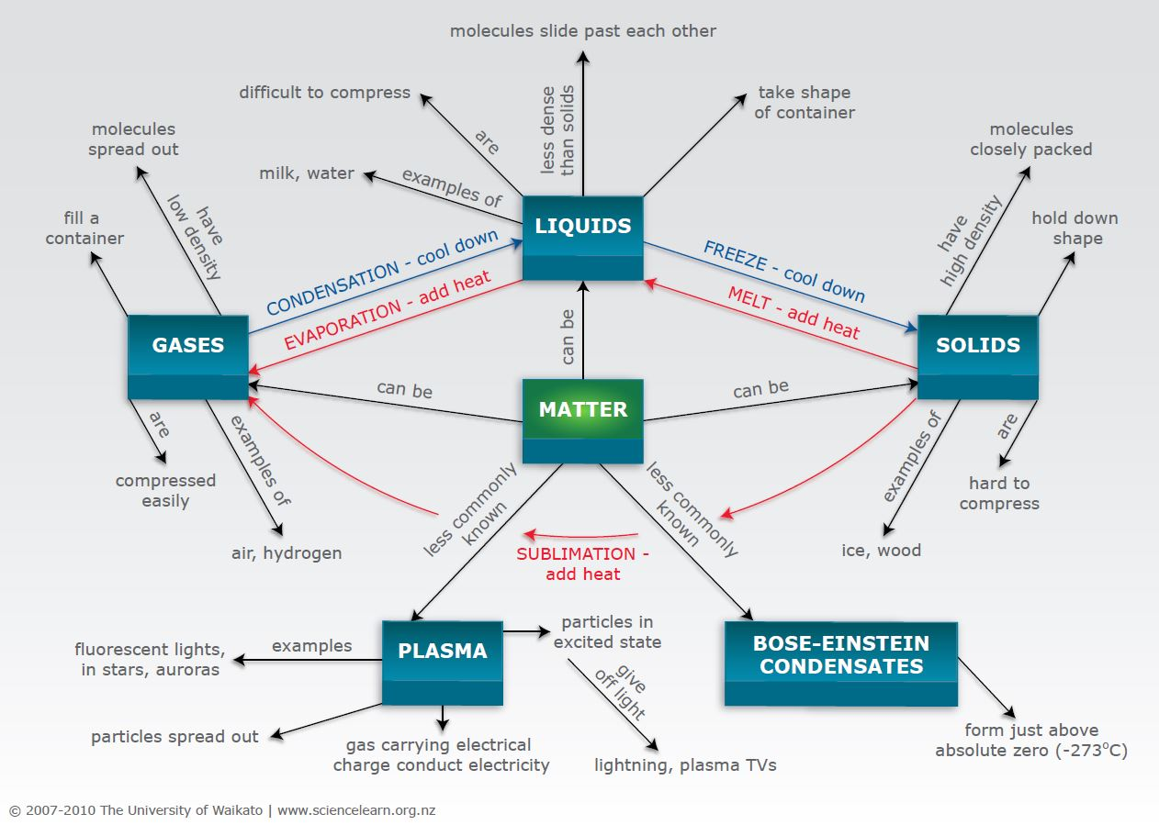
SUMMARY OF THE CHAPTER

Slide 7
HOME ASSIGNMENT
EXPLAIN HOW DOES EVAPORATION CAUSES COOLING
EXPLAIN THE FACTORS AFFECTING THE RATE OF EVAPORATION.

Slide 8
THANKING YOU
ODM EDUCATIONAL GROUP

