Slide 1


MATTER IN OUR SURROUNDING
SUBJECT-CHEMISTRY
CHAPTER NO-01
CHAPTER NAME-MATTER IN OUR SURROUNDING
PERIOD-6

Slide 2

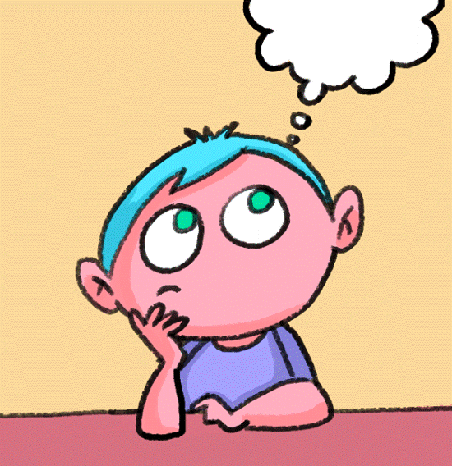
LEARNING OBJECTIVE
Students will be able to
Familiarise with the scales of temperature.
They would also know of the two special states of matter (Plasma and BEC)

Slide 3
SCALES OF TEMPERATURE
Celsius scale
Kelvin scale
Fahrenheit scale
Relationship between different scales of temperature are as follows.
K=0c + 273
C=5/9(f-32)
F=9c/5 + 32

Slide 4
PLASMA
Plasma is the 4th state of matter usually composed of ionized gases.
It is a mixture of free electrons and ions.
The glowing of the sun and the stars are due to the plasma.
The fluorescent tubes and the neon sign bulbs due to plasma

Slide 5
BEC(BOSE–EINSTEIN CONDENSATE)
Bec is the 5th state of matter.
It was discovered by S.N. Bose and albert Einstein.
They have very low energy and behaves like ice
They exist in super cool temperature.
They are also known as bosons.

Slide 6
HOME ASSIGNMENT
What is the normal body temperature of the human body in degree celcius. Convert it into degree Fahrenheit
Mention the physical state of matter at i) 250 degree Celsius ii) 25 degree Celsius
Write a short note on plasma
Explain BEC.

Slide 7
THANKING YOU
ODM EDUCATIONAL GROUP

