Slide 1


MATTER IN OUR SURROUNDING
SUBJECT-CHEMISTRY
CHAPTER NO-01
CHAPTER NAME-MATTER IN OUR SURROUNDING
PERIOD-4

Slide 2


LEARNING OBJECTIVE
Students will be able to
Familiarise with the melting point of ice and would be able to obtain it.

Slide 3
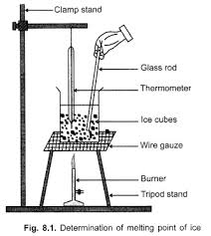
DETERMINATION OF MELTING POINT

Slide 4
HOME ASSIGNMENT
EXPLAIN BY AN ACTIVITY TO DETERMINE THE MELTING POINT OF ICE WITH A WELL LABELLED DIAGRAM

Slide 5
THANKING YOU
ODM EDUCATIONAL GROUP

