Slide 1


MATTER IN OUR SURROUNDING
SUBJECT-CHEMISTRY
CHAPTER NO-01
CHAPTER NAME-MATTER IN OUR SURROUNDING
PERIOD-3

Slide 2

LEARNING OBJECTIVE
Students will be able to
Get to know of the interconversion of the states of matter.
Know of the various factors affecting the interconversion of matter.

Slide 3
INTERCONVERSION OF MATTER
THE CHANGE OF STATE FROM SOLID TO LIQUID ON HEATING IS KNOWN AS FUSION OR MELTING
2) THE CHANGE OF STATE FROM LIQUID TO GAS ON HEATING IS KNOWN AS VAPOURISATION
3) THE CHANGE OF STATE FROM GAS TO LIQUID ON COOLING IS KNOWN AS CONDENSATION
4) THE CHANGE OF STATE FROM LIQUID TO SOLID ON COOLING IS KNOWN AS SOLIDIFICATION
5) THE CHANGE OF STATE FROM GAS TO SOLID DIRECTLY ON HEATING IS KNOWN SUBLIMATION.

Slide 4

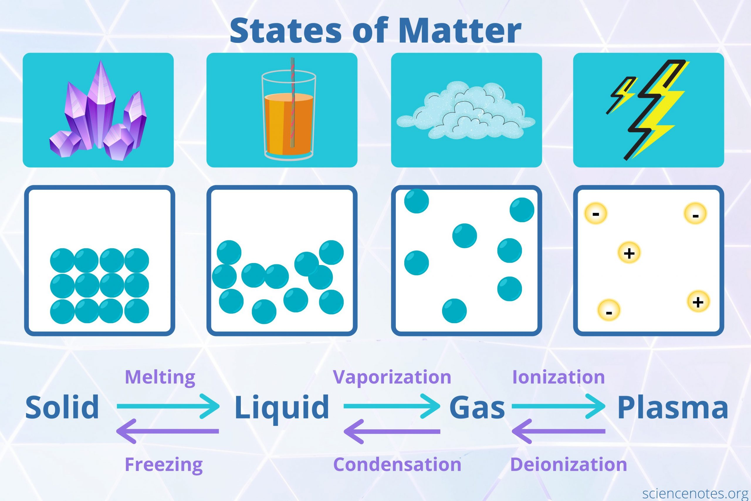
States of matter

Slide 5
FACTORS AFFECTING THE CHANGE OF STATE OF MATTER
TEMPERATURE- INCREASE IN TEMPERATURE CHANGES THE STATE OF MATTER FROM SOLID TO LIQUID AND THEN TO GASES.
PRESSURE-INCREASE IN PRESSURE CHANGES THE STATE OF MATTER FROM GASES TO LIQUID AND THEN TO SOLID.

Slide 6
HOME ASSIGNMENT
EXPLAIN THE INTERCONVERSION OF MATTER WITH SUITABLE DAILY LIFE EXAMPLES.
WHAT ARE THE FACTORS AFFECTING THE CHANGE OF THE STATE OF MATTER.
EXPLAIN HOW DOES TEMPERATURE AND PRESSURE AFFECTS THE INTERCONVERSION OF THE STATE OF MATTER.SUPPORT YOUR ANSWER WITH EXAMPLES.

Slide 7
THANKING YOU
ODM EDUCATIONAL GROUP

