Slide 1


MATTER IN OUR SURROUNDING
INTRODUCTION
SUBJECT-CHEMISTRY
CHAPTER NO-01
CHAPTER NAME-MATTER IN OUR SURROUNDING
PERIOD-1

Slide 2

LEARNING OBJECTIVE
Students will be able to
Understand the concept of matter.
Get aware of the characteristics of the particles of matter with activities.

Slide 3
CONCEPT OF MATTER
Any thing that occupies space, has mass and can be perceived by the senses is known as Matter.
Matter is made up of five basic elements – Air, Water, Fire , Earth and Sky according to the ancient philosopher.
Modern Scientist believes in the Physical and the chemical Nature of Matter.
Physical nature of Matter-Solid, Liquid and Gas (Appearance)
Chemical nature of matter depends upon the composition of matter.

Slide 4
CHARACTERISTICS OF THE PARTICLES OF MATTER
Particles of matter have space between them
Particles of matter are very small in size.
Particles of matter are continuously moving.
Particles of matter attract each other.

Slide 5
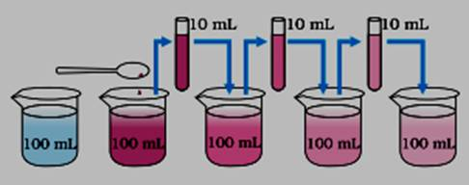
CHARACTERISTICS OF THE PARTICLES OF MATTER
Particles of matter are very small in size

Slide 6
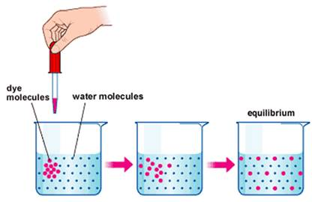
CHARACTERISTICS OF THE PARTICLES OF MATTER
Particles of matter have inter particle space between them.

Slide 7
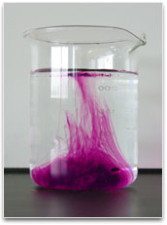
CHARACTERISTICS OF THE PARTICLES OF MATTER
Particles of matter are in constant random motion.

Slide 8
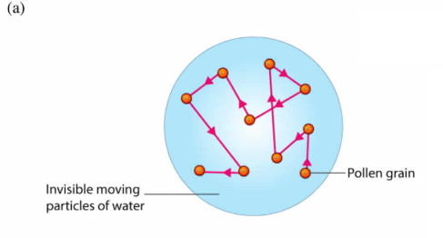
CHARACTERISTICS OF THE PARTICLES OF MATTER
BROWNIAN MOTION
The haphazard, random motion of the suspended particles on the surface of a liquid or in air is called Brownian Motion.
This was first noticed by Mr. Robert Brown.
It gives the evidence for the existence and movement of the particles in liquids.
For example, movement of pollen grains in water.

Slide 9
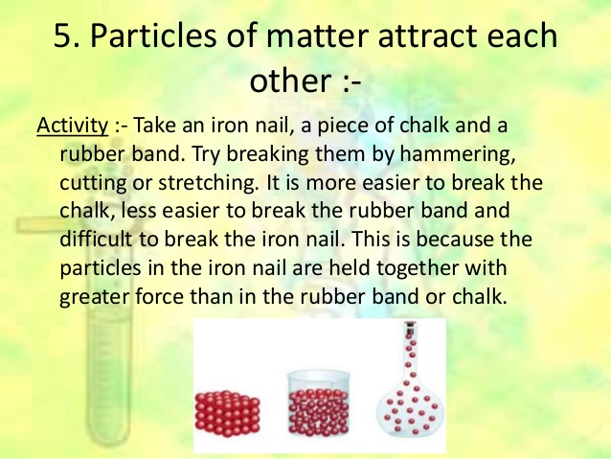
CHARACTERISTICS OF THE PARTICLES OF MATTER
Particles of matter attract each other.

Slide 10
HOME ASSIGNMENT
EXPLAIN BY AN ACTIVITY THAT PARTICLES OF MATTER HAVE SPACE BETWEEN THEM.
MENTION THE FIVE BASIC ELEMENTS OF MATTER.
WHAT DO YOU UNDERSTAND BY THE TERM MATTER.SUPPORT YOUR ANSWER WITH EXAMPLES

Slide 11
THANKING YOU
ODM EDUCATIONAL GROUP

