Slide 1


THE STRUCTURE OF ATOM
SUBJECT-CHEMISTRY
CHAPTER-04
CONCEPT OF ISOTOPES AND ISOBARS
PERIOD-7

Slide 2


LEARNING OBJECTIVE
STUDENTS WILL BE ABLE TO UNDERSTAND :-
THE CONCEPT OF ISOTOPES.
FAMILARIZE THEMSELVES WITH THE ISOBARS

Slide 3
WARM UP QUESTIONS
WHY SOME ELEMENTS HAVE AVERAGE ATOMIC MASS ?
NAME THE CHEMICAL WHICH IS USED IN THE TREATMENT OF CANCER?
WHAT DO YOU MEAN BY CARBON DATING?

Slide 4
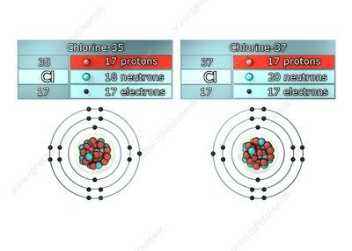
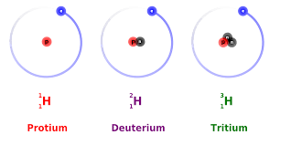
ISOTOPES
ISOTOPES ARE THE ATOMS OF THE SAME ELEMENT HAVING SAME ATOMIC NUMBER BUT DIFFERENT MASS NUMBER.
THEY HAVE DIFFERENT PHYSICAL PROPERTY BUT SIMILAR CHEMICAL PROPERTIES.
FOR EXAMPLE , HYDROGEN HAS THREE ISOTOPES.
FOR EXAMPLE , CHLORINE HAS TWO ISOTOPES.
THE ISOTOPES THAT EMIT RADIOACTIVE RADIATIONS ARE KNOWN AS RADIOACTIVE ISOTOPES (URANIUM – 235).

Slide 5
APPLICATION OF ISOTOPES
U-235 IS USED AS A NUCLEAR FUEL.
COBALT-60 (Co-60) IS USED IN THE TREATMENT OF CANCER.
IODINE -131 IS USED IN THE TREATMENT OF GOITRE.
PHOSPHOROUS – 32 IS USED IN THE TREATMENT OF BLOOD CANCER.
SODIUM-24 IS USED TO DETECT BLOOD CLOT.
ARSENIC-74 IS USED IN THE DETECTION OF TUMOURS.
CARBON -14 IS USED TO FIND THE AGE OF THE FOSSILS

Slide 6
ISOBARS
ISOBARS ARE THE ATOMS OF THE DIFFERENT ELEMENTS HAVING DIFFERENT ATOMIC NUMBER BUT SIMILAR MASS NUMBER.
THEY HAVE DIFFERENT PHYSICAL AS WELL AS CHEMICAL PROPERTIES.
FOR EXAMPLE , ARGON AND CALCIUM ARE ISOBARS.
BOTH ARGON AND CALCIUM HAVE SAME MASS NUMBER OF 40 BUT THEY HAVE DIFFERENT ATOMIC NUMBER.

Slide 7
HOME ASSIGNMENT
WHAT ARE ISOTOPES? GIVE EXAMPLES.
MENTION THE USES OF THE FOLLOWING ISOTOPES:-
U-235
C-14
I-131
Co-60
WHAT ARE ISOBARS ? GIVE EXAMPLE.

Slide 8
THANKING YOU
ODM EDUCATIONAL GROUP

