Slide 1


THE STRUCTURE OF ATOM
SUBJECT-CHEMISTRY
CHAPTER-03
RUTHERFORD’S ATOMIC MODEL , DRAWBACKS OF THE RUTHERFORD’S ATOMIC MODEL
PERIOD-4

Slide 2


LEARNING OBJECTIVE
STUDENTS WILL BE ABLE TO UNDERSTAND :-
THE EXPERIMENT OF THE SCATTERING OF ALPHA PARTICLES THROUGH A GOLD FOIL.
FAMILARIZE THEMSELVES WITH THE DRAWBACKS OF RUTHERFORD’S ATOMIC MODEL.

Slide 3
WARM UP QUESTIONS
WHAT WAS THE SECOND ATOMIC MODEL?
WHO PROPOSED THE SECOND ATOMIC MODEL?

Slide 4
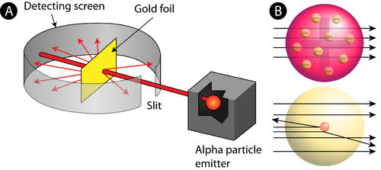
RUTHERFORD’S MODEL OF ATOM
AN ATOM CONSISTS OF TWO PARTS (a) NUCLEUS (b) EXTRANUCLEAR PART.
MOST OF THE SPACE IN AN ATOM IS EMPTY.
THE ENTIRE MASS OF AN ATOM IS CONCENTRATED IN THE NUCLEUS.
THE NUCLEUS IS VERY HEAVY.
THE NUCLEUS IS NOT ONLY HEAVY BUT ALSO POSITIVE IN NATURE AS IT CONTAINS POSITIVELY CHARGED PARTICLE PROTONS.
THE ELECTRONS REVOLVE AROUND THE NUCLEUS IN AN CIRCULAR ORBITS DUE TO CENTRIFUGAL FORCE.
THIS MODEL IS ALSO KNOWN AS RUTHERFORD’S PLANETORY MODEL AND THE ELECTRONS AS PLANETORY ELECTRONS

Slide 5
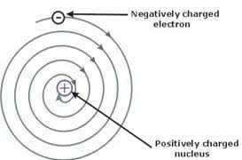
DRAWBACKS OF RUTHERFORD’S MODEL OF ATOM
RUTHERFORD COULD NOT EXPLAIN THE STABILITY OF AN ATOM.
A CHARGED PARTICLE WHEN REVOLVE AROUND ANOTHER CENTRAL FORCE LIKE NUCLEUS,IT LOSES ENERGY CONTINOUSLY IN THE FORM OF RADIATIONS.
HENCE THE ELECTRONS TAKE A SPIRAL PATH AND FINALLY FALLS INTO THE NUCLEUS.HENCE AN ATOM COLLAPSE.BUT AN ATOM IS QUITE STABLE

Slide 6
HOME ASSIGNMET
EXPLAIN RUTHERFORD’S ALPHA PARTICLES SCATTERING EXPERIMENT.
WHAT ARE THE LIMITATIONS OF RUTHERFORD’S ATOMIC MODEL.

Slide 7
THANKING YOU
ODM EDUCATIONAL GROUP

Slide 8
WATCH A VIDEO
https://youtu.be/kHaR2rsFNhg

