Slide 1

THE STRUCTURE OF ATOM
SUBJECT-CHEMISTRY
CHAPTER-03
DISCOVERY OF ELECTRONS, PROPERTIES OF ELECTRONS
PERIOD-1

Slide 2

LEARNING OBJECTIVE
STUDENTS WILL BE ABLE TO :-
UNDERSTND THE EXPERIMENT PERFORMED FOR THE DISCOVERY OF ELECTRON
FAMILARIZES WITH THE PROPERTIES OF ELECTRON.

Slide 3
WARM UP QUESTIONS
MENTION THE FIVE BASIC ELEMENTS OF WHICH MATTER IS MADE UP OF?
IS ATOM IS CHARGED OR NEUTRAL?
WHAT DO YOU MEAN BY VACUUM TUBE?

Slide 4
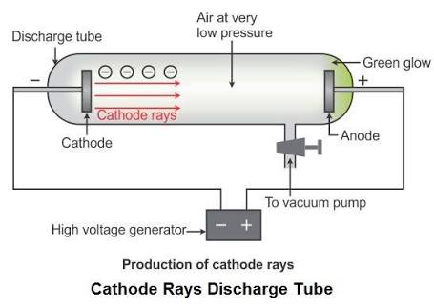
DISCOVERY OF ELECTRON
THE EXISTENCE OF ELECTRON IN AN ATOM WAS DISCOVERED BY J.J THOMSON IN THE YEAR 1897 BY THE CATHODE RAY EXPERIMENT.
HE TOOK GASES AT A VERY HIGH TEMPERATURE OF 10000 VOLTS AND PRESSURE OF O.OO1 mm OF Hg IN A DISCHARGE RAY TUBE.
HE OBSERVED INVISIBLE RAYS EMERGES FROM THE CATHODE AND MOVES TOWARDS ANODE.
HE NAMED THESE RAYS AS CATHODE RAYS THAT CARRY NEGATIVE PARTICLES CALLED ELECTRONS.

Slide 5
PROPERTIES OF ELECTRONS
AN ELECTRON HAS A NEGATIVE CHARGE OF – 1.6 X 10 -19 COULOMB.
AN ELECTRON HAS A MASS OF 9.1 X 10 -31 Kg.
THE MASS OF ELECTRON IS NEARLY 1/1840 TIMES THE MASS OF AN ATOM OF HYDROGEN.
THE RATIO OF CHARGE /MASS OR e/m RATIO OF AN ELECTRON IS 1.7 X 10 11 COULOMBS/Kg

Slide 6
HOME ASSIGNMENT
EXERCISE-1 Q1 TO Q6
WHAT IS e/m ratio AN ELECTRON?
EXPLAIN THE DISCOVERY OF ELECTRON WITH A DIAGRAM. NAME THE SCIENTIST WHO DISCOVERED IT.
MENTION ANY THREE PROPERTIES OF ELECTRONS.
WHAT ARE CATHODE RAYS? MENTION ITS PROPERTIES.

Slide 7

WATCH A VIDEO
https://youtu.be/4QAzu6fe8rE

Slide 8
THANKING YOU
ODM EDUCATIONAL GROUP

