Slide 1


SESSION : 7
CLASS : IV
SUBJECT : ENGLISH GRAMMAR
CHAPTER NUMBER: 9
CHAPTER NAME : SUBJECT- VERB AGREEMENT
SUBTOPIC : INTRODUCTION, Q. 1

Slide 2
LEARNING OBJECTIVE :
Enable the students to
Ensure that subjects and verbs always agree with each other.
The relationship between subjects and verbs lie at the heart of grammatically correct English writing.
Subject-verb agreement unifies a sentence and makes it easier to understand.

Slide 3
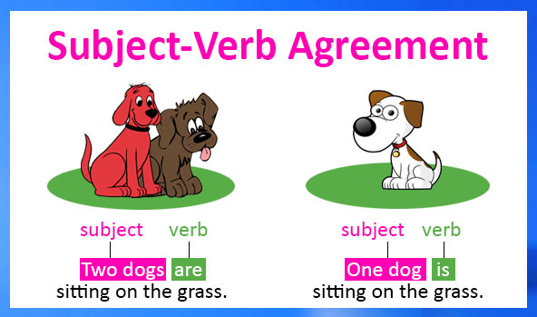
LET’S READ THE SENTENCES BELOW….

Slide 4
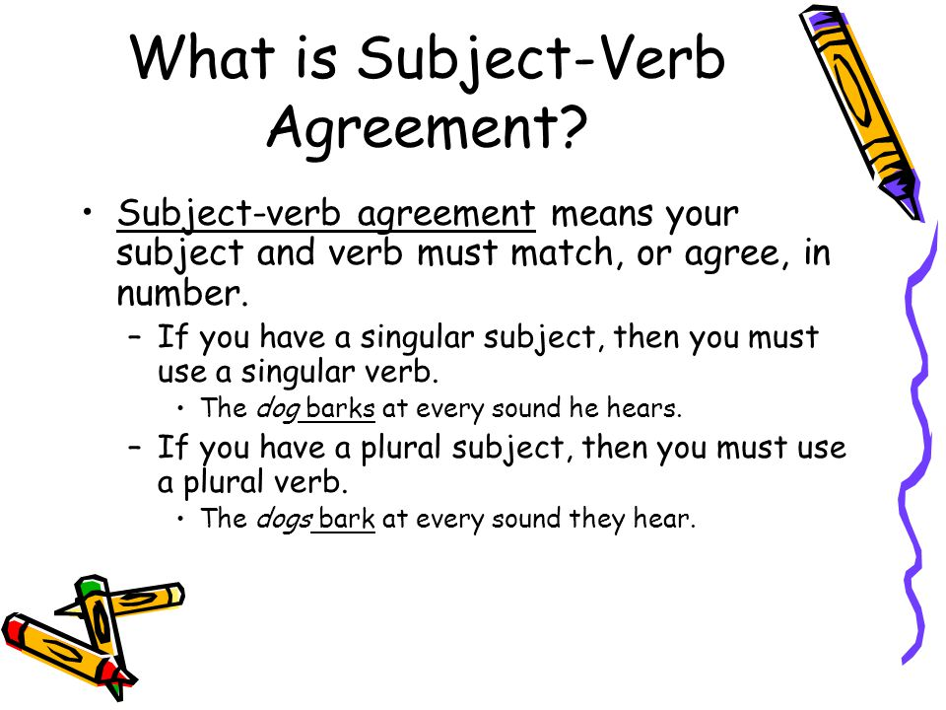

Slide 5
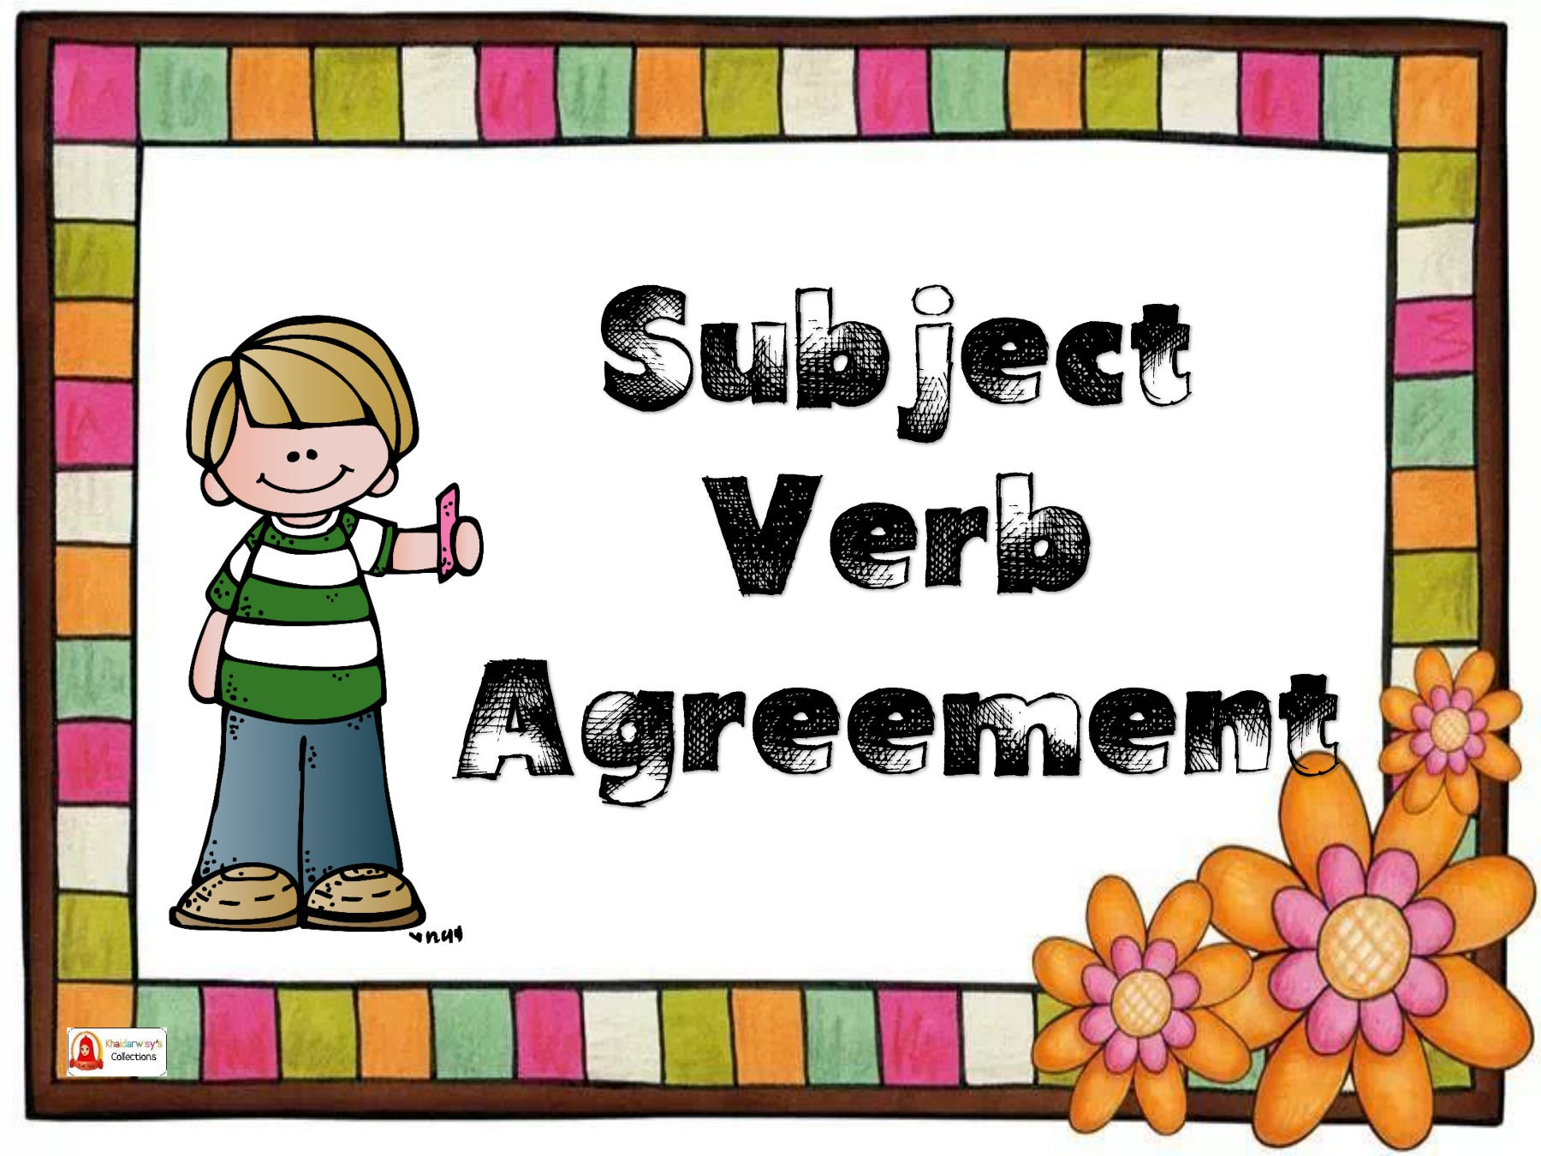
RULES
Subject Verb
Singular subject - singular verb(s/es)
Plural subject(s) - plural verb (were, are, have)
“YOU” is a plural
subject – plural verb (were , do , are have)
Singular subjects- - these verbs take singular verb
each, neither ,every

Slide 6
Few more rules –
Verbs used in simple past tense without any helping verbs remain the same for both singular and plural subjects.
When a verb is used with a helping verb, the main verb stays the same but the helping verb changes its form for a singular or plural subject

Slide 7
Choose the correct verbs to fill in the blanks.
This car ( run/runs) very fast.
The book and the bag (belongs/belong)to me.
Raja and Raahil (is going/are going) to attend the classes from next week.
The teacher (is talking/are talking) to the students.
Tim and Jim (walk/walks) to school everyday.
runs
belong
are going
is talking
walk

Slide 8

HOME WORK
Read pg. 32 & 33

Slide 9
LEARNING OUTCOME
Explain the rules for subject-verb agreement.
Identify and correct errors in subject-verb agreement.

Slide 10
THANKING YOU
ODM EDUCATIONAL GROUP

