Slide 1


SESSION : 2
CLASS : IV
SUBJECT : ENGLISH GRAMMAR
CHAPTER NUMBER: 7
CHAPTER NAME : HELPING AND LINKING VERBS
SUBTOPIC : Q.3 – 5

Slide 2

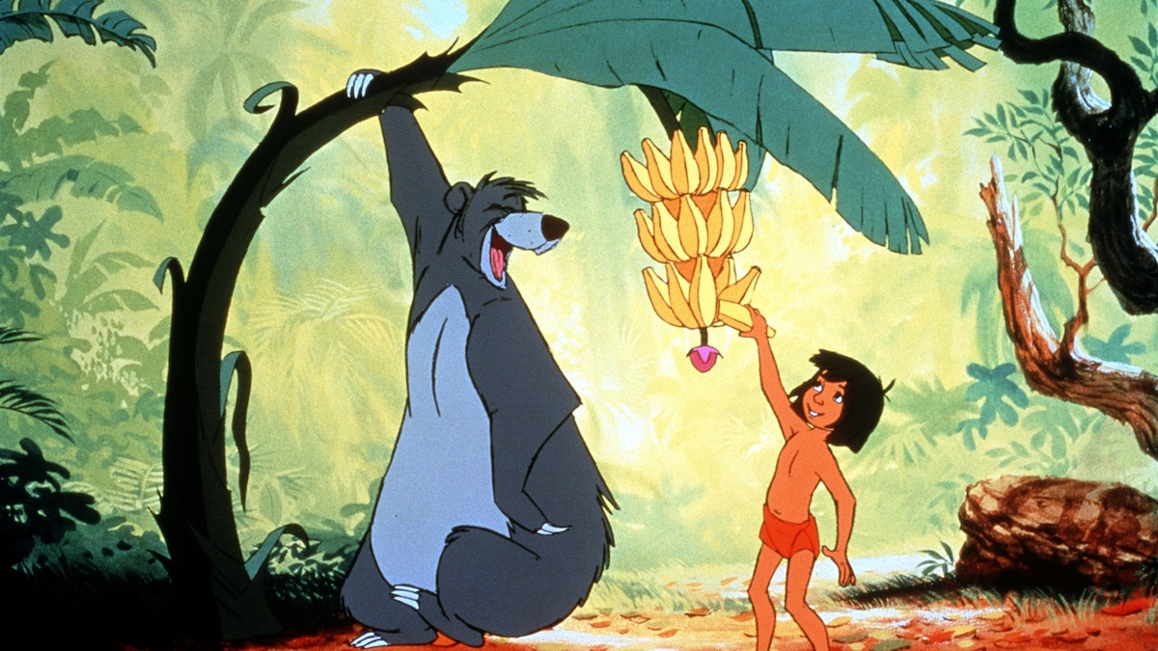
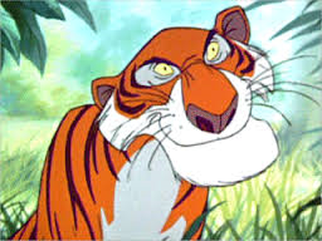
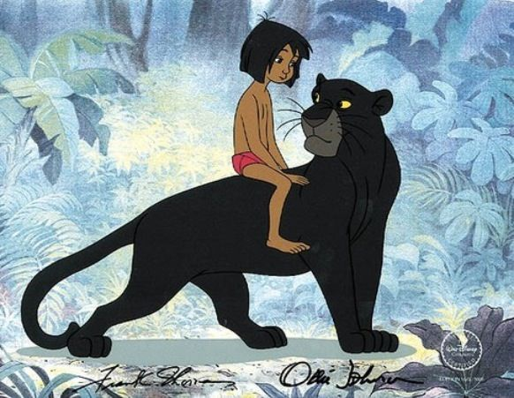
Lets recreate the jungle book with main verb
& helping verb…
Baloo and
Bagheera –
helping verbs
Main verb

Slide 3
Helping verbs
verbs which help the main verb to express a complete meaning is called as a helping verb.
Things that a helping verb does –
Helping verb helps a main verb to indicate the time of an action
It extends the meaning of the main verb
A helping verb is placed before the main verb
Lets us read the sentences given below –
The children are playing in the park.
We will complete our work today.
The words ‘are’ , ‘will’ gives us information about the time when actions of playing and completing take place.

Slide 4
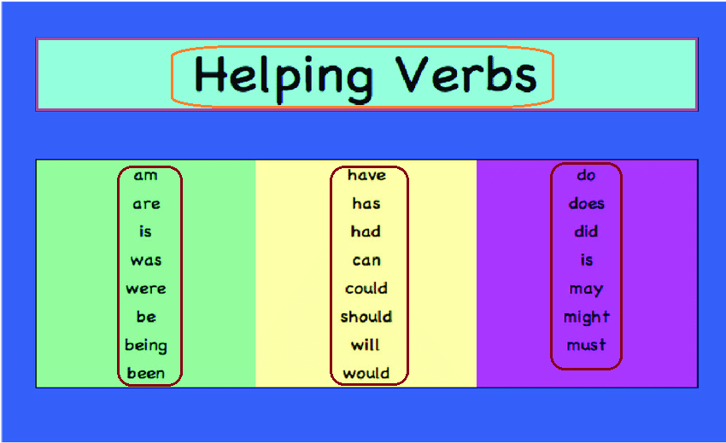
Examples of helping verbs –
Am does shall has
Been can will being
Have was be might
Is did should must
Do could would
Are were may

Slide 5
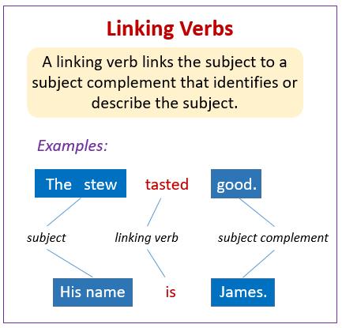

Slide 6
3. Fill in the blanks with the appropriate helping verbs from the box.
( is am are was were had )
Lisa __ painting pictures of animals.
We __ planning to take a bus to the zoo.
Ryan and his friends ___ talking about ghosts.
I __ taking part in the inter-school competition.
The team __ won three matches in a row.

Slide 7
ANSWERS
Lisa is painting pictures of animals.
We are planning to take a bus to the zoo.
Ryan and his friends were talking about ghosts.
I am taking part in the inter-school competition.
The team had won three matches in a row.

Slide 8
4.Read the following sentences. Write L against the sentence that has a linking verb and H against the sentence that has a helping verb.
Geeta is a student of Hyderabad Public school.
Our grandmother is making cookies.
Prem is helping his mother clean the cupboards now.
The sun was shining brightly in the east.
I was very young when we visited Kashmir.
H
H
H
L
L

Slide 9
5. Rearrange the words and use a correct linking or helping verb to form complete sentence.
a. a/Raghu/boy/clever
b. Raining/yesterday/it
c. completed/paper/Sunny/the
d. Tinky’s /not/uncle/well/today/feeling
Raghu is a clever boy.
It was raining yesterday.
Sunny had completed the paper.
Tinky’s uncle is not feeling well today.

Slide 10
e. My/best/you/friend
f. Kiran/Hyderabad/gone/to/weekend/for the
g. shifting/we/Chennai/to
h.in church/girls/the/Sunday/last
You are my best friend.
Kiran has gone to Hyderabad for the weekend.
We are shifting to Chennai.
The girls were in the church last Sunday.

Slide 11
walking/in the/Dhruv/park
j. I/to the/place/Earth/coldest/been/on
Dhruv was walking in the park.
I had been to the coldest place on Earth.

Slide 12
HOMEWORK
Extra Questions
Make sentences with the following helping verbs and linking verbs
Shall-
Been-
Might-
Was-
Were-
Did-

Slide 13
LEARNING OUTCOME
The children learn the use of helping verb and linking verb in different sentences.

Slide 14
THANKING YOU
ODM EDUCATIONAL GROUP

