Slide 1


SESSION : 1
CLASS : IV
SUBJECT : ENGLISH GRAMMAR
CHAPTER NUMBER: 7
CHAPTER NAME : HELPING AND LINKING VERBS
SUBTOPIC : Introduction with examples, Q.1,2,3

Slide 2

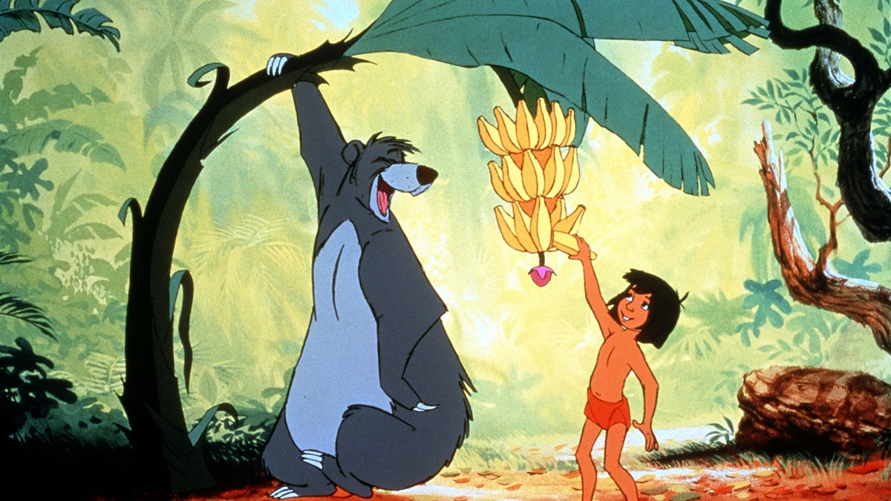
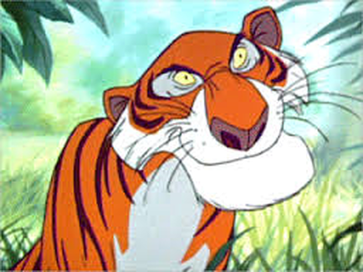

Lets recreate the jungle book with main verb
& helping verb…
Baloo and
Bagheera –
helping verbs
Main verb

Slide 3
Helping verbs
verbs which help the main verb to express a complete meaning is called as a helping verb.
Things that a helping verb does –
Helping verb helps a main verb to indicate the time of an action
It extends the meaning of the main verb
A helping verb is placed before the main verb
Lets us read the sentences given below –
The children are playing in the park.
We will complete our work today.
The words ‘are’ , ‘will’ gives us information about the time when actions of playing and completing take place.

Slide 4
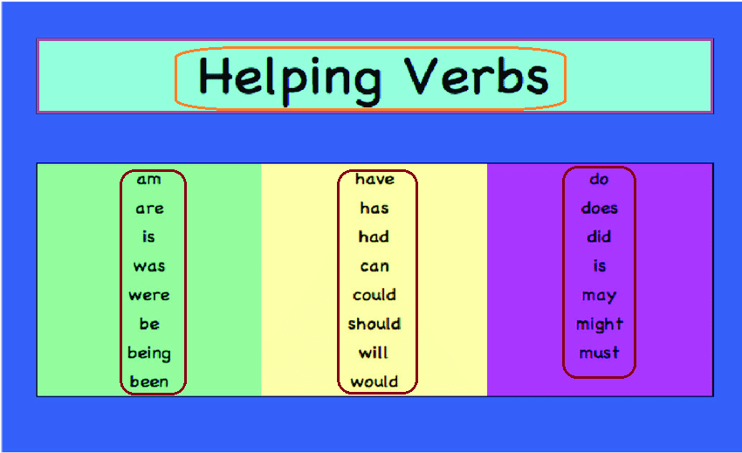
Examples of helping verbs –
Am does shall has
Been can will being
Have was be might
Is did should must
Do could would
Are were may

Slide 5
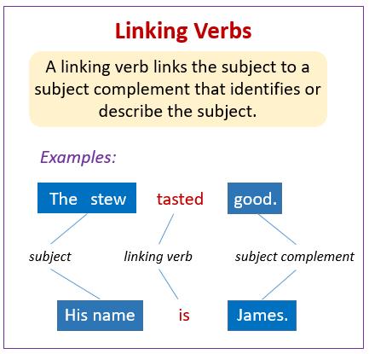

Slide 6
Underline the helping verbs and circle the linking verbs in the sentences given below.
Strong winds in this part of the village will uproot the trees.
Jenny’s friends were very polite.
The boxes are in the back of my truck.
Austin is talking to Mr. Jain.
The toy shop has a huge collection of toys.

Slide 7
ANSWERS
Strong winds in this part of the village will uproot the trees.
Jenny’s friends were very polite.
The boxes are in the back of my truck.
Austin is talking to Mr. Jain.
The toy shop has a huge collection of toys.

Slide 8
2. Fill in the blanks in each sentence with the correct linking verb from the box.
Arun ___ the last one to go up on the stage.
She will ___ happy if you gift her a storybook.
Harry ____ in a bad mood right now.
I ____ about to leave for the airport.
They ____ in Australia last month.
am is are was were be

Slide 9
ANSWERS
Arun was the last one to go up on the stage.
She will be happy if you gift her a storybook.
Harry is in a bad mood right now.
I am about to leave for the airport.
They were in Australia last month.

Slide 10
LEARNING OUTCOME
The children learn the use of helping verb and linking verb in different sentences.

Slide 11
THANKING YOU
ODM EDUCATIONAL GROUP

