Slide 1


SESSION : 3
CLASS : IV
SUBJECT : ENGLISH GRAMMAR
CHAPTER NUMBER: 6
CHAPTER NAME : ADVERBS OF FREQUENCY.
SUBTOPIC : Recapitulation,Q .5, 6

Slide 2
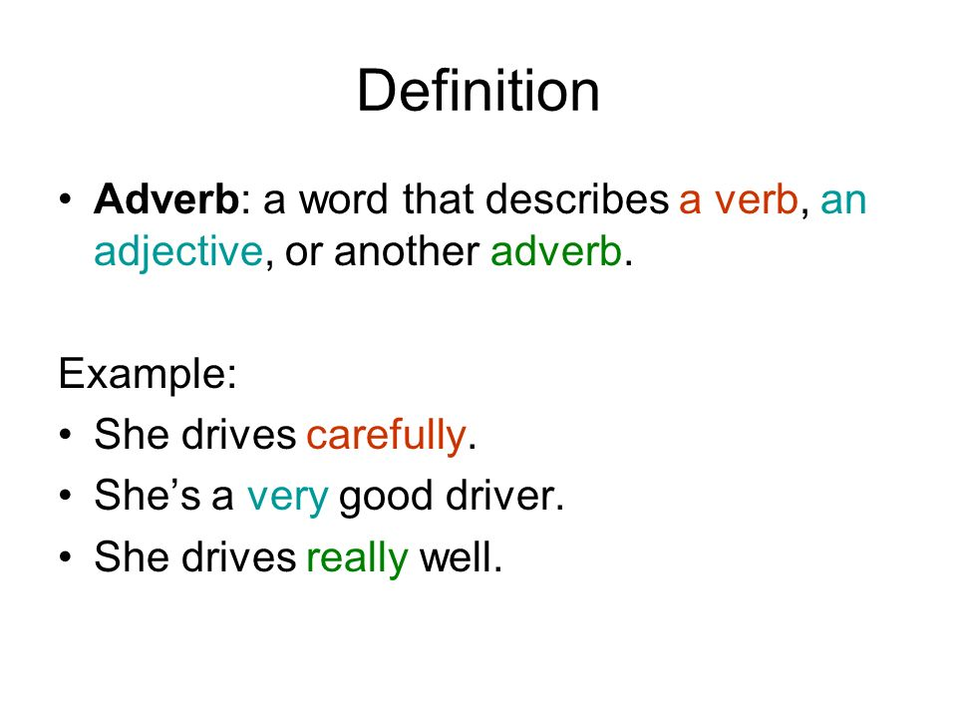
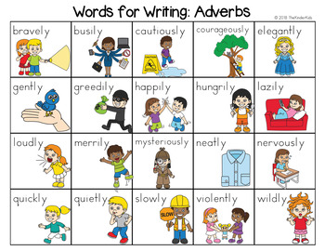

Slide 3
Adverbs of frequency
It talks about the frequency of an action, or how often something happens.
Ex- always , often , sometimes ,regularly, rarely, monthly,
weekly, never, seldom, yearly, ever, hardly
Adverbs of frequency have different positions in a sentence. These adverbs can be placed before the main verb.

Slide 4
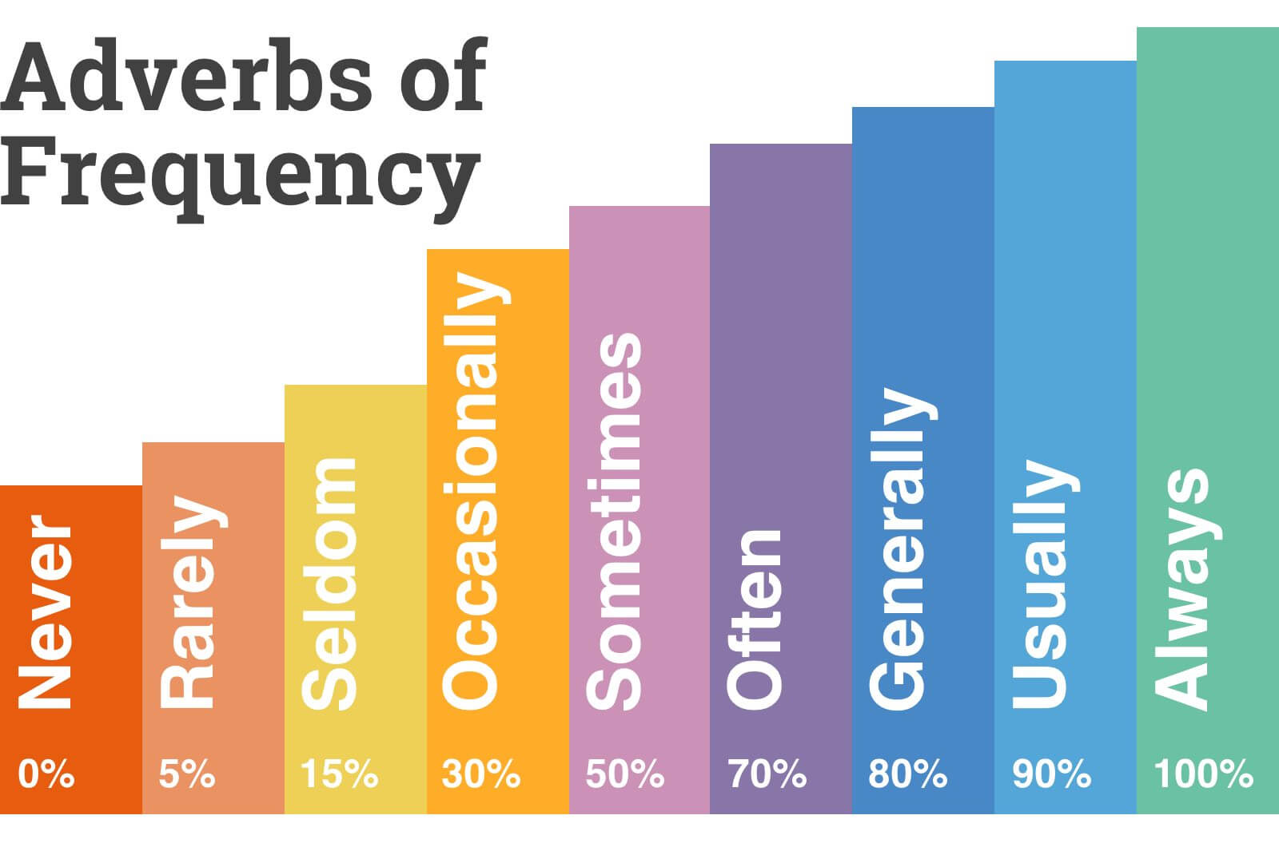
scale of adverbs in decreasing order of their frequency

Slide 5
5. Choose the correct adverbs of frequency from the box and complete the sentences. There could be more than one correct answer.
I am ___ late. I ___ arrive on time for school.
Sai is good at mathematics. He ___ scores more than 90.
I ___ eat at the restaurant across the street. They serve good food.
I ___ take a bus to school. I hate travelling by bus.
My uncle ___ allows me to take his dog out for walks. He is very sweet.
always usually often sometimes never rarely

Slide 6
ANSWERS
I am never late. I always arrive on time for school.
Sai is good at mathematics. He never scores more than 90.
I usually eat at the restaurant across the street. They serve good food.
I rarely take a bus to school. I hate travelling by bus.
My uncle sometimes allows me to take his dog out for walks. He is very sweet.

Slide 7
6. Given below are a few adverbs of frequency. Use them to make sentences , as per the instructions given in brackets.
rarely (use before the main verb)
always (use after am/is/are/was/were)
Regularly (use at the end of the sentence)
Seldom (use before the main verb)
Sometimes (use at the beginning of sentence)

Slide 8
ANSWERS
rarely (use before the main verb)
Ans – I rarely go for swimming classes these days.
b. always (use after am/is/are/was/were)
Ans- I am always ready for my football practice.
c. Regularly (use at the end of the sentence)
Ans- You should study regularly.
d. Seldom (use before the main verb)
Ans- She seldom watches TV in the afternoon.
e. Sometimes (use at the beginning of sentence)
Ans- Sometimes I go for a walk in the park.

Slide 9
EXTRA QUESTIONS
Put the adverbs of frequency in the right place.
He ____ listens to the radio.
_____ they read a book.
Peter ____ gets angry.
Tom is ____ very friendly.
Raman is ____ hungry in the evenings.
They ____ watch TV in the afternoon.
My sister is ____ punctual.
She is ____ too late for school.
I ____ see him.
I ____ see him these

Slide 10
EXTRA QUESTIONS ANSWERS
Put the adverbs of frequency in the right place.
He often listens to the radio.
Sometimes they read a book.
Peter never gets angry.
Tom is always very friendly.
Raman is often hungry in the evenings.
They seldom watch TV in the afternoon.
My sister is always punctual.
She is never too late for school.
I rarely see him.
I never see him these days.

Slide 11
LEARNING OUTCOME
The children learn the use of adverb of frequency in different sentences.

Slide 12
THANKING YOU
ODM EDUCATIONAL GROUP

