Slide 1


SESSION : 2
CLASS : IV
SUBJECT : ENGLISH GRAMMAR
CHAPTER NUMBER: 6
CHAPTER NAME : ADVERBS OF FREQUENCY.
SUBTOPIC : Recapitulation,Q .3,4

Slide 2
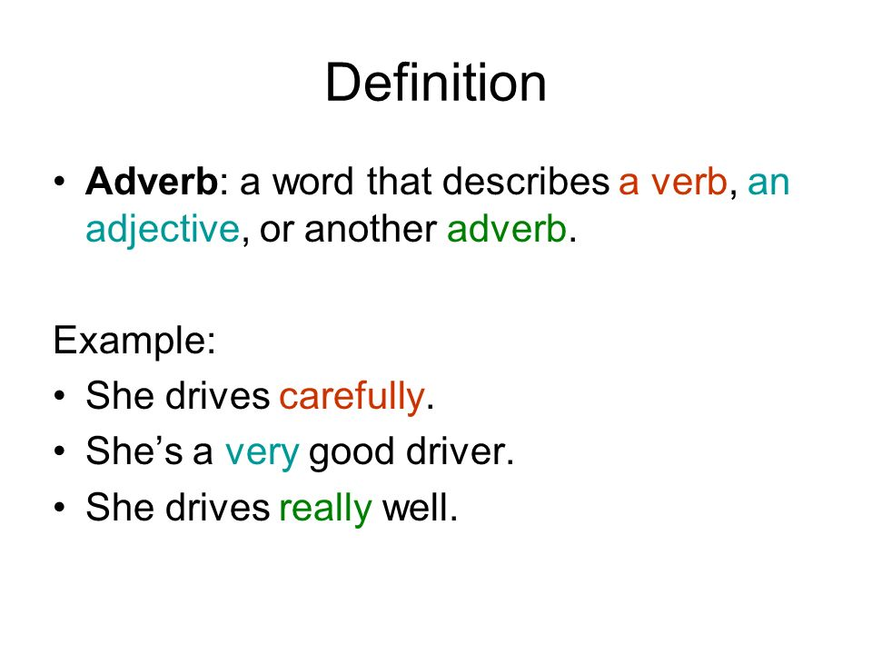
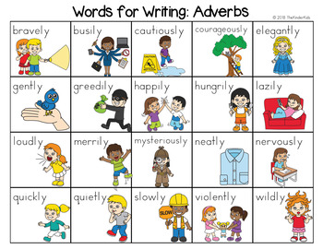

Slide 3
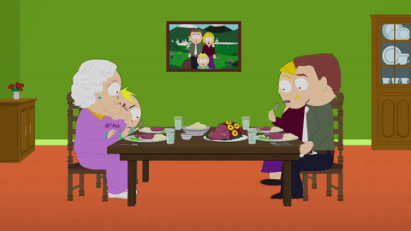
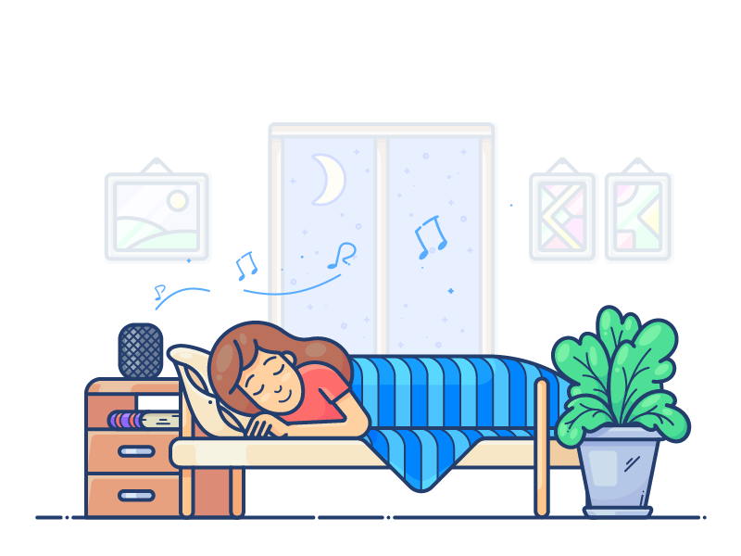
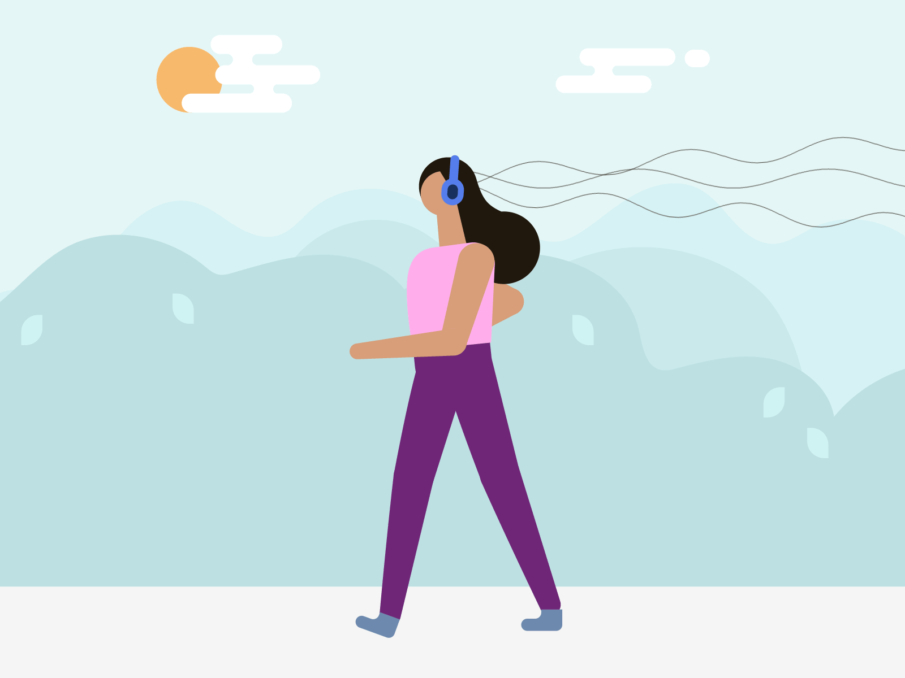
USUALLY
SOMETIMES
ALWAYS

Slide 4
Adverbs of frequency
It talks about the frequency of an action, or how often something happens.
Ex- always , often , sometimes ,regularly, rarely, monthly,
weekly, never, seldom, yearly, ever, hardly
Adverbs of frequency have different positions in a sentence. These adverbs can be placed before the main verb.

Slide 5
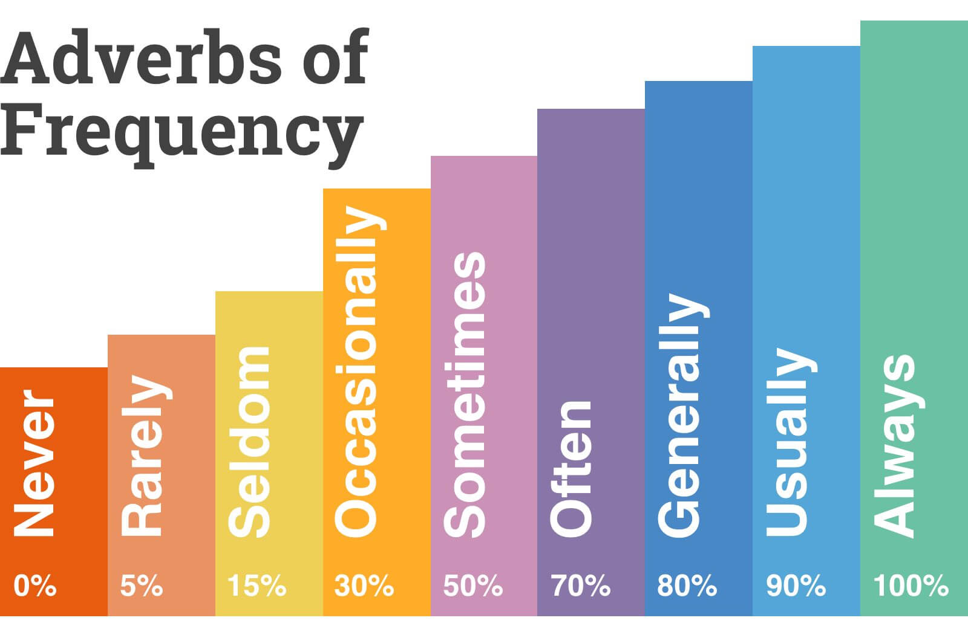
scale of adverbs in decreasing order of their frequency

Slide 6
3.Read the following sentences and circle the correct word order.
Sheila eats always/always eats with her group of friends.
Raju and Anirban always meet up/ meet up always to study together.
Anu seldom says/says seldom anything bad about anyone.
Sneha’s answers in class are right usually/usually right.
Rahul has always/always has his books with him.
Josh picks up sometimes/sometimes picks up his friends while going to school.

Slide 7
ANSWERS
Sheila eats always/always eats with her group of friends.
Raju and Anirban always meet up/ meet up always to study together.
Anu seldom says/says seldom anything bad about anyone.
Sneha’s answers in class are right usually/usually right.
Rahul has always/always has his books with him.
Josh picks up sometimes/sometimes picks up his friends while going to school.

Slide 8
4.Underline the adverbs of frequency in the passage below. Then arrange them in the decreasing order of their frequency.
This is Martha. She likes to stay active. She never goes to bed late and usually gets up early so that she can go out for a run. She sometimes goes swimming at the sports Centre. Often ,she rides her father’s old bicycle to her school. She is also a musician. Martha frequently attends music concerts in the city auditorium. She seldom watches TV because she likes doing things outside.

Slide 9
ANSWERS
This is Martha. She likes to stay active. She never goes to bed late and usually gets up early so that she can go out for a run. She sometimes goes swimming at the sports Centre. Often ,she rides her father’s old bicycle to her school. She is also a musician. Martha frequently attends music concerts in the city auditorium. She seldom watches TV because she likes doing things outside.
Order of frequency –
Usually, frequently, often , sometimes ,seldom , never

Slide 10
LEARNING OUTCOME
The children learn the use of adverb of frequency in different sentences.

Slide 11
THANKING YOU
ODM EDUCATIONAL GROUP

