Slide 1


SESSION : 1
CLASS : IV
SUBJECT : ENGLISH GRAMMAR
CHAPTER NUMBER: 6
CHAPTER NAME : ADVERBS OF FREQUENCY.
SUBTOPIC : INTRODUCTION WITH EXAMPLES

Slide 2
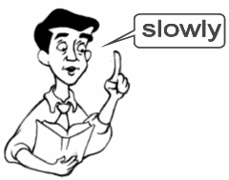

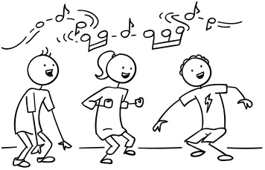
WHAT DOES THESE PICTURES SAY …….

Slide 3
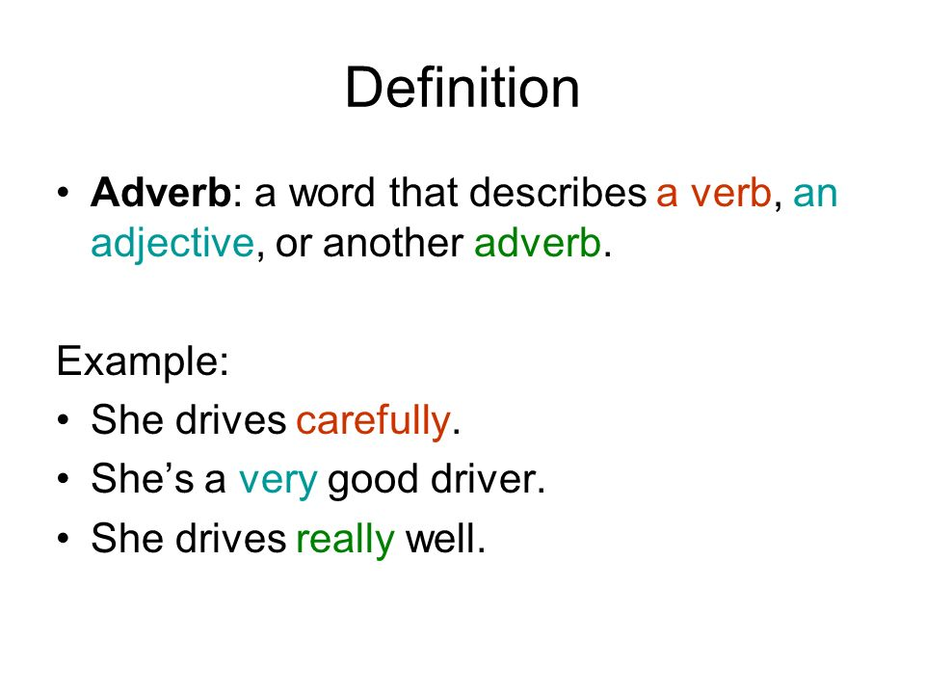
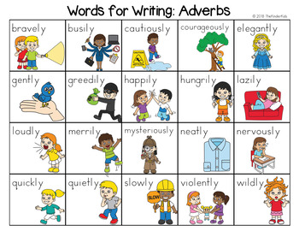

Slide 4
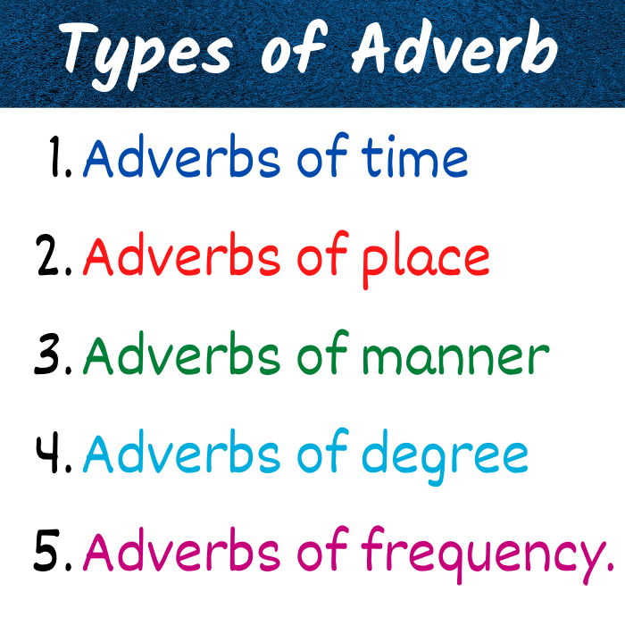

Slide 5
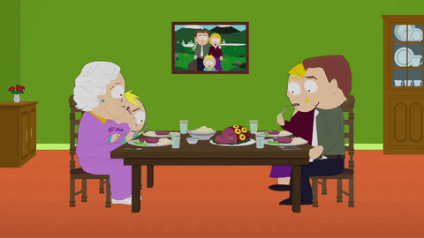
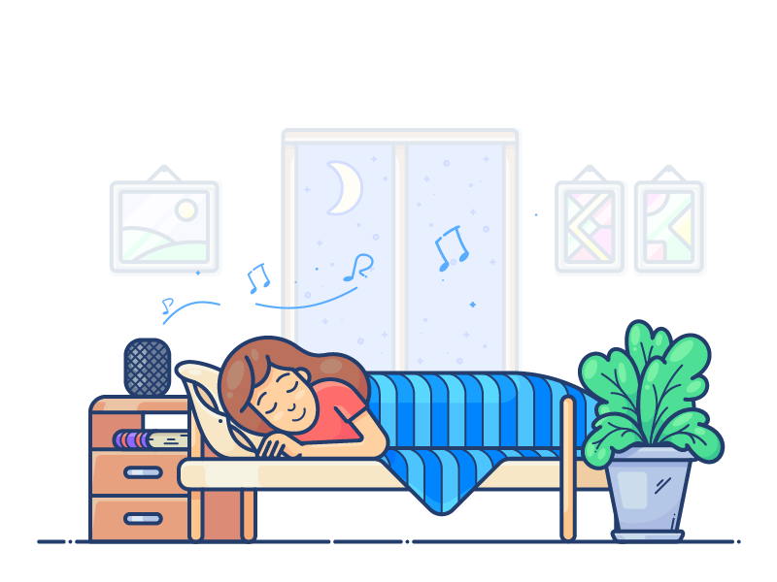

USUALLY
SOMETIMES
ALWAYS

Slide 6
Adverbs of frequency
It talks about the frequency of an action, or how often something happens.
Ex- always , often , sometimes ,regularly, rarely, monthly,
weekly, never, seldom, yearly, ever, hardly
Adverbs of frequency have different positions in a sentence. These adverbs can be placed before the main verb.

Slide 7
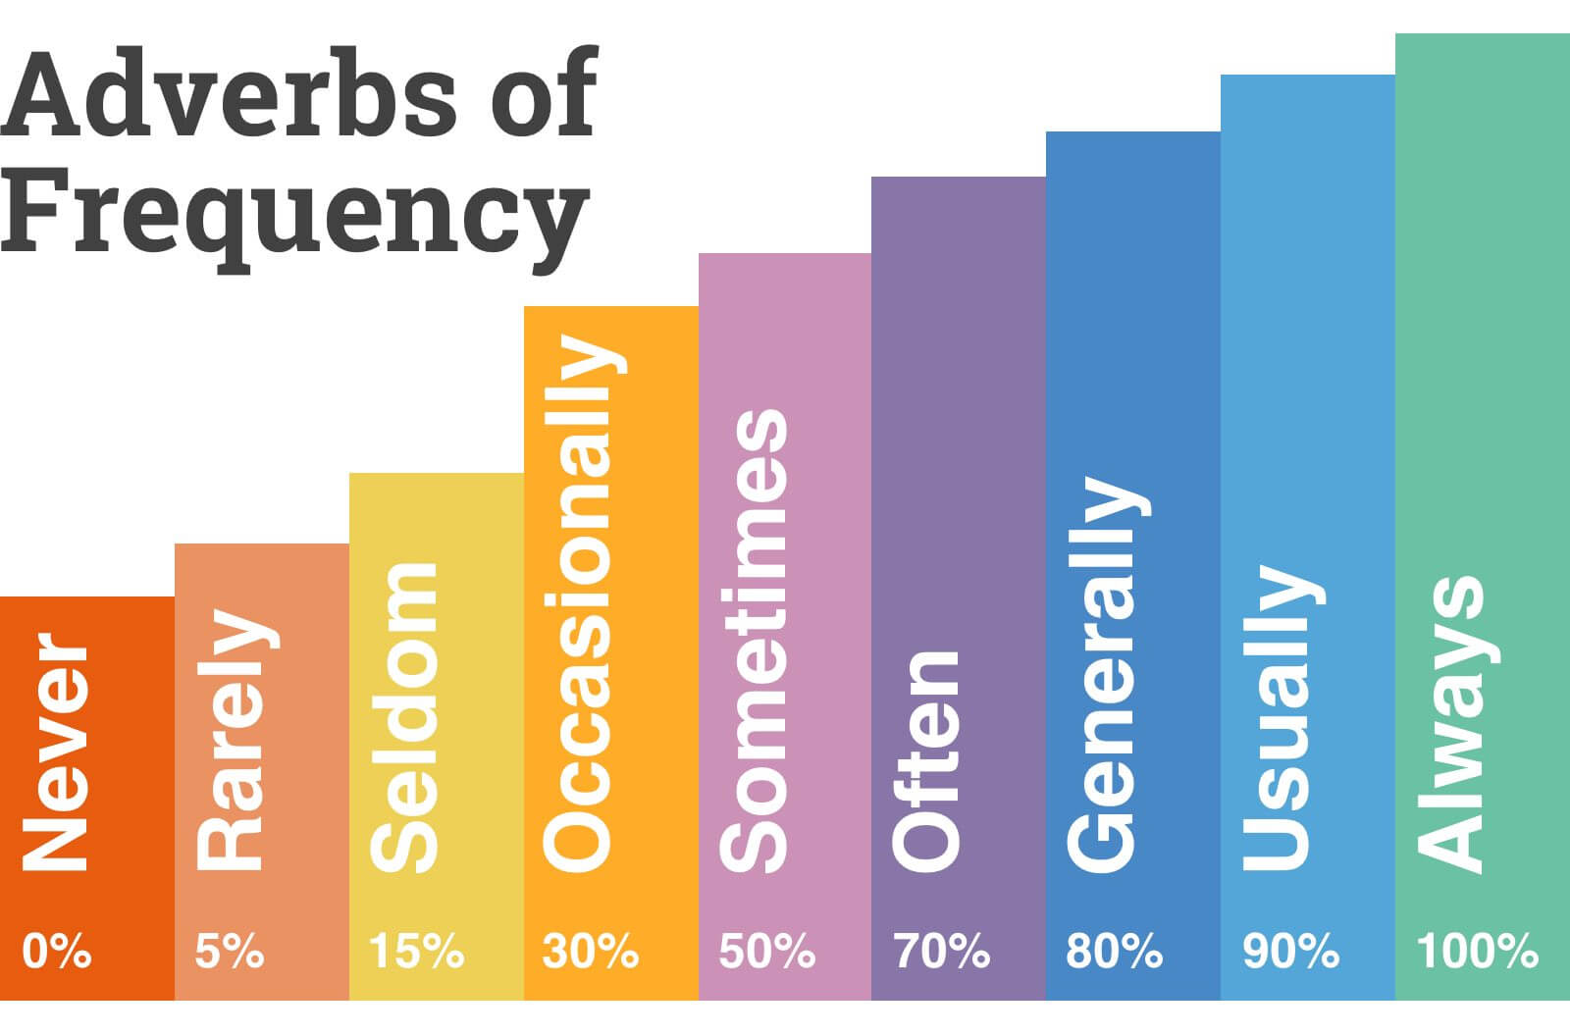
scale of adverbs in decreasing order of their frequency

Slide 8
1. Underline the adverbs of frequency in the sentences below.
Mohan rarely attends the music classes after school.
You should visit your dentist regularly.
I usually sleep early, but last night I stayed up late.
How often do you meet your friends?
I am not a professional sing. I sing occasionally.

Slide 9
ANSWERS
1. Underline the adverbs of frequency in the sentences below.
Mohan rarely attends the music classes after school.
You should visit your dentist regularly.
I usually sleep early, but last night I stayed up late.
How often do you meet your friends?
I am not a professional sing. I sing occasionally.

Slide 10
2.Circle the most appropriate adverb of frequency in each sentence.
Pritha amazes me. She is never/always so happy and lively.
I have frequently/never seen him come on time. He is always late.
Devika is a good student. Her answers in the English class are seldom/usually right.
Nurul and I had a fight in the second standard. I always/rarely talk to him now.
I seldom/often worry about the exams. I have studied well this year.

Slide 11
ANSWERS
2.Circle the most appropriate adverb of frequency in each sentence.
Pritha amazes me. She is never/always so happy and lively.
I have frequently/never seen him come on time. He is always late.
Devika is a good student. Her answers in the English class are seldom/usually right.
Nurul and I had a fight in the second standard. I always/rarely talk to him now.
I seldom/often worry about the exams. I have studied well this year.

Slide 12
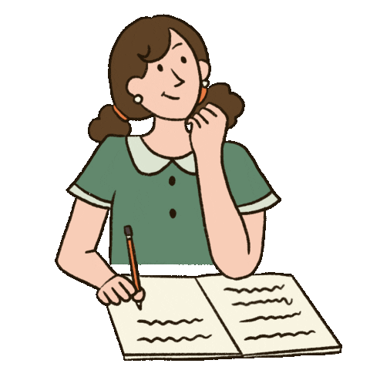
Read page no. 20, 21

Slide 13
LEARNING OUTCOME
The children learn the use of adverb of frequency in different sentences.

Slide 14
THANKING YOU
ODM EDUCATIONAL GROUP

