Slide 1


SESSION : 1
CLASS : IV
SUBJECT : ENGLISH GRAMMAR
CHAPTER NUMBER: 5
CHAPTER NAME : ORDER OF ADJECTIVES
SUBTOPIC : INTRODUCTION, Q. 1, 2

Slide 2
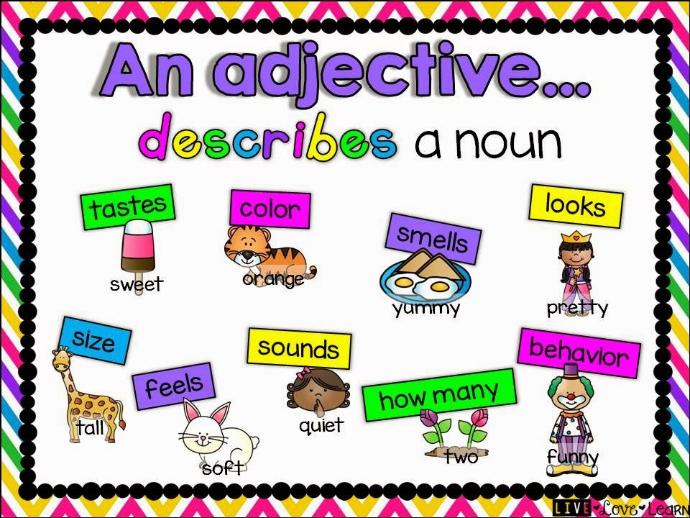

Slide 3
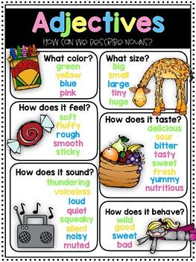
Adjectives are words that describe the color , number, size and quality of the nouns and pronouns they qualify.

Slide 4
Read these sentences carefully and circle the adjectives.
a. Five juicy yellow mangoes are kept on the table.
b. That little cute bunny is my favorite toy.
c. There is a big black dog on the porch.
d. My dad gifted me a big brown teddy bear on my birthday.
e. There is a small green parrot sitting on his shoulder.

Slide 5
f. This is an old beautiful wooden armchair.
g. It is an old nice building.
h. Raghu is a nice and intelligent boy.
i. She wore a lovely blue dress.

Slide 6
ANSWERS
a. Five juicy yellow mangoes are kept on the table.
b. That little cute bunny is my favorite toy.
c. There is a big black dog on the porch.
d. My dad gifted me a big brown teddy bear on my birthday.
e. There is a small green parrot sitting on his shoulder.

Slide 7
f. This is an old beautiful wooden armchair.
g. It is an old nice building.
h. Raghu is a nice and intelligent boy.
i. She wore a lovely blue dress

Slide 8
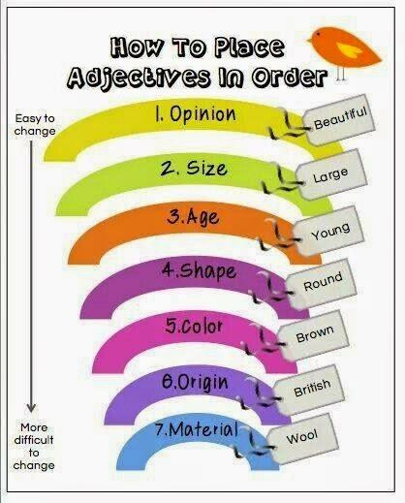

Slide 9
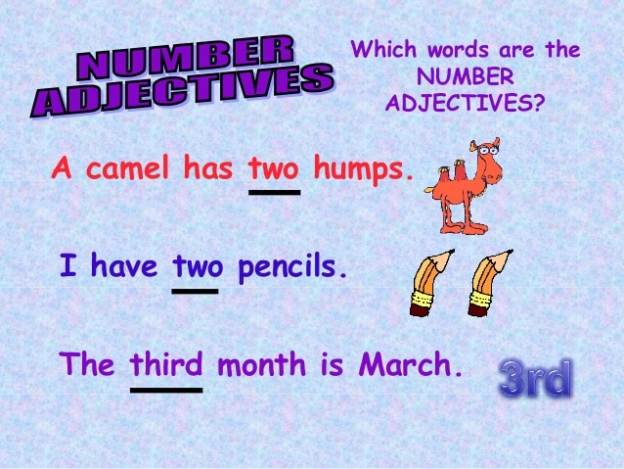
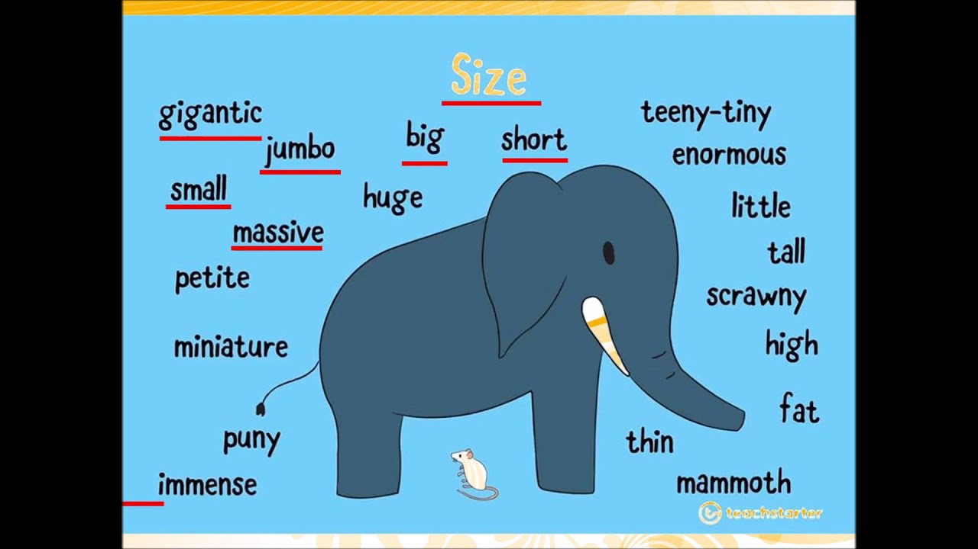

Slide 10
ORDER OF ADJECTIVES
Adjective of number
Adjective of size
Adjective of age
Adjective of shape or quality
Adjective of colour
Adjective of material

Slide 11
2. Tick the correct arrangement of adjectives in the following
sentences and add a comma , and (and) where necessary.
a. That large old steel / steel old large cupboard belonged to my grandfather.
Ans – That old,large and steel cupboard belonged to my grandfather.
b. Annabelle was a/an scary ancient /ancient scary doll.
Ans- Annabelle was a scary and ancient doll.
c. The ice cream was (creamy mouth watering/ mouth watering creamy).
Ans- The ice cream was creamy and mouth watering.
d. Reshma has a (brown fierce huge/huge fierce brown) dog.
Ans- Reshma has a huge ,fierce and brown dog.

Slide 12
e. Both Arnab and Rajesh got (paper long new/new long
paper) notebooks.
Ans -Both Arnab and Rajesh got new and long paper notebooks.
f. It is a (red beautiful/beautiful red) flower.
Ans - It is a beautiful and red flower.
g. Pooja’s sister has (thick black long/ long thick black ) hair.
Ans - Pooja’s sister has thick ,ling and black hair.

Slide 13

HOME WORK
Read pg. 15 & 16

Slide 14
LEARNING OUTCOME
The children learn the use of order of adjectives in different sentences.

Slide 15
THANKING YOU
ODM EDUCATIONAL GROUP

