Slide 1


SESSION : 2
CLASS : IV
SUBJECT : ENGLISH
CHAPTER NUMBER: 3
CHAPTER NAME : Distributive Adjective
SUBTOPIC : Recap, Q3

Slide 2
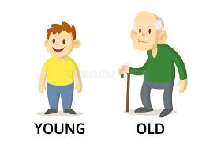
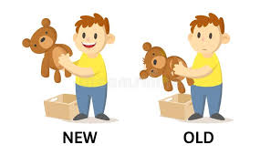
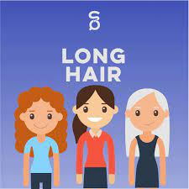
The girls have long hair.
Raju is young but grandpa is old.
John has a new toy, jimmy has an old toy.
The bold words are adjectives as they are describing the qualities or states of the nouns.

Slide 3
Each girl will get a chocolate.
He used to call me everyday.
I like neither of you.
Is there any money left?
Each, every, neither, any are referring to individual members of a group.
Adjectives that refer to individual members of a group are called distributive adjectives.
Some examples- each, every, neither, either, any, both etc.

Slide 4
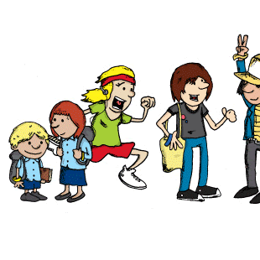
Each is used to describe and highlight an individual member of a group, or multiple individuals.
By using each you recognize the item is a part of a group, but that also needs to be pointed out as singular item.
Ex-
EACH PERSON IS WEARING A DIFFERENT COSTUME.

Slide 5

Every is used to the group as a collection of individual members.
Every cannot be used with plural nouns.
Every can express different points in a series, especially with time expressions.
Ex-
EVERY STUDENT IS ENCOURAGED TO PARTICIPATE IN DIFFERENT COMPETITIONS.

Slide 6
3. Identify the errors, if any, in the use of distributive adjectives in the following sentences. Rewrite the sentences correctly.
Each student gets a free book.
Neither orphan child needs care and support.
Every one of the answers is correct.
They gave a pen to either boy.
Neither student has to wear the uniform.

Slide 7
ANSWERS
Every student gets a free book.
Each orphan child needs care and support.
Each one of the answers is correct.
They gave a pen to each boy.
Every student has to wear the uniform.

Slide 8
LEARNING OUTCOME
The children learn the use of distributive adjective in different sentences.

Slide 9
THANKING YOU
ODM EDUCATIONAL GROUP

