Slide 1


SESSION: 1
CLASS : IV
SUBJECT : ENGLISH
CHAPTER NUMBER: 3
CHAPTER NAME : Distributive Adjective
SUBTOPIC : Introduction with examples pg. 9, 10

Slide 2
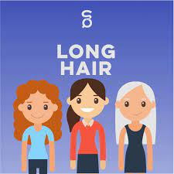
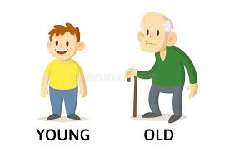
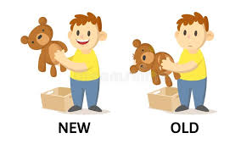
lets recap
The girls have long hair.
Raju is young but grandpa is old.
John has a new toy, jimmy has an old toy.
The bold words are adjectives as they are describing the qualities or states of the nouns.

Slide 3
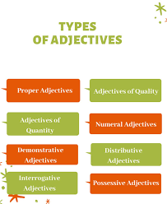
DISTRIBUTIVE ADJECTIVES

Slide 4
Each girl will get a chocolate.
He used to call me everyday.
I like neither of you.
Is there any money left?
Each, every, neither, any are referring to individual members of a group.
Adjectives that refer to individual members of a group are called distributive adjectives.
Some examples- each, every, neither, either, any, both etc.

Slide 5

Points to remember
Each: Each is used to refer to one specific
person of a group.
Every: Every is use to refer to each member of
a group.
Either: Either is used to refer to one or the other between two options.
Neither: Neither means that none of the option listed can be considered.

Slide 6
Q1. Underline the distributive adjectives in the sentence below
I have realized that neither bag is big enough.
Every body in this class wears a white shirt.
Either team may win.
Each group is to follow its leader.
My father has to go to the factory every day.
Every student in my class is intelligent.

Slide 7
LEARNING OUTCOME
The children learn the use of adverb of frequency in different sentences.

Slide 8
THANKING YOU
ODM EDUCATIONAL GROUP

