Slide 1


SESSION : 8
CLASS : III
SUBJECT : COMPUTER
CHAPTER NUMBER:5
CHAPTER NAME :EDITING TEXT IN MS WORD 2016
SUBTOPIC : Selecting the text using mouse and keyboard Inserting the text, Moving and copying the text

Slide 2

LEARNING OBJECTIVE:
To enable students to know about Selecting the text using mouse and keyboard Inserting the text, Moving and copying the text,.

Slide 3
Selecting the text using mouse
To select a word, double-click it.
To select a single line of text, click in the left margin next to the line.
To select a sentence, hold down [Ctrl] and then click anywhere in the sentence.
To select a paragraph, click three times in the paragraph. Alternatively, click twice in the left margin next to the paragraph.
To select the entire document, click three times in the left margin.

Slide 4
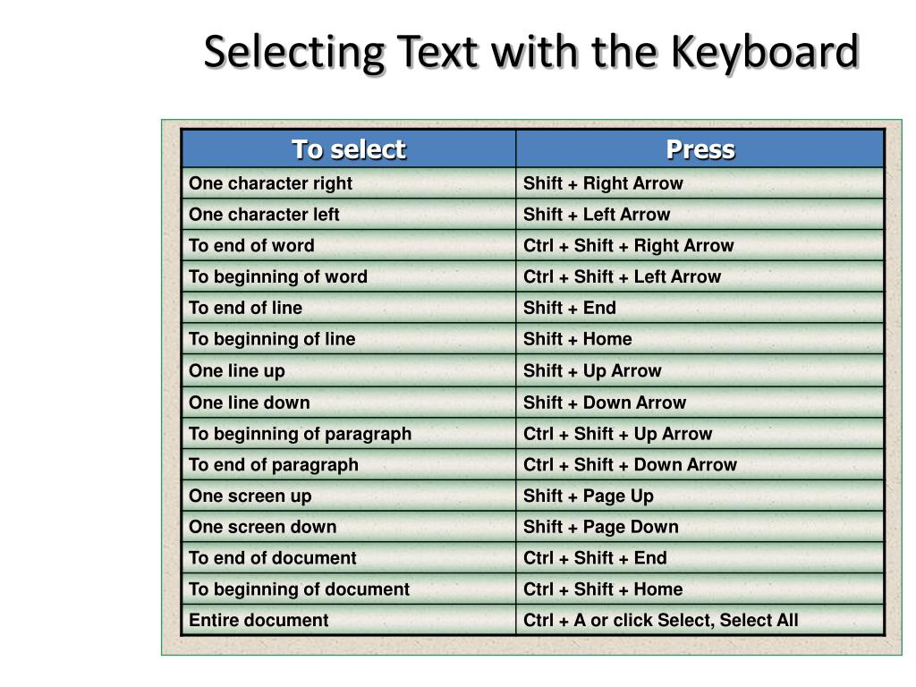

Slide 5
INSERTING THE TEXT
BY USING INSERT MODE
BY USING OVERTYPE MODE

Slide 6
MOVING THE TEXT
This feature is used to move the text from its original location to new location

Slide 7
COPYING THE TEXT
This feature is used to copy a text from one location to another within a document and also from one document to another.

Slide 8
DELETING THE TEXT
Using delete key
Using backspace key

Slide 9
LEARNING OBJECTIVE:
Students will learn about Selecting the text using mouse and keyboard Inserting the text, Moving and copying the text,.

Slide 10
THANKING YOU
ODM EDUCATIONAL GROUP

