Slide 1


SESSION : 8
CLASS : III
SUBJECT : COMPUTER
CHAPTER NUMBER:5
CHAPTER NAME :EDITING TEXT IN MS WORD 2016
SUBTOPIC :QUIZ

Slide 2

LEARNING OBJECTIVE:
To enable students to know about word 2016 through quiz
.

Slide 3
1.Which program manages all the jobs of a computer?
2.To arrange the icons on the desktop which mouse click will you do on the blank area.
3.Pressing windows key + D combination will minimize or maximize all the open windows.
4.To open the start menu, which key will you press?
5.The start screen of word 2016 is known as ?

Slide 4
Tell the use of these mouse pointers
Normal
Double headed arrow
Busy
Four headed arrow

Slide 5
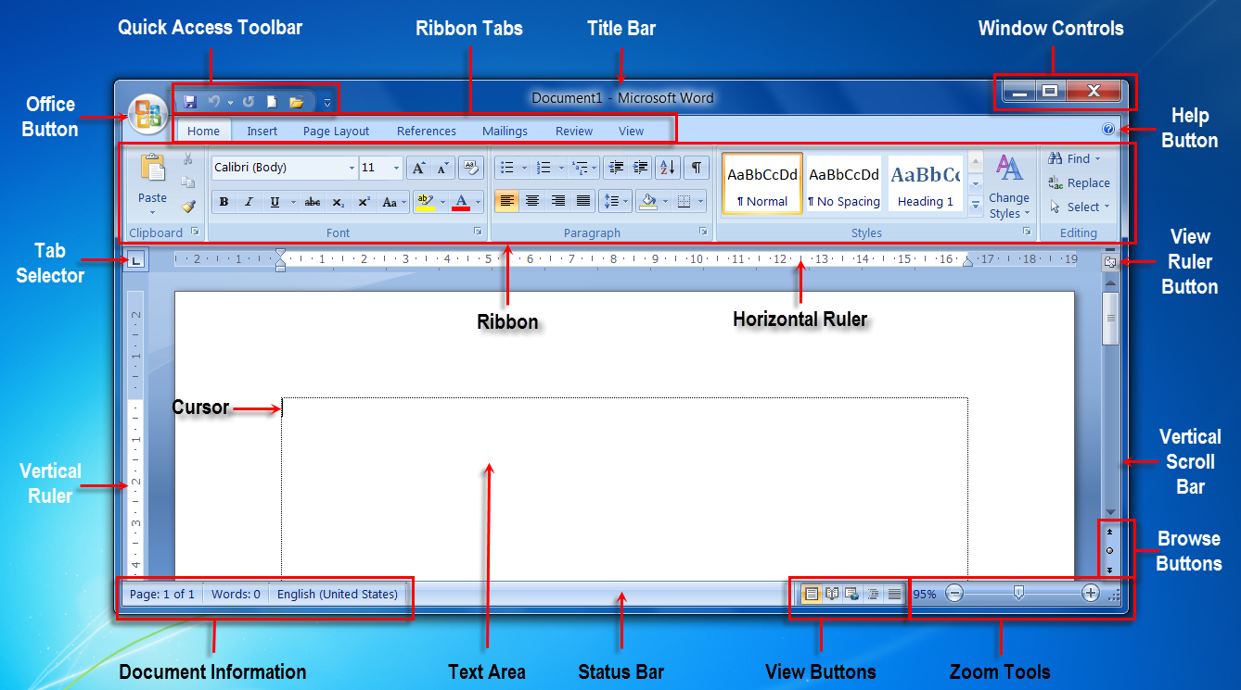
Identify the parts of Word 2016 window.

Slide 6
Who am I
Name the term used for the process of loading operating system.
Name the box that displays the preview of the screen saver.
Name the option that displays all the apps and programs in the computer.
Write the shortcut key combination to activate Task view.

Slide 7
LEARNING OBJECTIVE:
Students will get different types of questions about word 2016.

Slide 8
THANKING YOU
ODM EDUCATIONAL GROUP

