Slide 1


SESSION : 7
CLASS : III
SUBJECT : COMPUTER
CHAPTER NUMBER:5
CHAPTER NAME :EDITING TEXT IN MS WORD 2016
SUBTOPIC :START WORD 2016, ENTERING TEXT

Slide 2

LEARNING OBJECTIVE:
to enable students to know about how start word 2016, enter text.
.

Slide 3
Application based questions
Recapitulation
1. Adarsh wants to arrange all the icons on the desktop in alphabetical order. Suggest him the way to do so.
Ans:Right click in the blank area>>sort by>>Name
2. Karan working on many applications on his computer.By mistake he has clicked somewhere on the taskbar and all the opened windows have minimized.Which buttons has Karan clicked on?
Ans:Karan hasclicked on Peek button

Slide 4
Multiple choice questions
1.Which program manages all the jobs of a computer?
a.Operating system b.Desktop c.Screen saver
2.To arrange the icons on the desktop _____ click on the blank area.
a.Left b. Right c. Double
3.Pressing windows key + D combination _____ all the open windows.
Maximizes b. closes c. minimizes
4.To open the start menu, press the ______ key.
a. CTRL b.Windows c.ALT
√
√
√
√

Slide 5
Name the mouse pointers, which perform the following actions
For pointing, selecting, and dragging an item.
For resizing the picture.
It indicates that you have to wait because the computer is busy.
For moving pictures and toolbars.
Normal
Double headed arrow
Busy
Four headed arrow

Slide 6
Answer in one word
Name the term used for the process of loading operating system.
Name the box that displays the preview of the screen saver.
Name the option that displays all the apps and programs in the computer.
Write the shortcut key combination to activate Task view.
Booting
Preview box
Strat button
Windows logo key+ Tab key

Slide 7
Answer the following questions
1. Define the term Windows.
Ans: Windows is an operating system.
2.What is Desktop?
Ans: The first screen that appears with labelled pictures on it, is called Desktop.
3. What is Taskbar?
Ans: The long horizontal bar located at the bottom of the desktop is called as Taskbar.

Slide 8
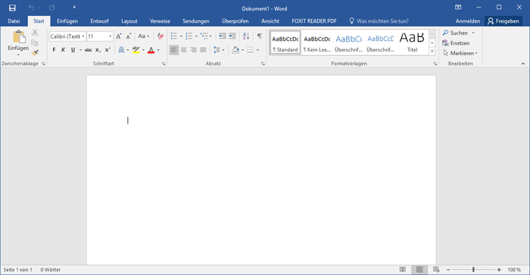

CW
Word 2016 is an application software which is used for word processing.

Slide 9
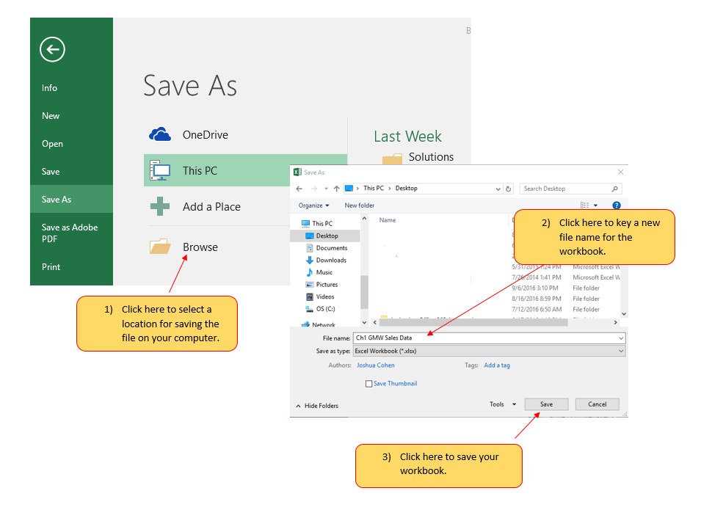
Start word 2016
The start screen of word 2016 is known as Backstage view.
Backstage view is the central location for managing the word documents.
To create a new document click on the blank document thumbnail .
The small blinking vertical line on the screen is known as Cursor.

Slide 10
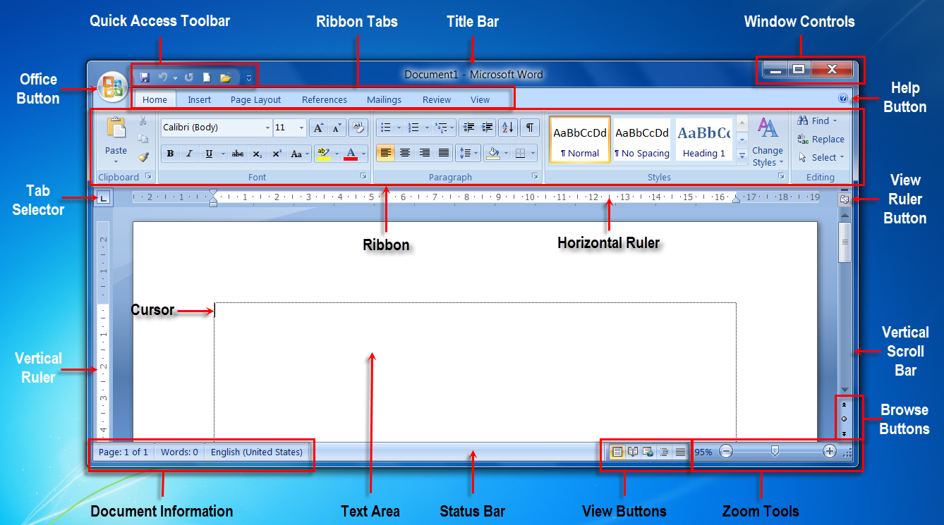
Parts of Word 2016 window.

Slide 11
While typing in a word, word wraps the text automatically.
Wrapping means if the text does not fit in the current line then word shifts it to the next line by default.

Slide 12
LEARNING OBJECTIVE:
Students will get knowledge about how start word 2016, enter text.

Slide 13
THANKING YOU
ODM EDUCATIONAL GROUP

