Slide 1


SESSION : 2
CLASS : III
SUBJECT : COMPUTER
CHAPTER NUMBER:3
CHAPTER NAME :TUX PAINT
SUBTOPIC : HAZE BRUSH, THE DIFFERENCE BETWEEN PAINT AND LINE TOOL, STAMP TOOL

Slide 2

LEARNING OBJECTIVE:
To enable students to know about different tools in Tux Paint.

Slide 3
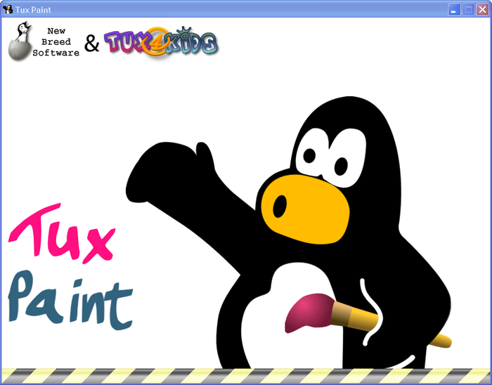
Tux Paint
It is an amazing drawing program for students.
It has a lot of creative tools, funny animations, and magical effects.

Slide 4
VINE BRUSH
Select the paint tool. Now you will see the brushes sub-tool box on the right hand side.
Select the filled circle shape and choose brown colour from the palette. Draw the trunk of a tree.
Scroll down and select the vine brush from the brushes sub-tool box. Now, select green colour from the colors palette.

Slide 5
HAZE BRUSH
Haze brush is a unique sub-tool that produces a hazy appearance.
Select the Paint tool , then choose the required colours to draw mountains, Sun, and river.
Now select the Haze brush and select light blue colour. Draw a few clouds in the sky..

Slide 6
CW
Paint tool | Lines tool
While selecting the paint tool, the pointer changes into a brush shape It is a free hand drawing tool The selected brush type pattern is directly drawn on the canvas | When lines tool is selected, the pointer changes in to cross hair(+) symbol. It draws only in the form of straight line. The pattern appears on canvas only after you complete the line and release the mouse button.

Slide 7
STAMP TOOL
It is an interesting tool, which you have already used in your previous class.
This tool is used to add readymade images as stamps. Tux paint already have some inbuilt stamps.
Additional stamps can be downloaded from the following web site ,

Slide 8
Home Work
Write the parts of the tux paint window.

Slide 9
LEARNING OBJECTIVE:
Students will know about Tux Paint and its features.

Slide 10
THANKING YOU
ODM EDUCATIONAL GROUP

