Slide 1


CLASS : 2
SESSION NO : 5
SUBJECT : MATHEMATICS
TOPIC: CH-7 DIVISION
SUB TOPIC:WORD PROBLEMS .
.

Slide 2

TODAY’S TOPIC
WORD PROBLEMS.
BOOK PAGE 75

Slide 3
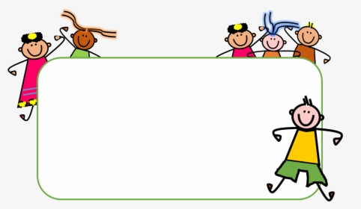



Slide 4
LET’S HAVE A RECAP
Long Division Method
6
2
Divide 78 by 3
3
7 8
_
6
1
8
_
1 8
0

Slide 5
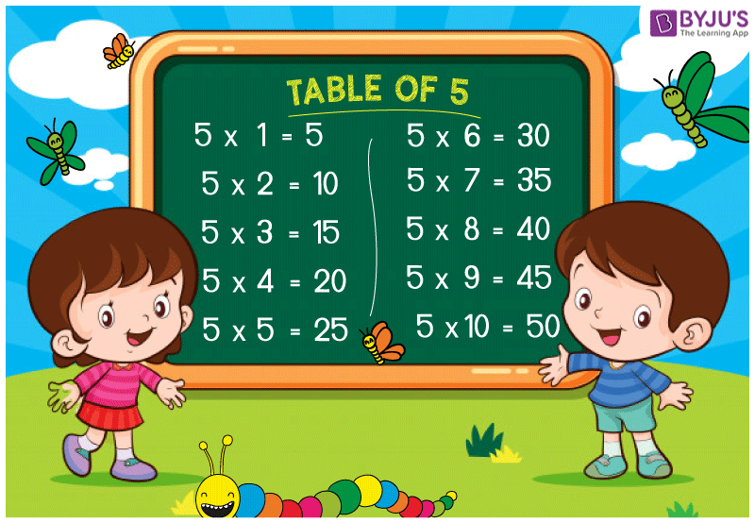
Divide 91 by 5
1
8
5
9 1
_
5
X
4
1
X
_
4 0
1

Slide 6
C.W
1.A book has 72 pages.There are 9 such books on a shelf.How many pages are there in all?.
1
Number of pages in one book = 72
7 2
Number of books on a shelf -9
x 9
6
4
8
So, there are 648 pages in all.

Slide 7
3 . An aeroplane carried 130 passengers on the first day,453 on the second day and 255 on the third day.how many passengers travelled by the plane on all three days ?.
1
Passengers carried on first day = 130
1 3 0
Passengers carried on second day =453
4 5 3
Passengers carried on third day =253
+
2 5 5
So, 838 passengers travelled by the plane on all three days.
8
3
8

Slide 8
5.Mary had 96 sweets.She gave six sweets to each of her friends.To how many friends did she give the sweets?.
Number of sweets = 96
) (
1
6
Number of sweets given to each friend = 6
96
6
-
6
3
6
So, She gave the sweets to her 16 friends.
-
3 6
0

Slide 9
7.There were 583 mango trees on a farm,but 286 trees fell down due to heavy rain.How many trees were left?.
4
17
13
Number of mango trees =583
5 8 3
Number of mango trees fell down =286
-
2 8 6
2
9
7
So, 297 trees were left.

Slide 10
SUB | HOME ASSIGNMENT
Mathematics | ________________________

Slide 11
THANKING YOU
ODM EDUCATIONAL GROUP

