Slide 1


CLASS : 2
SESSION NO : 04
SUBJECT : MATHEMATICS
TOPIC: CH-7 DIVISION
SUB TOPIC:LET US REVISE .
.

Slide 2

TODAY’S TOPIC
LET US REVISE.
BOOK PAGE 71

Slide 3
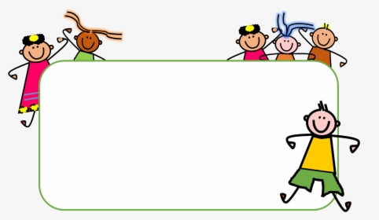



Slide 4
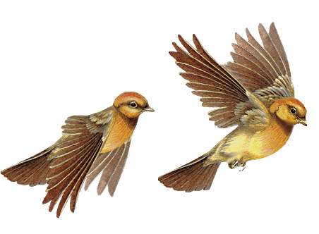

JUST HAVE A RECAP.
Put 8 birds equally into 4 branches.
8 ÷ 4=
2

Slide 5
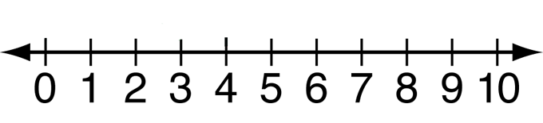
Today’s topic
Divide 8 by 4 using a number line.
2
8 ÷ 4 =_______
2
1

Slide 6
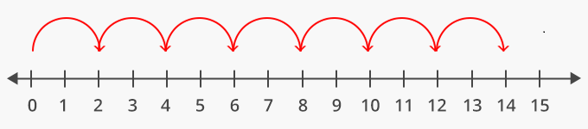
15÷5=
3
1
3
2

Slide 7
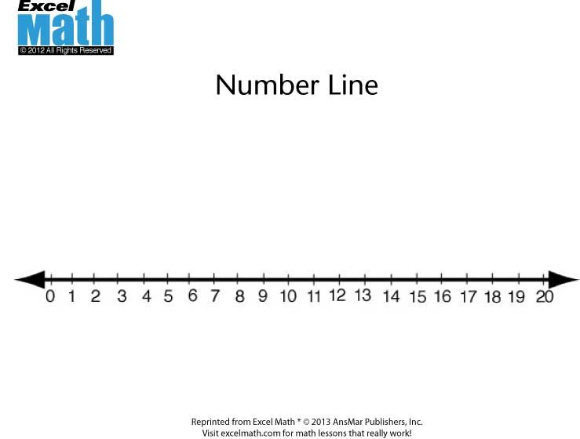
CW
Q5.In book page no -71
Divide 20 by 4 using a number line.
4
3
2
1
5
20 ÷ 4 = 5

Slide 8
Fill in the blanks( in note book)
8
40 ÷ 5=
8 × 5=
40
4
6. 24 ÷ 6=
× 6= 24
4
7
7. 35 ÷ 5=
× 5= 35
7

Slide 9
SUB | HOME ASSIGNMENT
Mathematics | ________________________

Slide 10
THANKING YOU
ODM EDUCATIONAL GROUP

