Slide 1


CLASS : 2
SESSION NO : 03
SUBJECT : MATHEMATICS
TOPIC: CH-7 DIVISION
SUB TOPIC:LET US REVISE .
.

Slide 2

TODAY’S TOPIC
LET US REVISE.
BOOK PAGE 70

Slide 3
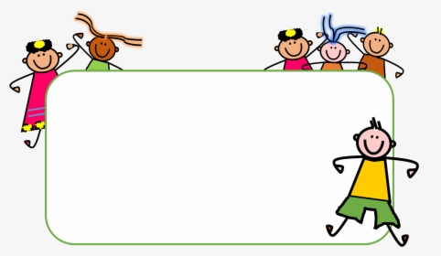



Slide 4
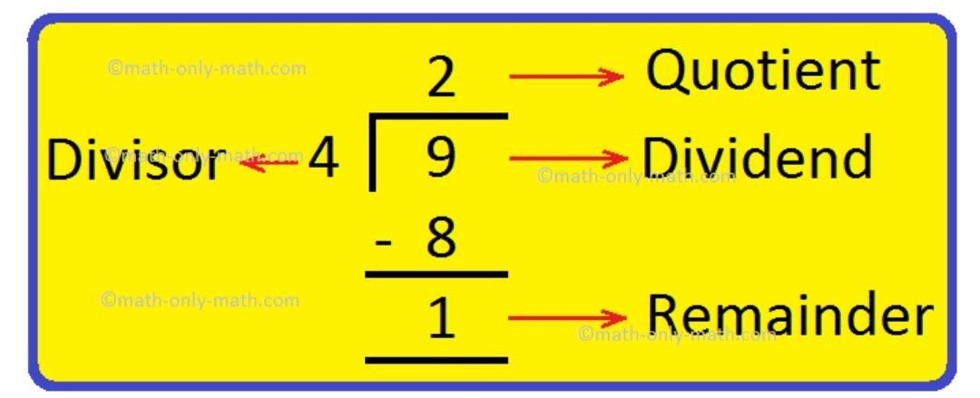
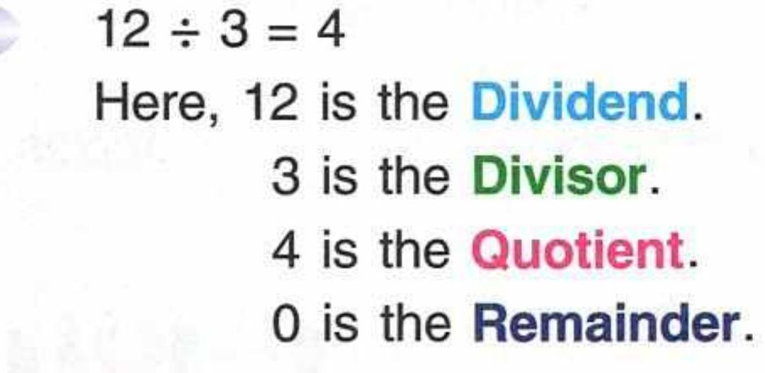
LET’S HAVE A RECAP
1.The number which we divide is called dividend.
2.The number by which we divide is called divisor.
3.The answer we get after dividing is called quotient.
4.The remaiming part at the end of the sum is called remainder.

Slide 5

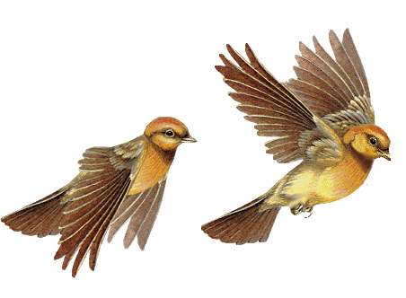
Today’s topic
ACTIVITY
Equally divided

Slide 6

Put 8 birds equally into 4 branches.
8 ÷ 4=
2

Slide 7

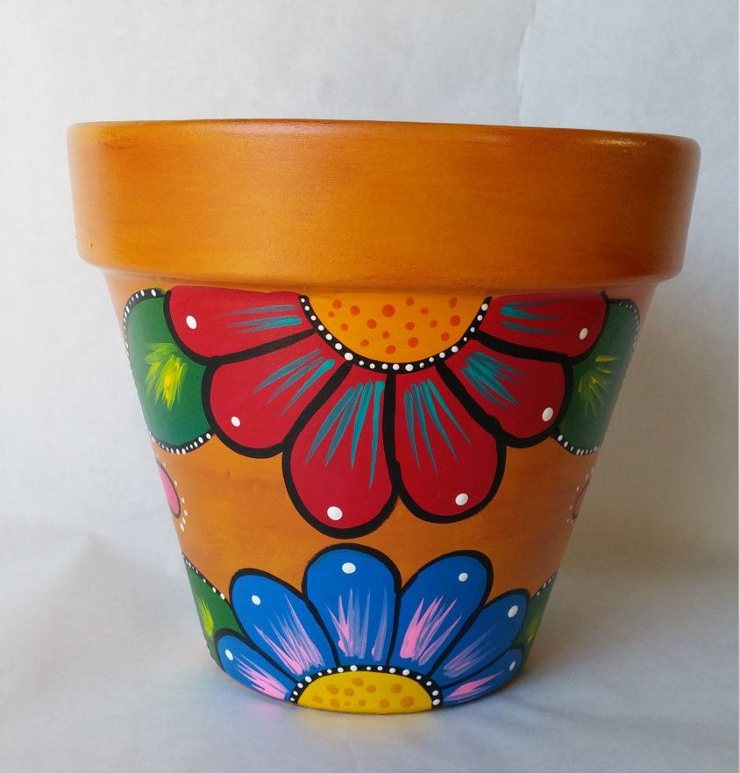
ACTIVITY
Put 10 flowers equally in 2 flower pots.How many flowers will be there in each pot?.
10÷2=5
5
5
Pot 2: _____ flowers
Pot 1: _____ flowers

Slide 8
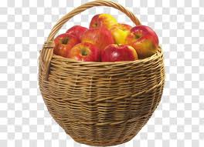

CW
1. A basket has 18 apples which are to be shared equally among 3 children. How many apples each child will get?
1 8
- 3
1
1 5
- 3
2
1 2
- 3
3
18 apples
9
- 3
4
6 - 3
5
6
3
- 3
Each child will get ______ apples each.
6
0

Slide 9
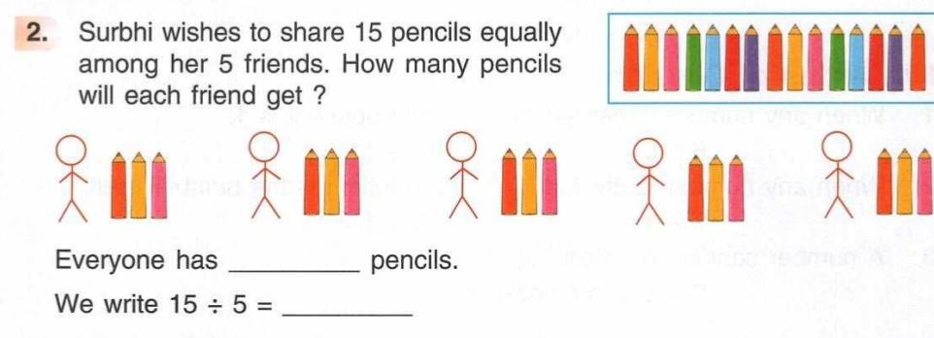
3
3

Slide 10
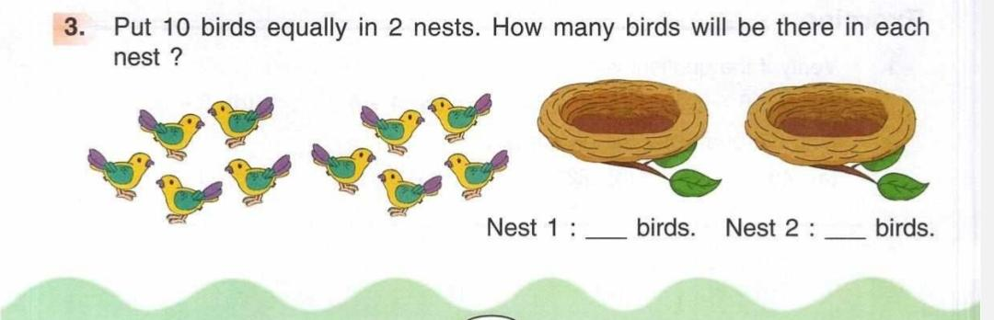
5
5

Slide 11
SUB | HOME ASSIGNMENT
Mathematics | ________________________

Slide 12
THANKING YOU
ODM EDUCATIONAL GROUP

