Slide 1


CLASS : 2
SESSION NO : 02
SUBJECT : MATHEMATICS
TOPIC: CH-7 DIVISION
SUB TOPIC:PROPERTIES OF DIVISION .
.

Slide 2

TODAY’S TOPIC
PROPERTIES OF DIVISION.

Slide 3
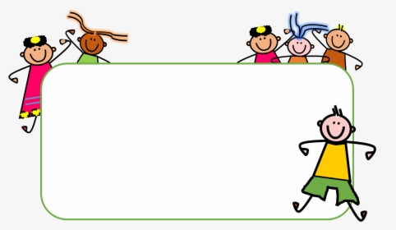



Slide 4
Division
Point to remember.
1.The number which we divide is called dividend.
2.The number by which we divide the dividend is called divisor.
3.The answer we get after dividing is called quotient.
4.The remaiming part at the end of the sum is called remainder.

Slide 5




LET’S HAVE A RECAP
6÷3=2

Slide 6
2
6 ÷ 3 = 2
3
6
6
0
DIVIDEND
DIVISOR
QUOTIENT
REMAINDER

Slide 7
Today’s topic
1.When any number is divided by itself,the quotient is 1.
15 ÷15=1
2.When any number is divided by 1, the quotient is the number itself.
15 ÷1=15
3.A number can not be divided by 0.
15 ÷0 is not possible.

Slide 8
CW
1.Verify if the quotient is 1.
a.6 ÷ 6 =
1
b.4 ÷ 4 =
1
2.Find the quotient if the divisor is 1.
a.45=
45 ÷ 1 = 45
b.22=
22 ÷ 1 = 22

Slide 9
SUB | HOME ASSIGNMENT
Mathematics | Draw /paste pictures of 15 ice-creams and distribute them equally in to 3 groups in notebook.

Slide 10
THANKING YOU
ODM EDUCATIONAL GROUP

