Slide 1


CLASS : 2
SESSION NO : 01
SUBJECT : MATHEMATICS
TOPIC: CH-7 DIVISION
SUB TOPIC:THE DIVISION IS REPEATED SUBTRACTION .
.

Slide 2

TODAY’S TOPIC
THE DIVISION IS REPEATED SUBTRACTION.

Slide 3
https://youtube.com/watch?v=5VaqKu0ENlY&feature=share

Slide 4






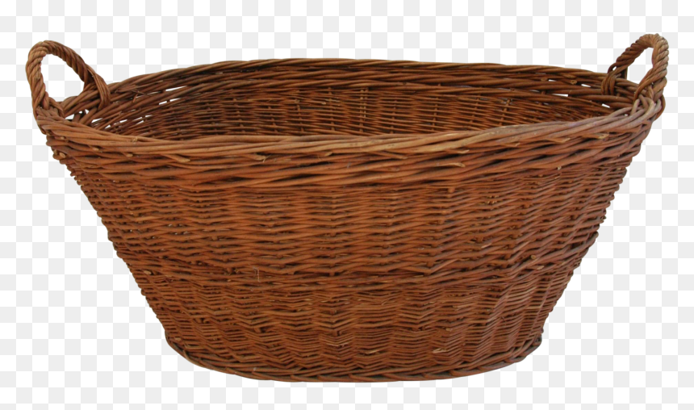
Introduction(Story based )
8 flowers

Slide 5
Equally distributed

Slide 6
6
Equal sharing
Repeated subtraction
4
=
2
-2
-2
-2
-2
8
0

Slide 7



DIVISION
2-2-2-2
8 4 = 2
Division is repeated subtraction.

Slide 8
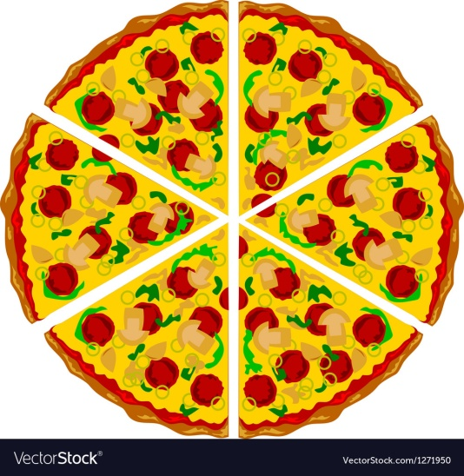


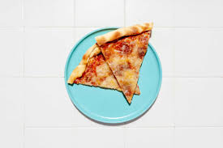
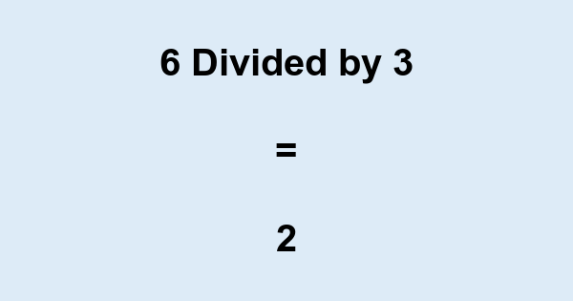
friends
Sammy

Slide 9
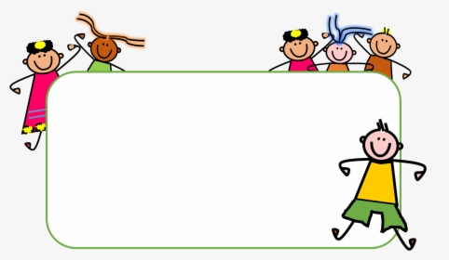
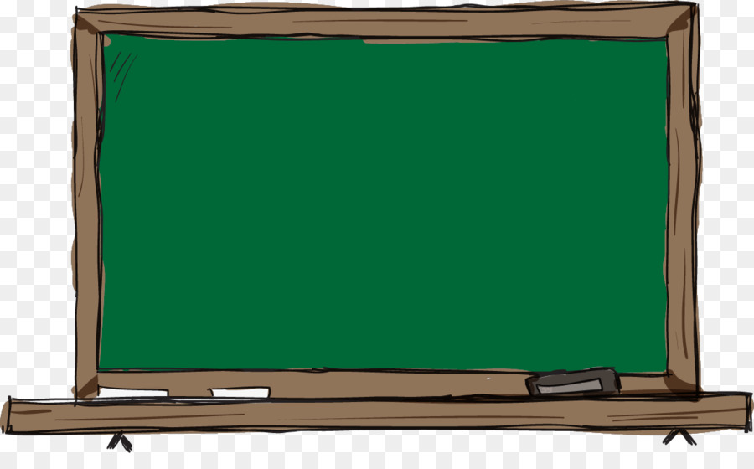
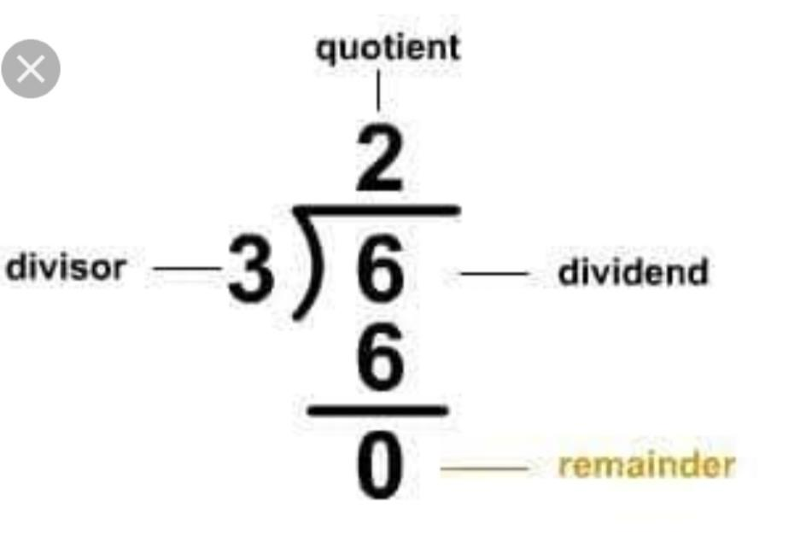
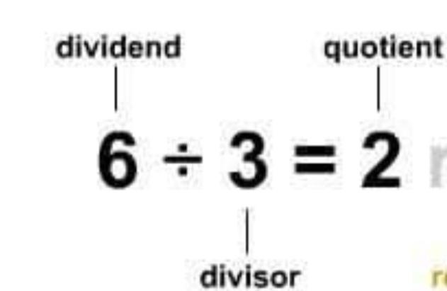
6 divided by 3 = 2
quotient
dividend
quotient
divisor
dividend
divisor
remainder

Slide 10
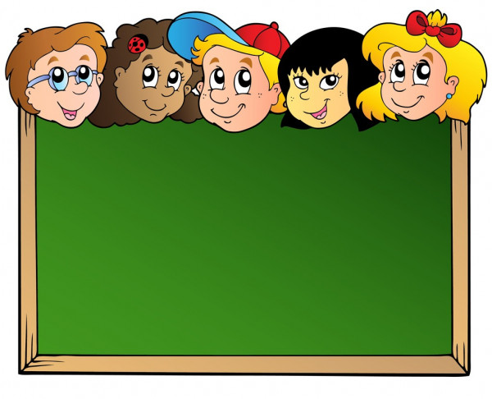
2
Quotient
3
6
Divisor
Dividend
_
6
0
Remainder

Slide 11


Slide 12
CW
Division
Point to remember.
1.The number which we divide is called dividend.
2.The number by which we divide the dividend is called divisor.
3.The answer we get after dividing is called quotient.
4.The remaiming part at the end of the sum is called remainder.

Slide 13
SUB | HOME ASSIGNMENT
Mathematics

Slide 14
THANKING YOU
ODM EDUCATIONAL GROUP

