Slide 1


MARKETING MANAGEMENT
SUBJECT : Business studies
CHAPTER NUMBER:11
CHAPTER NAME :Marketing Management
CLASS-72

Slide 2
Marketing Management
MARKET-Traditional View:
It refers to a place where the buyers and sellers meet each other for sale and purchase of the commodity.
MARKET-Modern View:
It refers to real and potential group of buyers and sellers of a product or service.
CUSTOMER: Refers to the people or entity that seeks satisfaction of their needs and wants.
MARKETER: A marketer refers to a person or entity who plays an active role in the process of marketing.

Slide 3
Marketing Management
MARKETING-CONCEPT:
It is a process of creating demand of a product or services in the market and satisfying the need of consumers by selling them goods or rendering services.
It starts before the production and continues after sales.
SELLING-CONCEPT:
The function of selling is related with promotion of goods and services through salesmanship, advertising, publicity and short-term incentives so that title of the product is transferred from seller to buyer.
Under it, product is converted into cash.

Slide 4
THANKING YOU
ODM EDUCATIONAL GROUP

Slide 5
MARKETING MANAGEMENT
SUBJECT : Business studies
CHAPTER NUMBER:11
CHAPTER NAME :Marketing Management
CLASS-73

Slide 6

Marketing Management
FEATURES OF MARKETING:
Needs and wants,
Market offering,
Customer value,
Customer satisfaction,
Exchange mechanism,
Feedback from customer,
After sale service.

Slide 7
Marketing Management
DIFFERENCE BETWEEN MARKETING AND SELLING:
S.N. | Basis of Difference | Marketing | Selling
1 | Part of the Process vs Wider Term | wider term | a part of the process of marketing
2 | Focus | on maximum satisfaction of the customer’s needs and wants | on affecting transfer of title and possession of goods from sellers to consumers or users
3 | Profit maximization | profit maximization through customer satisfaction | profit maximization through maximization of sales

Slide 8
Marketing Management
DIFFERENCE BETWEEN MARKETING AND SELLING:
S.N. | Basis of Difference | Marketing | Selling
4 | Start and End of the Activities | start much before the product is produced and continue even after the product has been sold | start after the product is produced and, finish with the sale of product
5 | Emphasis | on developing the product and other strategies as per the customer needs | on bending the customer according to the product
6 | Strategies | integrated marketing involving strategies in respect of product, promotion, pricing and physical distribution | involves efforts like promotion and persuasion

Slide 9
THANKING YOU
ODM EDUCATIONAL GROUP

Slide 10
MARKETING MANAGEMENT
SUBJECT : Business studies
CHAPTER NUMBER:11
CHAPTER NAME :Marketing Management
CLASS-74

Slide 11
Marketing Management
MARKETING MANAGEMENT: It deals with planning, organizing and controlling the activities related to the marketing of goods and services to satisfy the consumer’s wants.
NATURE:
Goal Oriented,
Appropriate Marketing Mix,
Functional Area of Management,
Specialized Job,
Marketing Concept in Action.

Slide 12
Marketing Management
MARKETING MANAGEMENT: It deals with planning, organizing and controlling the activities related to the marketing of goods and services to satisfy the consumer’s wants.
OBJECTIVES:
Creation of demand,
Market share,
Goodwill,
Profitable sales volume through customer satisfaction,
Determining marketing mix to satisfy customers,
Generating profits.

Slide 13
THANKING YOU
ODM EDUCATIONAL GROUP

Slide 14
MARKETING MANAGEMENT
SUBJECT : Business studies
CHAPTER NUMBER:11
CHAPTER NAME :Marketing Management
CLASS-75

Slide 15
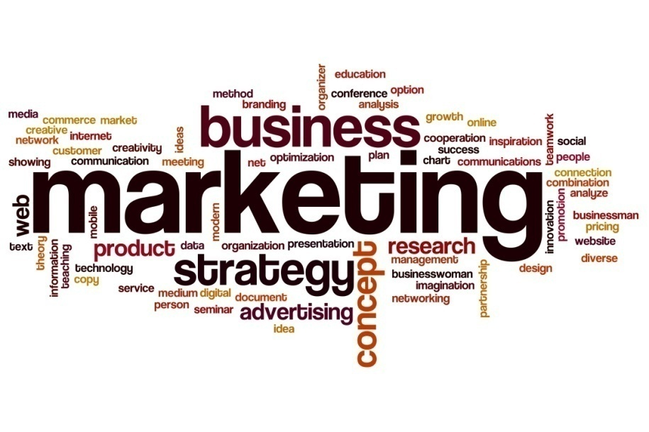
Marketing Management
MARKETING FUNCTIONS:
Market research,
Product planning and development,
Buying and assembling,
Storage and warehousing,
Transportation,
Marketing planning,
Standardization and grading,
Packaging and labeling,
Branding,
Pricing,
Promotion and selling,
Customer support services,
Risk taking.

Slide 16
THANKING YOU
ODM EDUCATIONAL GROUP

Slide 17
MARKETING MANAGEMENT
SUBJECT : Business studies
CHAPTER NUMBER:11
CHAPTER NAME :Marketing Management
CLASS-76

Slide 18
Marketing Management
MARKETING MANAGEMENT PHILOSOPHIES:
Production concept:
The focus of business activities is on production of goods.
It is believed that profits could be maximized by producing at large scale and reducing the average cost of production.
It is also assumed that consumers would favour those products which were widely available at an affordable price.
Thus, availability and affordability of the product is considered to be the key to the success of a firm.
Therefore, greater emphasis is placed on improving the production and distribution efficiency of the firms.

Slide 19
Marketing Management
MARKETING MANAGEMENT PHILOSOPHIES:
Product concept:
The focus of business activity is to bringing continuous improvement in the quality, incorporating new features etc.
Thus, product improvement is the key to profit maximization of a firm, under the concept of product orientation.
Selling concept:
Greater importance to attracting and persuading customers to buy the product.
It is assumed that the customers would not buy, or not buy enough, unless they are adequately convinced and motivated to do so.
Therefore, firms must undertake aggressive selling and promotional efforts to make customers buy their products.
The use of promotional techniques such as advertising, personal selling and sales promotion are considered essential for selling of products.

Slide 20
THANKING YOU
ODM EDUCATIONAL GROUP

Slide 21
MARKETING MANAGEMENT
SUBJECT : Business studies
CHAPTER NUMBER:11
CHAPTER NAME :Marketing Management
CLASS-77

Slide 22
Marketing Management
MARKETING MANAGEMENT PHILOSOPHIES:
Marketing concept:
Marketing orientation/concept implies that focus on satisfaction of customer’s needs is the key to the success of any organization in the market.
It assumes that in the long run an organization can achieve its objective of maximization of profit by identifying the needs of its present and prospective buyers and satisfying them in an effective way.
All the decisions in a firm are taken from the point of view of the customers.
The purpose of marketing is to generate customer value at a profit.

Slide 23
Marketing Management
MARKETING MANAGEMENT PHILOSOPHIES:
Societal marketing concept:
The societal marketing concept holds that the task of any organization is to identify the needs and wants of the target market and deliver the desired satisfaction in an effective and efficient manner so that the long-term well-being of the consumers and the society is taken care of.
Thus, the societal marketing concept is the extension of the marketing concept as supplemented by the concern for the long-term welfare of the society.
Apart from the customer satisfaction, it pays attention to the social, ethical and ecological aspects of marketing. There are large number of such issues that need to be attended.

Slide 24
THANKING YOU
ODM EDUCATIONAL GROUP

Slide 25
MARKETING MANAGEMENT
SUBJECT : Business studies
CHAPTER NUMBER:11
CHAPTER NAME :Marketing Management
CLASS-78

Slide 26
Marketing Management
MARKETING MIX-CONCEPT:
It refers to the combination of four basic elements of marketing i.e. product, price, promotion and place, also known as four P’s of marketing.
PRODUCT-CONCEPT/PRODUCT MIX: It refers the activities related to products and items that a particular seller offers to the market. It includes Branding, Trade mark, Packaging and Labeling.
BRANDING: It refers the process by which a specific identification is provided to a product or service.

Slide 27

Marketing Management
CHARACTERISTICS OF GOOD BRAND NAME:
Simple,
Short,
Meaningful,
Easily pronounceable,
Suggestive,
Distinctive.
ADVANTAGES OF BRANDING:
Helps in advertising,
Establishes permanent identify of the product,
Promotes repurchasing,
Competition becomes easier with the help of brand loyalty.

Slide 28
THANKING YOU
ODM EDUCATIONAL GROUP

Slide 29
MARKETING MANAGEMENT
SUBJECT : Business studies
CHAPTER NUMBER:11
CHAPTER NAME :Marketing Management
CLASS-79

Slide 30

Marketing Management
LABELING:
It refers the process under which a label is prepared to give brief information regarding the product.
FUNCTIONS OF LABELLING:
Identification,
Classification,
Promotion,
Information,
Legal requirement.

Slide 31
THANKING YOU
ODM EDUCATIONAL GROUP

Slide 32
MARKETING MANAGEMENT
SUBJECT : Business studies
CHAPTER NUMBER:11
CHAPTER NAME :Marketing Management
CLASS-80

Slide 33
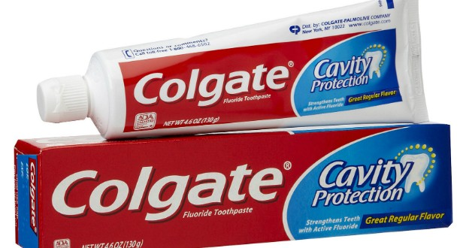
Marketing Management
PACKAGING:
It refers the process of designing and preparing containers in which products are packed.
FUNCTIONS OF PACKAGING:
Protection,
Identification,
Convenience,
Promotion.

Slide 34
THANKING YOU
ODM EDUCATIONAL GROUP

Slide 35
MARKETING MANAGEMENT
SUBJECT : Business studies
CHAPTER NUMBER:11
CHAPTER NAME :Marketing Management
CLASS-81

Slide 36
Marketing Management
PRICE: It is the amount on which the product or service is sold or bought.
PRICE MIX: It refers to a set of decisions that need to be taken into consideration before fixing price. Examples are company objectives, cost, competition, customer demand.
FACTORS DETERMINING PRICE:
Cost of production,
Demand for product,
Competition,
Purchasing power,
Government regulations,
Objective.

Slide 37
THANKING YOU
ODM EDUCATIONAL GROUP

Slide 38
MARKETING MANAGEMENT
SUBJECT : Business studies
CHAPTER NUMBER:11
CHAPTER NAME :Marketing Management
CLASS-82

Slide 39
Marketing Management
PHYSICAL DISTRIBUTION-CONCEPT/PLACE MIX: It refers to a set of decisions that need to be taken in order to make the product available to the consumers for purchase and consumption.
ACTIVITIES INVOLVED IN PHYSICAL DISTRIBUTION OF GOODS:
Transportation,
Inventory,
Warehousing,
Order processing.

Slide 40
Marketing Management
PHYSICAL DISTRIBUTION-CONCEPT/PLACE MIX: It refers to a set of decisions that need to be taken in order to make the product available to the consumers for purchase and consumption.
CHANNELS OF DISTRIBUTION/TYPES:
Direct channel / Zero level channel
Indirect channels:
One level: Manufacturer - Retailer
Two level: Manufacturer - Wholesaler - Retailer
Three level: Manufacturer - Agent – Wholesaler – Retailer

Slide 41
THANKING YOU
ODM EDUCATIONAL GROUP

Slide 42
MARKETING MANAGEMENT
SUBJECT : Business studies
CHAPTER NUMBER:11
CHAPTER NAME :Marketing Management
CLASS-83

Slide 43
Marketing Management
PHYSICAL DISTRIBUTION-CONCEPT/PLACE MIX: It refers to a set of decisions that need to be taken in order to make the product available to the consumers for purchase and consumption.
FACTORS AFFECTING THE CHOISE OF CHANNELS:
Value of product,
Nature of product,
Number of buyers,
Types of buyers,
Size of market,
Financial strength.

Slide 44
THANKING YOU
ODM EDUCATIONAL GROUP

Slide 45
MARKETING MANAGEMENT
SUBJECT : Business studies
CHAPTER NUMBER:11
CHAPTER NAME :Marketing Management
CLASS-84

Slide 46
Marketing Management
PROMOTION-CONCEPT/PROMOTION MIX: It is concerned with activities that are performed to promote sales.
ELEMENTS OF PROMOTION: Advertisement, Personal selling, Sales promotion and Public relations.
ADVERTISING-CONCEPT: It is the paid form of non-personal communication to promote ideas, goods or services by an identified sponsor.

Slide 47
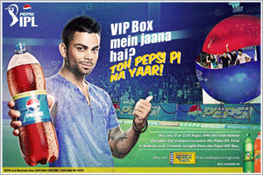
Marketing Management
ADVERTISING:
Features:
Paid form,
Impersonal presentation,
Speedy communication,
Identified sponsor.
OBJECTIONS AGAINST ADVERTISEMENT:
Adds to Costs,
Some Advertisements are in bad taste,
Undermines social values,
Confuses the buyers,
Encourages the sale of inferior goods.

Slide 48
THANKING YOU
ODM EDUCATIONAL GROUP

Slide 49
MARKETING MANAGEMENT
SUBJECT : Business studies
CHAPTER NUMBER:11
CHAPTER NAME :Marketing Management
CLASS-85

Slide 50

Marketing Management
ADVERTISING:
Merits:
Mass reach,
Enhance customer satisfaction,
Expressiveness,
Economical.
Limitations:
Less forceful,
Lack of feed-back,
Inflexibility,
Low effectiveness.

Slide 51
THANKING YOU
ODM EDUCATIONAL GROUP

Slide 52
MARKETING MANAGEMENT
SUBJECT : Business studies
CHAPTER NUMBER:11
CHAPTER NAME :Marketing Management
CLASS-85

Slide 53

Marketing Management
PERSONAL SELLING-CONCEPT: It involves face-to-face interaction between the seller and the prospective buyer.
Features:
Personal interaction,
Two way communication,
Better response,
Relationship.
QUALITIES OF A GOOD SALES MAN:
Physical Qualities – Personality, Stamina, Health, Tolerance.
Mental Qualities – Mental Alertness, Sharp Memory, Initiative, Imagination and Self Confidence.
Social Qualities – Sociability, Tact, Sound Character, Sweet Nature.
Vocational qualities – Knowledge of product, knowledge of competitive products, Training and Aptitude.

Slide 54
THANKING YOU
ODM EDUCATIONAL GROUP

Slide 55
MARKETING MANAGEMENT
SUBJECT : Business studies
CHAPTER NUMBER:11
CHAPTER NAME :Marketing Management
CLASS-86

Slide 56
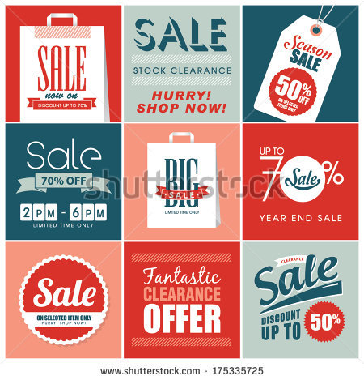
Marketing Management
SALES PROMOTION-CONCEPT: All marketing activities to increase the sale, other than advertising, personal selling and publicity come under sales promotion. These are done on short term basis to attract customers.
TECHNIQUES OF SALES PROMOTION:
Rebate,
Discount,
Refund,
Product combination,
Quantity gifts,
Instant draw and assigned gift,
Lucky draw,
Usable benefit,
Full finance,
Zero down payment,
Zero percent interest,
EMIs,
Free samples,
Contests.

Slide 57
THANKING YOU
ODM EDUCATIONAL GROUP

Slide 58
MARKETING MANAGEMENT
SUBJECT : Business studies
CHAPTER NUMBER:11
CHAPTER NAME :Marketing Management
CLASS-87

Slide 59

Marketing Management
PUBLIC RELATIONS-CONCEPT/MEANING: According to British Institute of Public Relations, ”Public relation is the deliberate, planned and sustained effort to establish and maintain mutual understanding between an organization and its public.”
ROLE OF PUBLIC RELATIONS:
More credible,
Less expensive,
Better Image,
Increases sales,
Attracts public,
Good relations.

Slide 60
THANKING YOU
ODM EDUCATIONAL GROUP

Slide 61
MARKETING MANAGEMENT
SUBJECT : Business studies
CHAPTER NUMBER:11
CHAPTER NAME :Marketing Management
CLASS-88

Slide 62

Marketing Management
PUBLIC RELATIONS-CONCEPT/MEANING: According to British Institute of Public Relations, ”Public relation is the deliberate, planned and sustained effort to establish and maintain mutual understanding between an organization and its public.”
PUBLIC RELATION TOOLS TO SHAPE THE PUBLIC IMAGE:
News,
Speeches and seminars,
Events and fares,
Written materials,
Public welfare activities,
Cultural activities.

Slide 63
THANKING YOU
ODM EDUCATIONAL GROUP

