Slide 1


FINANCIAL MANAGEMENT
SUBJECT : Business studies
CHAPTER NUMBER:9
CHAPTER NAME :Financial Management
CLASS-52

Slide 2
Financial Management
CONCEPT OF FINANCIAL MANAGEMENT:
It refers to efficient and effective acquirement and usage of business finance.
Business Finance:
Money required for carrying out business activities is called business finance.

Slide 3
Financial Management
ROLE OF FINANCIAL MANAGEMENT:
The size and the composition of fixed assets of the business
The quantum of current assets and its break-up into cash, inventory and receivables
The amount of long-term and short term funds to be used
Break-up of long-term financing into debt, equity etc
All items in the Profit and Loss Account, e.g., Interest, Expense, Depreciation, etc.

Slide 4
THANKING YOU
ODM EDUCATIONAL GROUP

Slide 5
FINANCIAL MANAGEMENT
SUBJECT : Business studies
CHAPTER NUMBER:9
CHAPTER NAME :Financial Management
CLASS-53

Slide 6
Financial Management
OBJECTIVES OF FINANCIAL MANAGEMENT:
Maximization of shareholders’ wealth is the main objective of financial management.
Shareholders’ wealth increases with the increase of market value of equity shares.
Market value of equity shares depends upon various financial decisions taken by management.
FINANCIAL DECISIONS:
INVESTMENT DECISION,
FINANCING DECISION AND
DIVIDEND DECISION.

Slide 7
Financial Management
INVESTMENT DECISION:
It is related with investment of funds in different assets of the organization.
Decision for investment in fixed assets is called long-term investment decision and for investment in current assets is called short-term investment decision.
A long-term investment decision is also called a Capital Budgeting decision.
Short-term investment decision comes under working capital management.

Slide 8
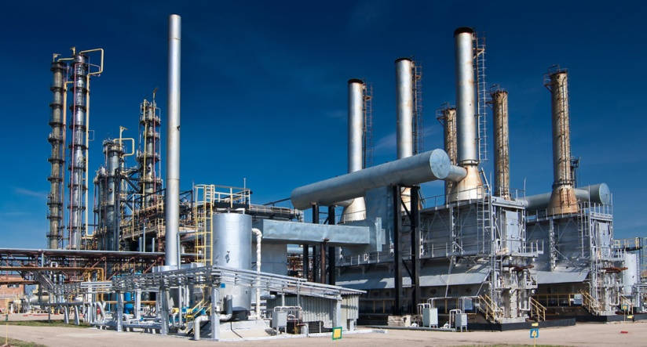
Financial Management
FACTORS AFFECTING INVESTMENT DECISION:
Cash Flows of the Project,
Rate of Return,
Investment Required,
Availability of Funds,
Rate of Interest,
Risk Involved.

Slide 9
THANKING YOU
ODM EDUCATIONAL GROUP

Slide 10
FINANCIAL MANAGEMENT
SUBJECT : Business studies
CHAPTER NUMBER:9
CHAPTER NAME :Financial Management
CLASS-54

Slide 11
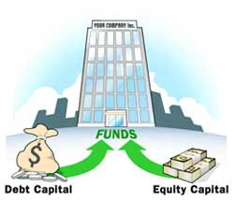
Financial Management
FINANCING DECISION:
It is related with selection of long term sources of funds to be acquired. Funds may be arranged either from equity(owned funds) or from debts(borrowed funds).
FACTORS AFFECTING FINANCING DECISION:
Cost,
Risk,
Floatation Costs,
Cash Flow Position of the Business,
Level of Fixed Operating Costs,
Control Considerations,
State of Capital Markets
JNV FRIENDS LTD.

Slide 12
THANKING YOU
ODM EDUCATIONAL GROUP

Slide 13
FINANCIAL MANAGEMENT
SUBJECT : Business studies
CHAPTER NUMBER:9
CHAPTER NAME :Financial Management
CLASS-55

Slide 14

Financial Management
DIVIDEND DECISION:
It is related with the decision regarding appropriation of profit earned by company.
How much of the profits is to be distributed to the shareholders and how much of it should be retained in the business for meeting the investment requirements.

Slide 15
Financial Management
FACTORS AFFECTING DIVIDEND DECISION:
Earnings,
Growth Opportunities,
Cash Flow Position,
Shareholders’ Preference,
Taxation Policy,
Stock Market Reaction,
Access to Capital Market,
Legal Constraints,
Contractual Constraints.

Slide 16
THANKING YOU
ODM EDUCATIONAL GROUP

Slide 17
FINANCIAL MANAGEMENT
SUBJECT : Business studies
CHAPTER NUMBER:9
CHAPTER NAME :Financial Management
CLASS-56

Slide 18
Financial Management
FINANCIAL PLANNING-CONCEPT:
It is the preparation of financial blueprint of an organization’s future operations.
The objective of financial planning is to ensure that enough funds are available at right time.
OBJECTIVES:
To ensure availability of funds whenever required,
To see that the firm does not raise resources unnecessarily.

Slide 19
Financial Management
FINANCIAL PLANNING-IMPORTANCE:
Prepares to face the future,
Helps in avoiding business shocks and surprises,
Helps in coordinating various business functions,
Reduces waste and duplication of efforts,
Tries to link the present with the future,
Provides a link between investment and financing decisions on a continuous basis,
Makes the evaluation of actual performance easier.

Slide 20
THANKING YOU
ODM EDUCATIONAL GROUP

Slide 21
FINANCIAL MANAGEMENT
SUBJECT : Business studies
CHAPTER NUMBER:9
CHAPTER NAME :Financial Management
CLASS-57

Slide 22
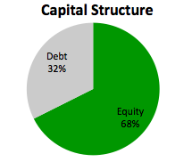
Financial Management
CAPITAL STRUCTURE-CONCEPT:
Capital structure refers to the proportion between owners’ fund and borrowed funds (long term).
Capitalization: It is the sum total of owners’ funds and borrowed funds (long term).
Financial Structure: It includes all long term and short term sources of funds.

Slide 23
Financial Management
FINANCIAL LEVERAGE/CAPITAL GEARING:
Use of fixed charge bearing securities (debt, preference share capital) in the capital structure of the company is called financial leverage or capital gearing.
More use of debt or preference capital increases financial leverage/capital gearing.
TRADING ON EQUITY
Increasing the proportion of fixed charge bearing securities in the capital structure of a company, so as to maximize the returns to equity shareholders is called trading on equity.
But, this is possible only when the rate of return of the company is higher than the rate of interest which a company pays on its borrowed funds.

Slide 24
THANKING YOU
ODM EDUCATIONAL GROUP

Slide 25
FINANCIAL MANAGEMENT
SUBJECT : Business studies
CHAPTER NUMBER:9
CHAPTER NAME :Financial Management
CLASS-58

Slide 26
Financial Management
EBIT-EPS analysis:
A company has Rs.10,00,000 capital:-
Option 1: The company uses only equity capital;
Option 2: The company uses 50% equity and 50% debt capital in its capital structure.
Rate of interest on debt is 10%.
Rate of Income-tax is 30%.
Profit/Earnings before Interest and Tax is Rs. 2,00,000.find the EPS
Particulars | Option 1 | Option 2
EBIT | 2,00,000 | 2,00,000
Less: Interest on Debt | Nil | 50,000
EBT | 2,00,000 | 1,50,000
Less: Income – tax @30% | 60,000 | 45,000
Net Profit after Int. and Tax | 1,40,000 | 1,05,000
No. of Equity Shares (FV Rs. 10 each) | 1,00,000 | 50,000
EPS | 1.40 | 2.10

Slide 27
THANKING YOU
ODM EDUCATIONAL GROUP

Slide 28
FINANCIAL MANAGEMENT
SUBJECT : Business studies
CHAPTER NUMBER:9
CHAPTER NAME :Financial Management
CLASS-59

Slide 29
Financial Management
FACTORS AFFECTING THE CHOICE OF CAPITAL STRUCTURE:
Cash Flow Position,
Interest Coverage Ratio,
Debt Service Coverage Ratio,
Return on Investment,
Cost of debt,
Tax Rate,
Cost of Equity,
Floatation Costs,
Risk Consideration,
Flexibility,
Control,
Regulatory Framework,
Stock Market Conditions,
Capital Structure of Other Companies.

Slide 30
THANKING YOU
ODM EDUCATIONAL GROUP

Slide 31
FINANCIAL MANAGEMENT
SUBJECT : Business studies
CHAPTER NUMBER:9
CHAPTER NAME :Financial Management
CLASS-60

Slide 32
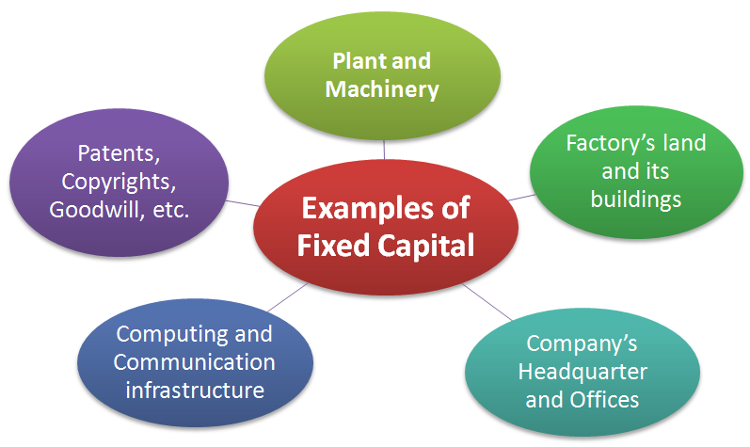
Financial Management
FIXED CAPTIAL-CONCEPT: It is the amount required to invest in the fixed assets. Decisions regarding investment in fixed assets are called capital budgeting decisions, and affect the growth, profitability and risk of the business in the long run.
IMPORTANCE:
Long-term Effects,
Large Investment,
More Risk,
Irreversible Decisions.

Slide 33
Financial Management
FACTORS AFFECTING THE REQUIREMENT OF FIXED CAPTIAL:
Nature of Business,
Scale of Operations,
Technique Used,
Technology Up gradation,
Growth Prospects,
Diversification,
Collaborations with Others for Use of Common Assets.

Slide 34
THANKING YOU
ODM EDUCATIONAL GROUP

Slide 35
FINANCIAL MANAGEMENT
SUBJECT : Business studies
CHAPTER NUMBER:9
CHAPTER NAME :Financial Management
CLASS-61

Slide 36
Financial Management
WORKING CAPTIAL-CONCEPT:
It is the amount invested in current assets required for day to day operations of the business.
Total of current assets is called gross working capital and excess of current assets over current liabilities is called net working capital.
STOCK
CASH
RECEIVABLES
WORKING CAPITAL
S. T. INVESTMENTS

Slide 37
Financial Management
FACTORS AFFECTING WORKING CAPITAL REQUIREMENTS:
Nature of Business,
Scale of Operations,
Seasonal Factors,
Production cycle,
Credit Allowed,
Credit Availability,
Availability of Raw Material,
Growth Prospects,
Level of Competition.
STOCK
CASH
RECEIVABLES
WORKING CAPITAL
S. T. INVESTMENTS

Slide 38
THANKING YOU
ODM EDUCATIONAL GROUP

