Slide 1


MINERAL AND POWER RESOURCES
Introduction: Mineral Resources
SUBJECT : (GEOGRAPHY)
CHAPTER NUMBER: 5
CHAPTER NAME : Mineral and Power Resources

Slide 2
CONTENT
Mineral Resources
Occurrence of Minerals
Types of Minerals
Extraction of Minerals
Distribution of Minerals (Asia, Europe, North America, South America, Africa, Australia, Antarctica)
Distribution of Minerals in India and its Uses (Iron-Ore, Bauxite, Mica, Copper, Manganese, Limestone, Gold, Salt, Silicon)

Slide 3
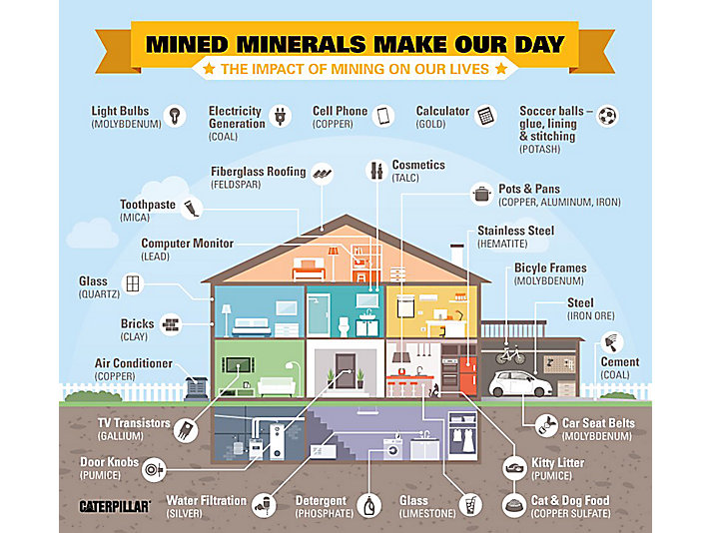

Slide 4


Slide 5
MINERAL RESOURCES
Minerals are naturally occurring substances found in the Earth’s crust.
Minerals are rarely found in the pure state. They are usually found in rocks, combined with other elements. Mostly they are found in low concentrations and in inaccessible places. Extraction becomes expensive.
Ore is a rock which contains enough mineral to make its mining economically profitable. Ores are of two types:-
High Grade Ores- the mineral content is high and impurities are less.
Low Grade Ores- the mineral content is low and impurities are more.

Slide 6
Geologists define mineral as a “homogenous, naturally occurring substance with a definable internal structure.” Minerals are found in varied forms in nature, ranging from the hardest diamond to the softest talc.
Rocks are combinations of homogenous substances called minerals.
A particular mineral that will be formed from a certain combination of elements depends upon the physical and chemical conditions under which the material forms.

Slide 7
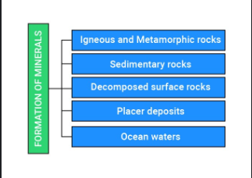
MODE OF OCCURRENCE OF MINERALS

Slide 8
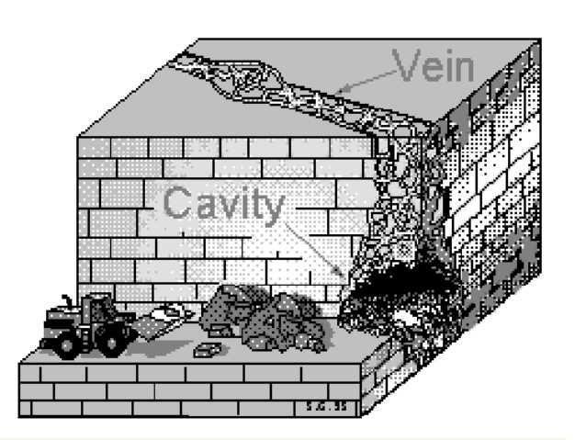
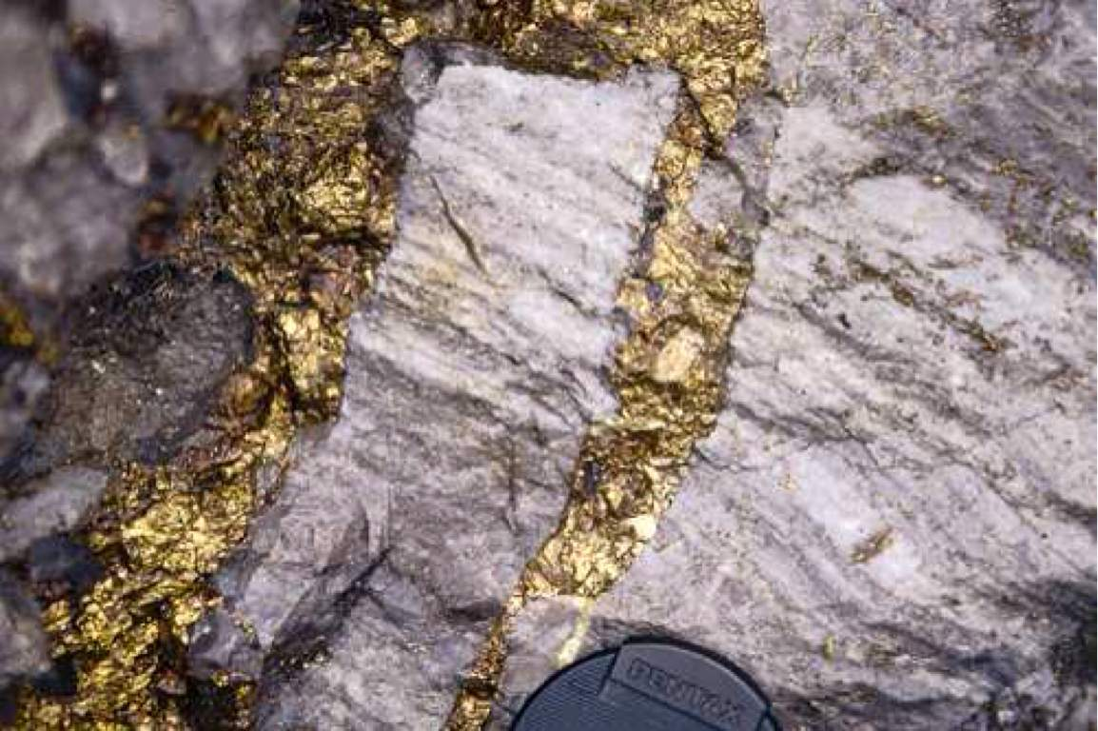
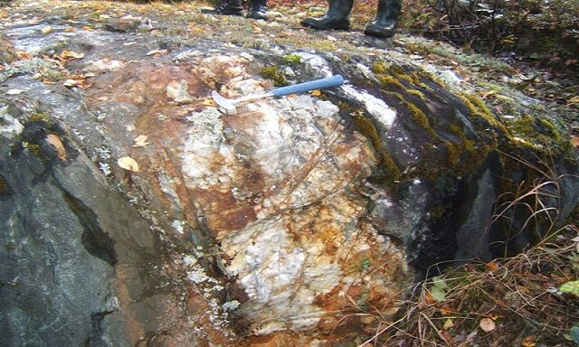
IGNEOUS AND METAMORPHIC ROCKS
In IGNEOUS AND METAMORPHIC ROCKS minerals may occur in the cracks, crevices, faults or joints.
The smaller occurrences are called veins and the larger are called lodes.
In most cases, they are formed when minerals in liquid/ molten and gaseous forms are forced upward through cavities towards the earth’s surface. They cool and solidify as they rise. Major metallic minerals like tin, copper, zinc and lead etc. are obtained from veins and lodes.

Slide 9
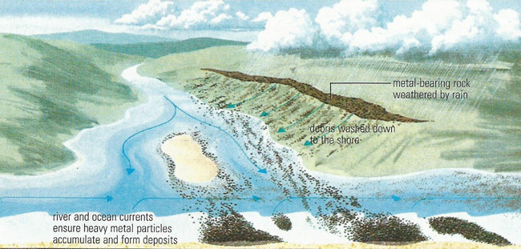
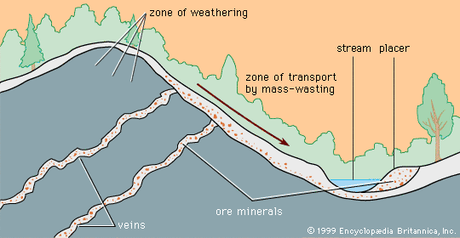

Slide 10
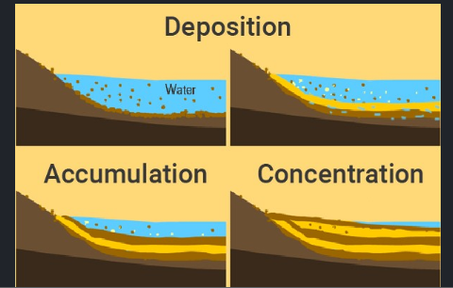
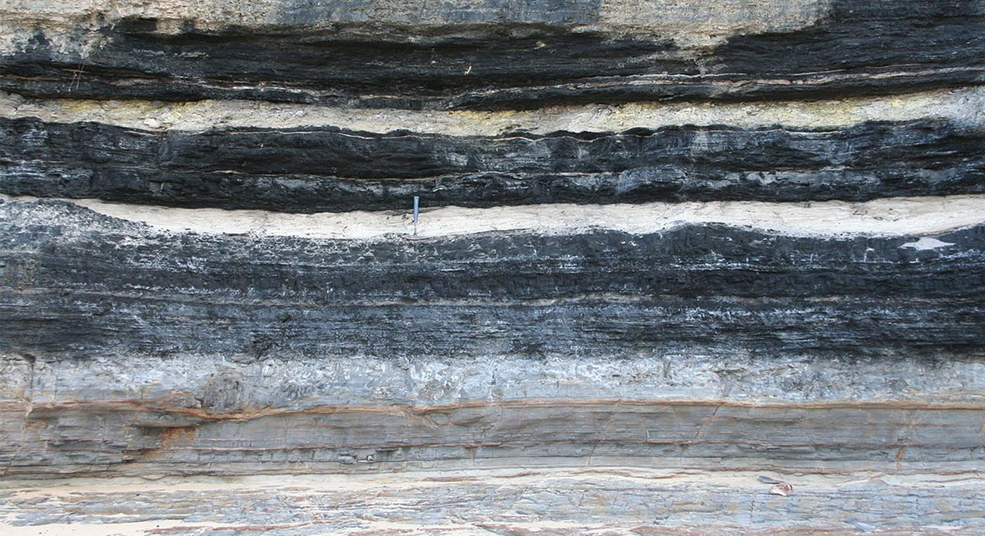
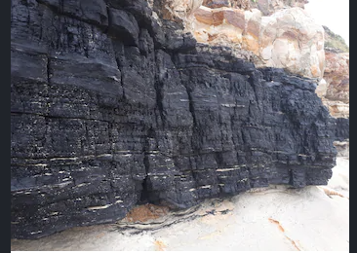
SEDIMENTARY ROCKS
(i) In SEDIMENTARY ROCKS a number of minerals occur in beds or layers.
(ii) They have been formed as a result of deposition, accumulation and concentration in horizontal strata. Coal and some forms of iron ore have been concentrated as a result of long periods under great heat and pressure. Another group of sedimentary minerals include gypsum, potash salt and sodium salt. These are formed as a result of evaporation especially in arid regions.
(iii) Another mode of formation involves the decomposition of surface rocks, and the removal of soluble constituents, leaving a residual mass of weathered material containing ores. Bauxite is formed this way.

Slide 11
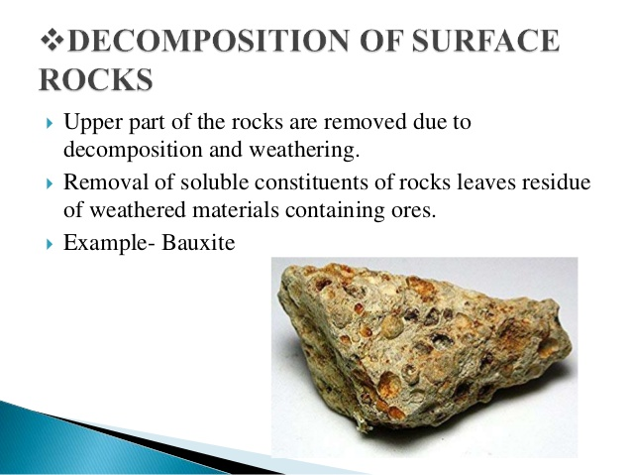
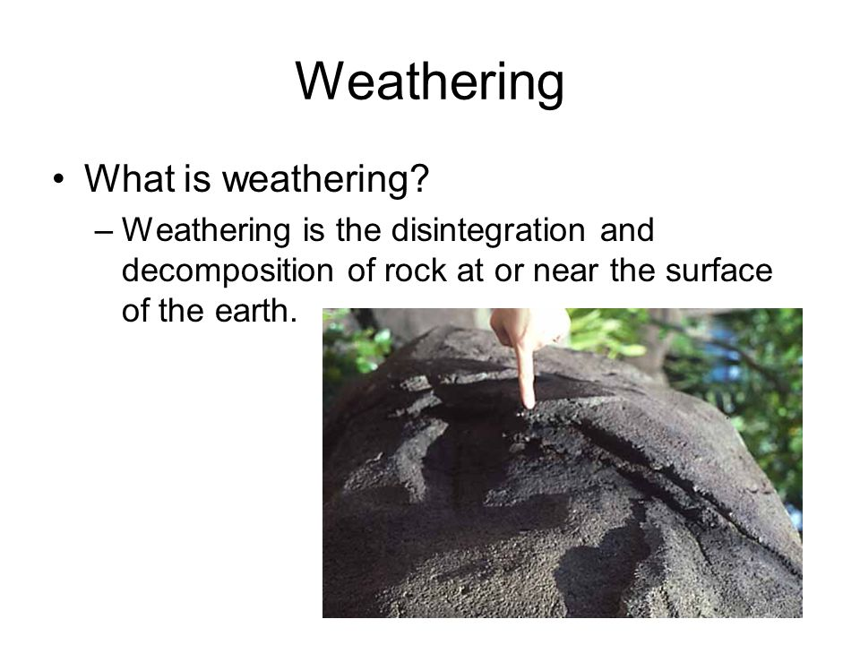
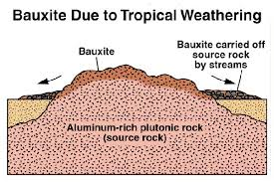

Slide 12
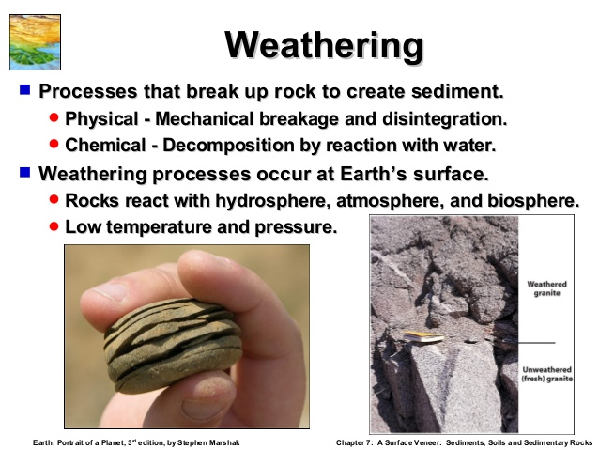

Slide 13
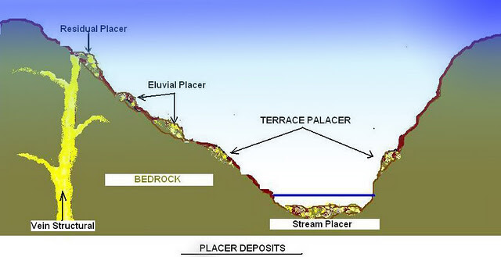
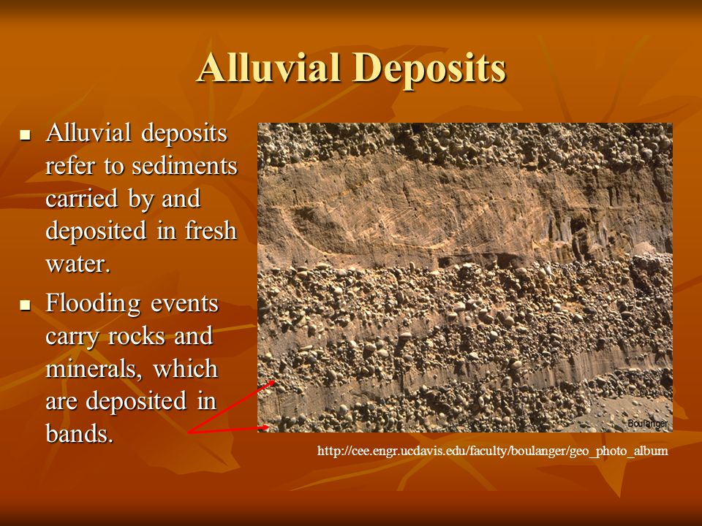
(iv) Certain minerals may occur as alluvial deposits in sands of valley floors and the base of hills. These deposits are called ‘placer deposits’ and generally contain minerals, which are not corroded by water. Gold, silver, tin and platinum are most important among such minerals.

Slide 14
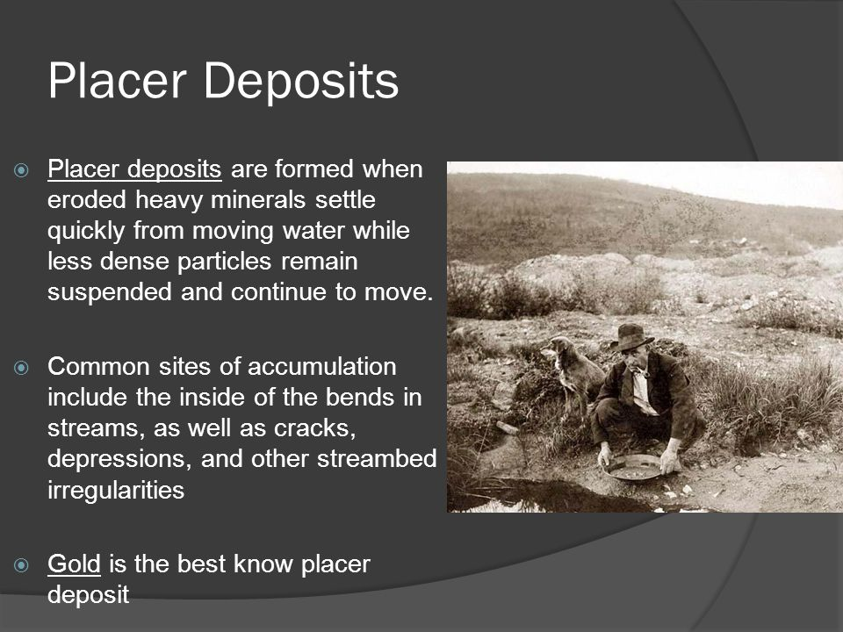
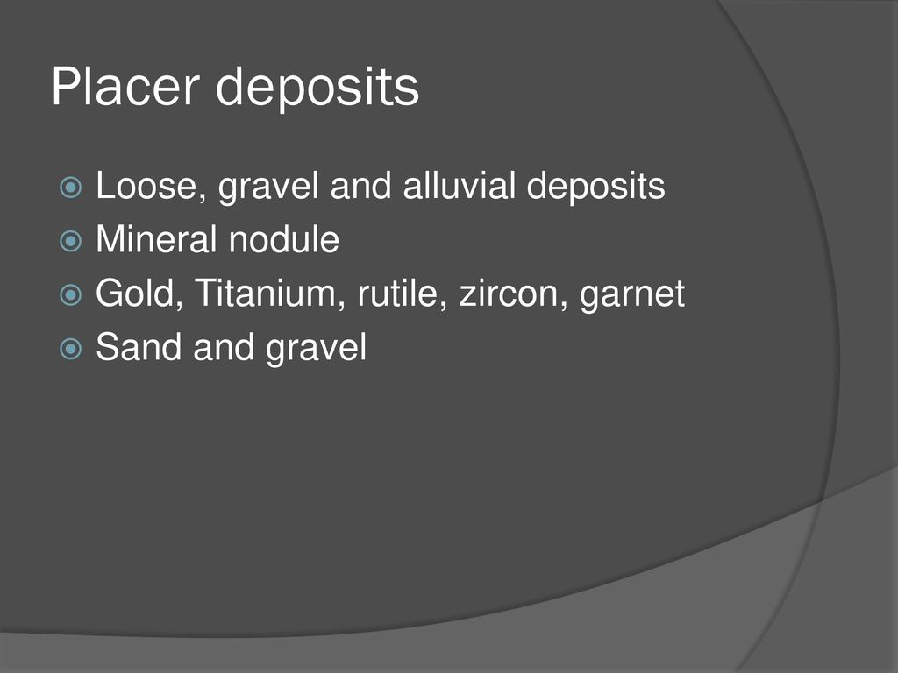

Slide 15
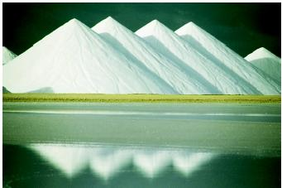
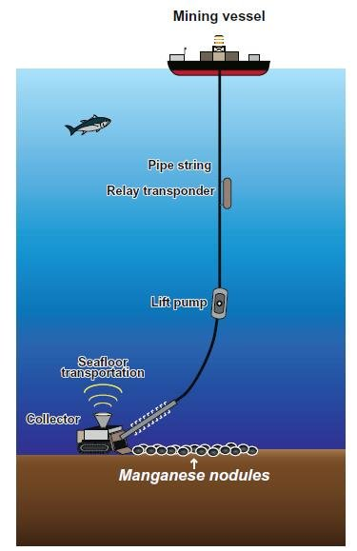
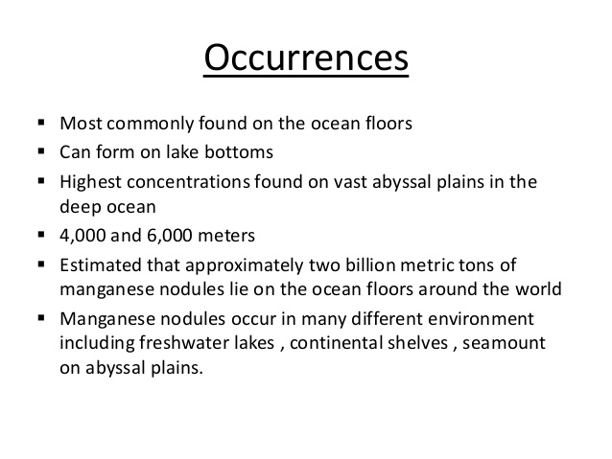
(v) The ocean waters contain vast quantities of minerals, but most of these are too widely diffused to be of economic significance. However, common salt, magnesium and bromine are largely derived from ocean waters. The ocean beds, too, are rich in manganese nodules.

Slide 16
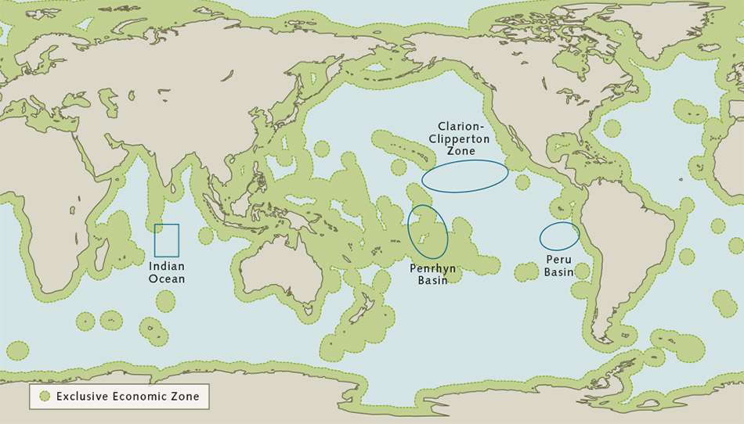

Slide 17
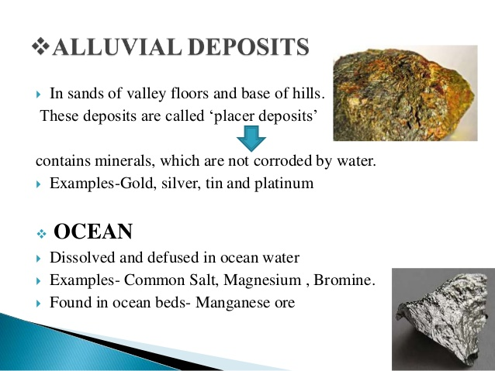

Slide 18
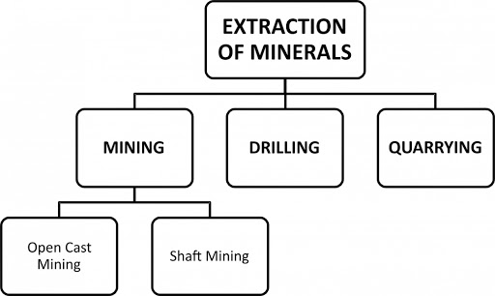
EXTRACTION OF MINERALS

Slide 19
All minerals are extracted from rocks.
Extraction is the process of taking out minerals from the rocks and is called mining.
Methods of mining depends upon the depth at which the mineral is located.
Open-Cast Mining- Minerals that lie near the surface are simply dug out of the ground through a process called open-cast mining. The opening formed is called an open-pit or quarry.
Shaft Mining- deep bores called shafts are made to reach mineral deposits that lie at great depths below the Earth’s surface.
Drilling- Petroleum and natural gas is drilled out through drilling, far below the Earth’s surface. Drilling can be done off-shore too.

Slide 20
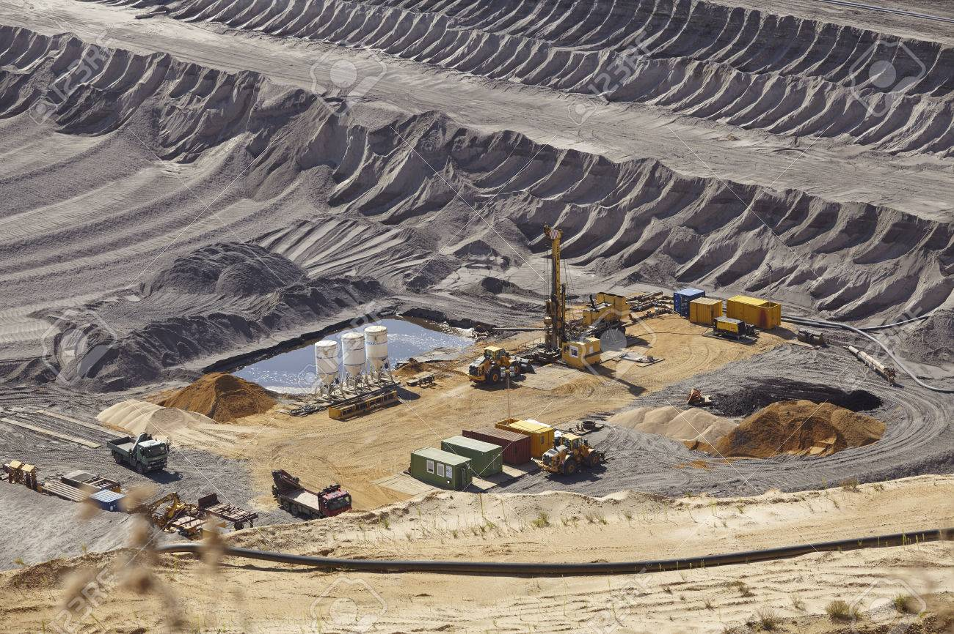
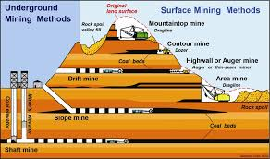
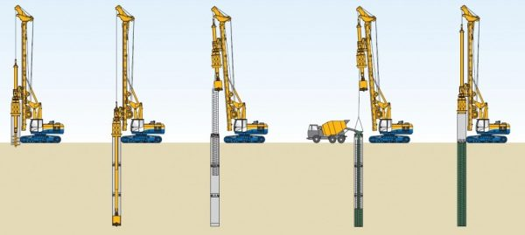
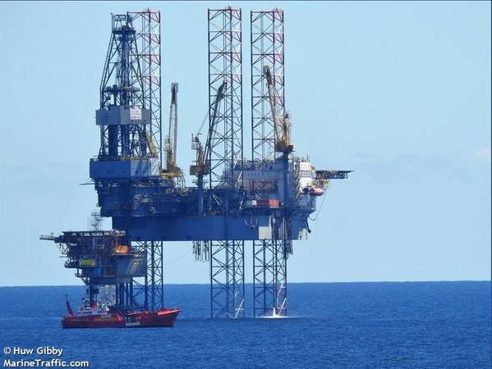

Slide 21
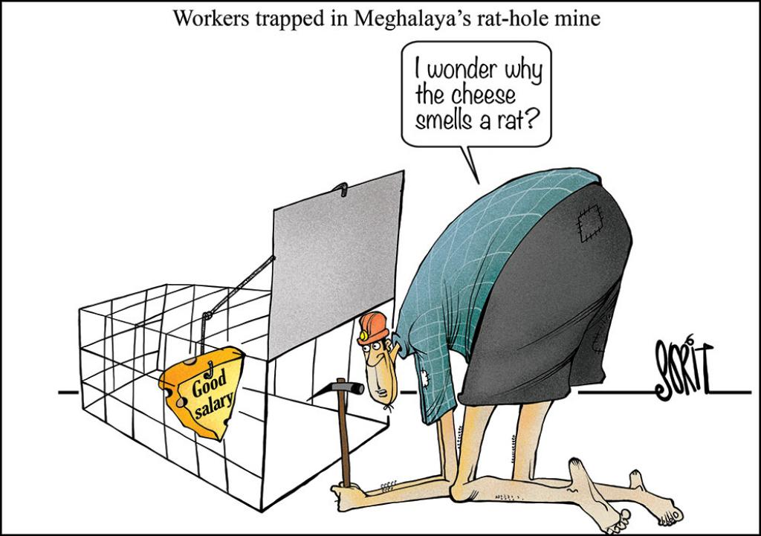
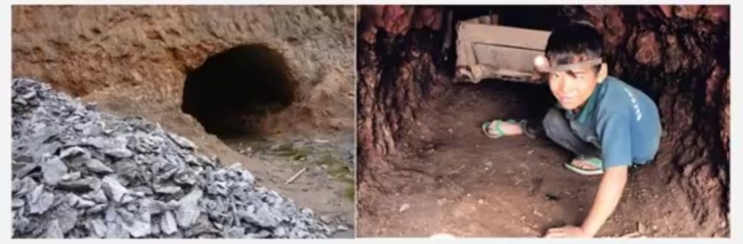
RAT-HOLE MINING
Most of the minerals in India are nationalized and their extraction is possible only after obtaining due permission from the government. But in most of the tribal areas of the north-east India, minerals are owned by individuals or communities.
In Meghalaya, there are large deposits of coal, iron ore, limestone and dolomite etc.
Coal mining in Jowai and Cherapunjee is done by family member in the form of a long narrow tunnel, known as ‘Rat hole’ mining.

Slide 22
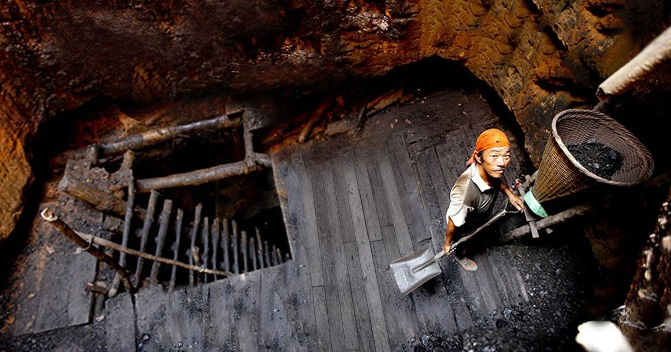
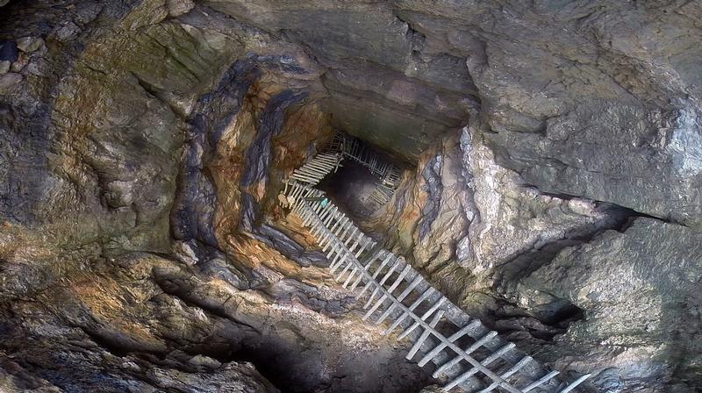

Slide 23
TYPES OF MINERALS
On the basis of composition, minerals are classified into metallic and non-metallic types.
Metallic, minerals contain metals in raw form.
Metals are hard substances that conduct heat and electricity and have shine. For example, iron ore and bauxite.
Metallic minerals are of two types: (a) Ferrous and (b) Non-ferrous.
Ferrous minerals contain iron ore, manganese, and chromites. Most of the Iron and steel industries and heavy industries depends on this mineral.
Non-ferrous minerals do not contain iron but may contain some other metals like gold, silver, copper or lead.
Non-metallic minerals do not contain metals. They are either organic or inorganic by origin. Organic minerals contain carbon. For example, coal, petroleum and natural gas. Limestone, mica, graphite are examples of inorganic minerals.

Slide 24
Types of Minerals | Rock Formations | Examples
Metallic minerals | Igneous and metamorphic rock formations | Iron-ore in north Sweden, copper and nickel deposits in Ontario, Canada; iron, nickel, chromites and platinum in South Africa are examples of minerals
Non-Metallic Minerals | Sedimentary rock formation | Limestone deposits of Caucasus region of France, manganese deposits of Georgia and Ukraine and phosphate beds of Algeria. Mineral fuels such as coal and petroleum are also found in the sedimentary strata

Slide 25
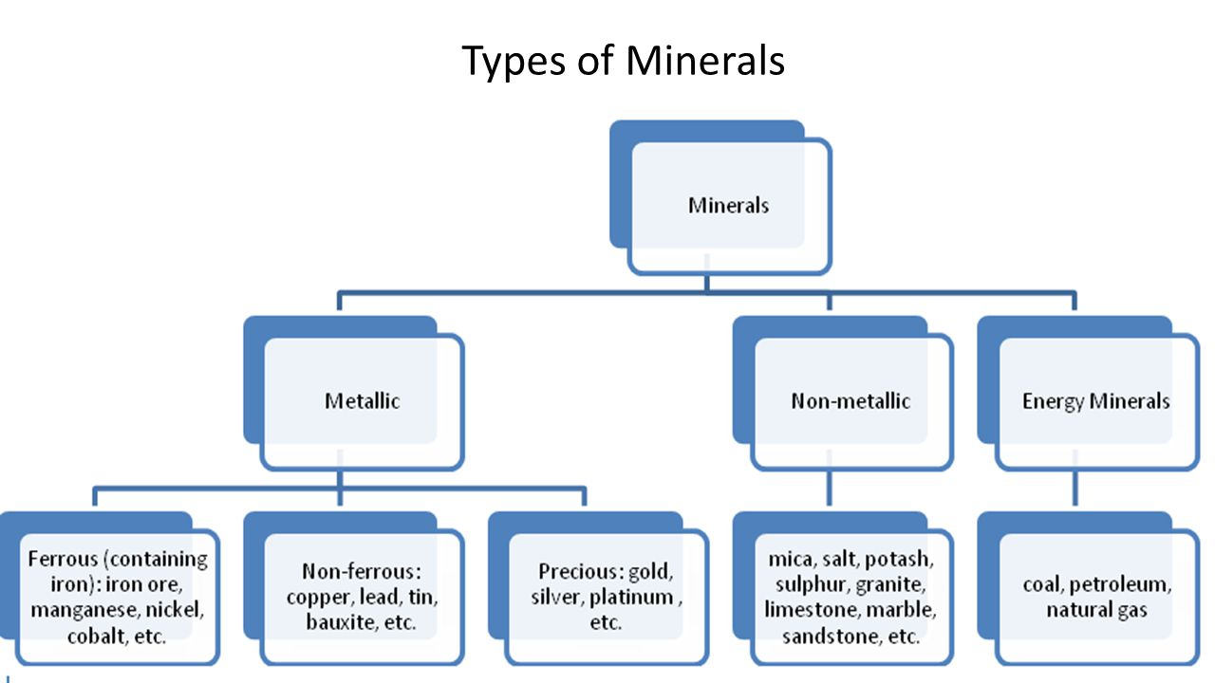

Slide 26
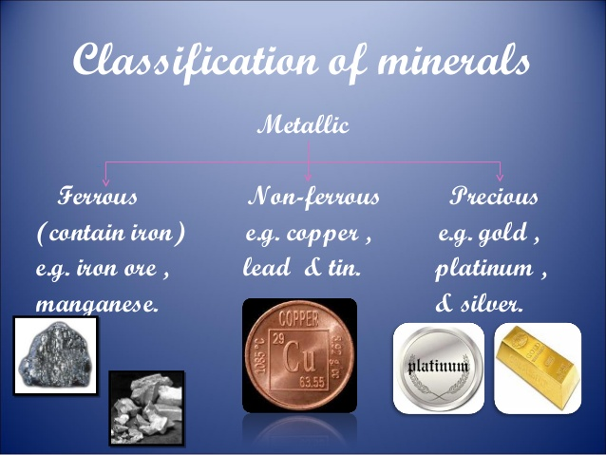

Slide 27
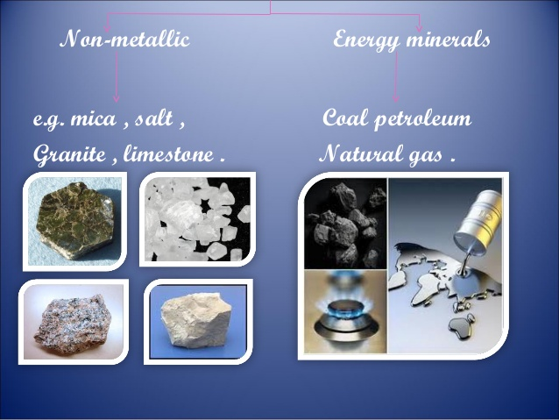

Slide 28
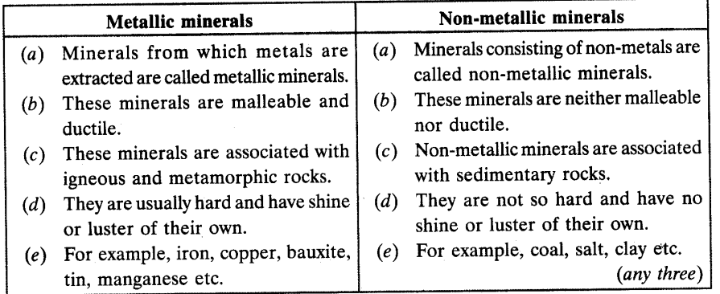

Slide 29
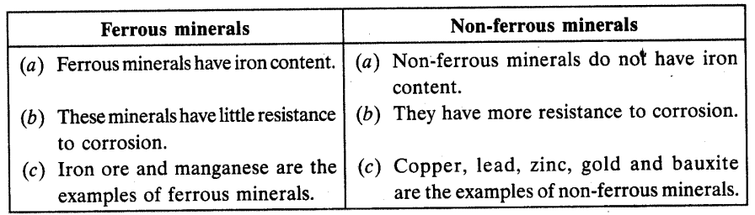

Slide 30
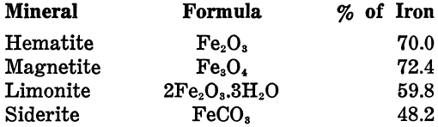
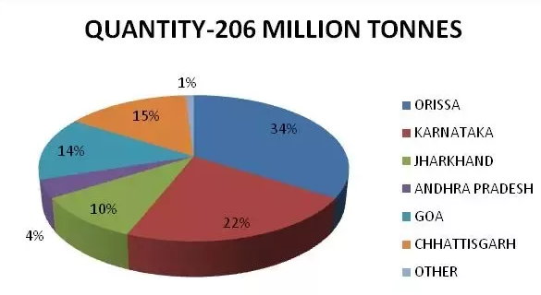
DISTRIBUTION OF MINERALS IN INDIA
FERROUS MINERALS:-
They provide base for the development of metallurgical industries.
IRON-ORE (basic mineral and backbone of industries)
Largest reserve of iron-ore in Asia- India
Types of Iron-ore found in India- Haematite and Magnetite
Areas of iron-ore mines- Coals fields of Chhota Nagpur plateau (Jharkhand, Odisha, Chhattisgarh, MP)
Iron-ore is used to make steel, build ships and in the construction industry.

Slide 31
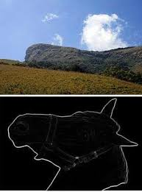

Kudre in Kannada means horse. The highest peak in the western ghats of Karnataka resembles the face of a horse.
The Bailadila hills look like the hump of an ox, and hence its name.

Slide 32
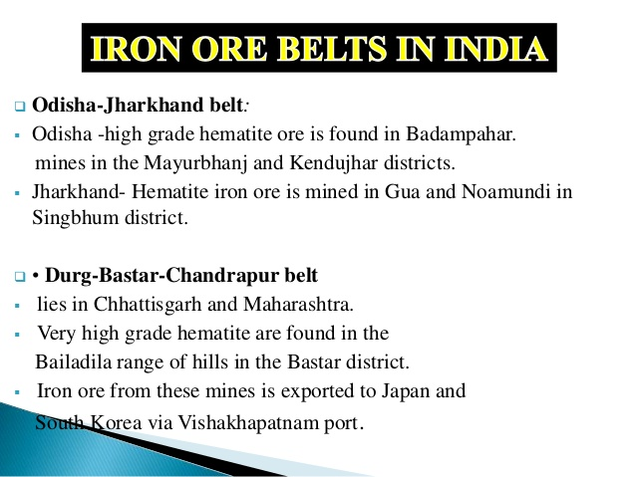

Slide 33
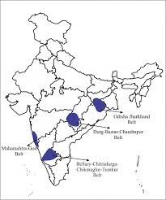
• MAHARASHTRA-GOA BELT includes the state of Goa and Ratnagiri district of Maharashtra. Though, the ores are not of very high quality, yet they are efficiently exploited. Iron ore is exported through Marmagao port.

Slide 34
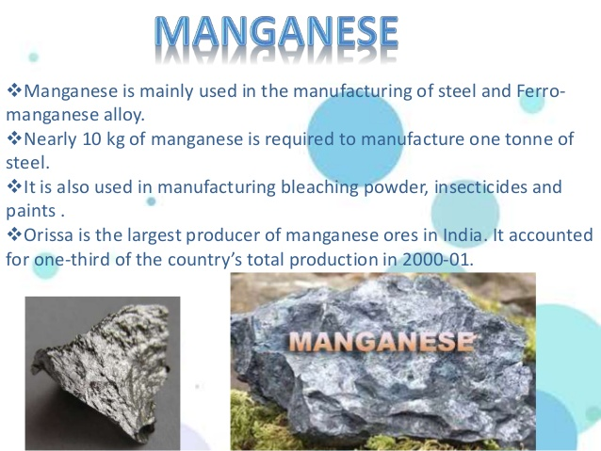

Slide 35
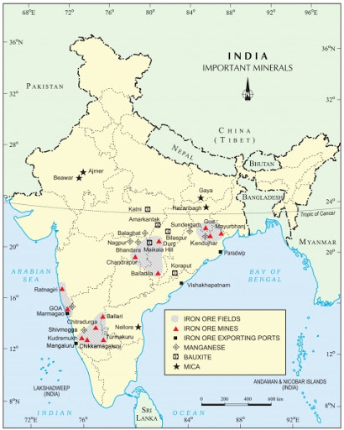
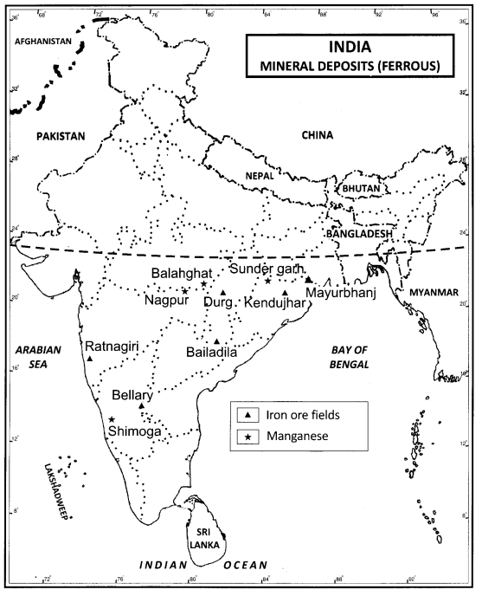

Slide 36
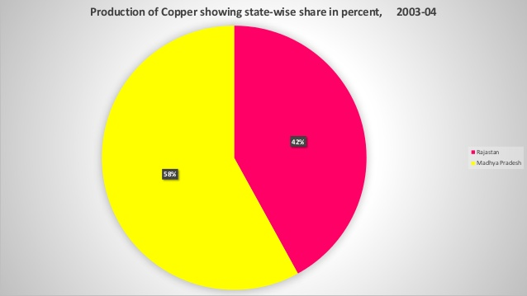
NON-FERROUS MINERALS:-
India’s reserves and production of non- ferrous minerals is not very satisfactory.
These minerals, which include copper, bauxite, lead, zinc and gold play a vital role in a number of metallurgical, engineering and electrical industries.
COPPER
Good conductor of electricity, used for making wires, electric motors, transformers and generators.
Area of production- Rajasthan, MP, Jharkhand, Karnataka
The Balaghat mines in Madhya Pradesh produce 52 per cent of India’s copper. The Singbhum district of Jharkhand is also a leading producer of copper. The Khetri mines in Rajasthan are also famous.

Slide 37
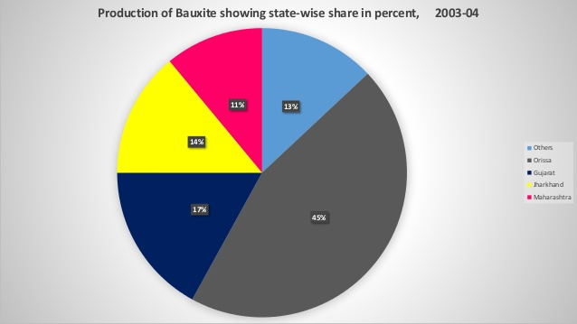
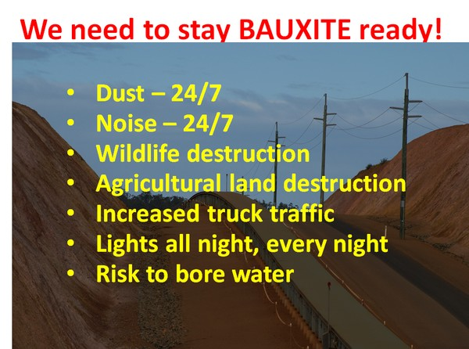
BAUXITE
Though, several ores contain aluminium, it is from bauxite, a clay-like substance that alumina and later aluminium is obtained. Bauxite deposits are formed by the decomposition of a wide variety of rocks rich in aluminium silicates.
Aluminium is used to manufacture automobiles and aircrafts, constructions, furniture, fittings, kitchenware etc because it combines the strength of metals such as iron, with extreme lightness and also with good conductivity and great malleability.
Largest producer of bauxite in India- Odisha is the largest bauxite producing state in India with 45 per cent of the country’s total production in 2000-01. Panchpatmali deposits in Koraput district are the most important bauxite deposits in the state.
Other areas are Jharkhand, Chhattisgarh, MP, Gujarat, Maharastra, Tamil Nadu
India’s bauxite deposits are mainly found in the Amarkantak plateau, Maikal hills and the plateau region of Bilaspur- Katni.

Slide 38
NON-METALLIC MINERALS:-
MICA
Largest producer and exporter in the world- India
Mica is a mineral made up of a series of plates or leaves. It splits easily into thin sheets. These sheets can be so thin that a thousand can be layered into a mica sheet of a few centimeters high.
Mica can be clear, black, green, red yellow or brown. Due to its excellent di-electric strength, low power loss factor, insulating properties and resistance to high voltage, mica is one of the most indispensable minerals used in electric and electronic industries.
Mica deposits are found in the northern edge of the Chota Nagpur plateau. Koderma Gaya – Hazaribagh belt of Jharkhand is the leading producer. In Rajasthan, the major mica producing area is around Ajmer. Nellore mica belt of Andhra Pradesh is also an important producer in the country.

Slide 39
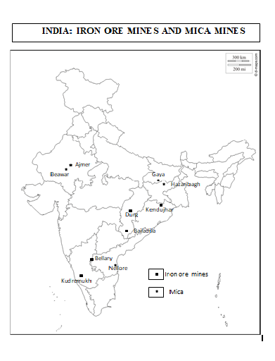
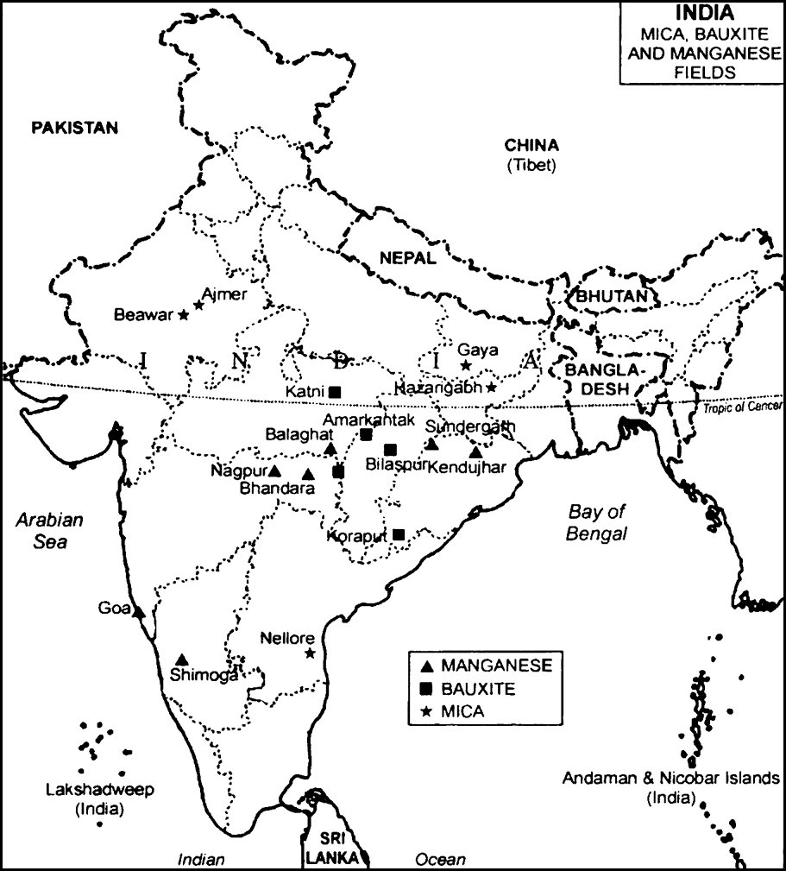

Slide 40
ROCK MINERALS
LIMESTONE
Areas- Bihar, Jharkhand, Odisha, MP, Chhattisgarh, Rajasthan, Gujarat, Tamil Nadu.
Limestone is found in association with rocks composed of calcium carbonates or calcium and magnesium carbonates. It is found in sedimentary rocks of most geological formations.
Limestone is the basic raw material for the cement industry and essential for smelting iron ore in the blast furnace.

Slide 41


HAZARDS OF MINING (KILLER INDUSTRY)

Slide 42
The dust and noxious fumes inhaled by miners make them vulnerable to pulmonary diseases.
The risk of collapsing mine roofs, inundation and fires in coalmines are a constant threat to miners.
The water sources in the region get contaminated due to mining.
Dumping of waste and slurry leads to degradation of land, soil, and increase in stream and river pollution.
Stricter safety regulations and implementation of environmental laws are essential to prevent mining from becoming a “killer industry”.

Slide 43
CONSERVATION OF MINERALS
Minerals are the non-renewable resources.
It is necessary to reduce wastage in process of mining.
Recycling of metals is the way to conserve mineral resources.
Over exploitation is harmful for environment as well.

Slide 44


Slide 45
RECAPITULATION:-
Mineral Resources
Mode of occurrence of minerals
Types of Minerals
Extraction of Minerals
Distribution of Minerals in India and its Uses (Iron-Ore, Bauxite, Mica, Copper, Manganese, Limestone)
Hazards of mining
Conservation of minerals

Slide 46
CONTENT:-
Energy Resources
Conventional Sources of Energy (Coal, Petroleum, Natural Gas, Electricity-Hydro and Thermal)
Non-Conventional Sources of Energy (Hydroelectric Power, Solar Energy, Wind Energy, Nuclear Power, Geothermal Energy, Tidal Energy, Biogas)
Need for using Non-Conventional Sources of Energy
Conservation of Energy

Slide 47
ENERGY RESOURCES
Energy is required for all activities. It is needed to cook, to provide light and heat, to propel vehicles and to drive machinery in industries.
Energy can be generated from fuel minerals like coal, petroleum, natural gas, uranium and from electricity.
Energy resources can be classified as conventional and nonconventional sources.
Conventional sources include: firewood, cattle dung cake, coal, petroleum, natural gas and electricity (both hydel and thermal).
Non-conventional sources include solar, wind, tidal, geothermal, biogas and atomic energy.
Firewood and cattle dung cake are most common in rural India. According to one estimate more than 70 per cent energy requirement in rural households is met by these two ; continuation of these is increasingly becoming difficult due to decreasing forest area. Moreover, using dung cake too is being discouraged because it consumes most valuable manure which could be used in agriculture.

Slide 48

CONVENTIONAL SOURCES OF ENERGY
The energy resources which have been in common use for a long time are known as conventional sources.
Firewood and fossil fuels are two main conventional energy sources.
Fossil fuels comprises of Coal( known as buried sunshine), Petroleum (known as black gold), Natural Gas and Hydroelectricity.

Slide 49
COAL
Coal is formed due the compression of plant material over millions of years. Coal, therefore, is found in a variety of forms depending on the degrees of compression and the depth and time of burial.
Decaying plants in swamps produce PEAT which has a low carbon and high moisture contents and low heating capacity.
LIGNITE is a low grade brown coal, which is soft with high moisture content. The principal lignite reserves are in Neyveli in Tamil Nadu and are used for generation of electricity.
Coal that has been buried deep and subjected to increased temperatures is BITUMINOUS coal. It is the most popular coal in commercial use. Metallurgical coal is high grade bituminous coal which has a special value for smelting iron in blast furnaces.
ANTHRACITE is the highest quality hard coal.
In India coal occurs in rock series of two main geological ages, namely Gondwana, a little over 200 million years in age and in tertiary deposits which are only about 55 million years old.
The major resources of Gondwana coal, which are metallurgical coal, are located in Damodar valley (West Bengal-Jharkhand). Jharia, Raniganj, Bokaro are important coalfields. The Godavari, Mahanadi, Son and Wardha valleys also contain coal deposits.
Tertiary coals occur in the north eastern states of Meghalaya, Assam, Arunachal Pradesh and Nagaland.
Coal is a bulky material, which loses weight on use as it is reduced to ash. Hence, heavy industries and thermal power station are located on or near the coalfields.

Slide 50



Slide 51

PETROLEUM
The world ‘petroleum’ is derived from the Latin words petra meaning rock and oleum meaning oil.
Petroleum is found as crude oil trapped in between layers of sedimentary rocks. It is thick black liquid found between the layers of rocks- drilled from oil fields located in off-shore and coastal areas.

Slide 52
NATURAL GAS
Found with petroleum deposits-released when crude oil is brought to the surface-used as a domestic and industrial fuel.
It is used as a source of energy as well as an industrial raw material in the petrochemical industry.
Large reserves of natural gas have been discovered in the Krishna- Godavari basin. Along the west coast the reserves of the Mumbai High and allied fields are supplemented by finds in the Gulf of Cambay. Andaman and Nicobar islands are also important areas having large reserves of natural gas.
The 1700 km long Hazira-BijaipurJagdishpur cross country gas pipeline links Mumbai High and Bassien with the fertilizer, power and industrial complexes in western and northern India. This artery has provided an impetus to India’s gas production. The power and fertilizer industries are the key users of natural gas.
In India, GAIL (Gas Authority of India Limited) was set up in 1984 as a Public Sector undertaking to locate new reserves and to transport and market natural gas.
CNC (Compressed Natural Gas) is eco-friendly automobile fuel to replace liquid fuels, is gaining wide popularity in the country.

Slide 53



Slide 54
ELECTRICITY
Electricity has such a wide range of applications in today’s world that, its per capita consumption is considered as an index of development.
Electricity is generated mainly in two ways: by running water which drives hydro turbines to generate hydro electricity; and by burning other fuels such as coal, petroleum and natural gas to drive turbines to produce thermal power. Once generated the electricity is exactly the same.
Hydro electricity is generated by fast flowing water, which is a renewable resource. India has a number of multi-purpose projects like the Bhakra Nangal, Damodar Valley corporation, the Kopili Hydel Project etc. producing hydroelectric power.
Thermal electricity is generated by using coal, petroleum and natural gas. The thermal power stations use non-renewable fossil fuels for generating electricity. There are over 310 thermal power plants in India.
Nuclear or Atomic Energy is obtained by altering the structure of atoms. When such an alteration is made, much energy is released in the form of heat and this is used to generate electric power. Uranium and thorium, which are available in Jharkhand and the Aravalli ranges of Rajasthan are used for generating atomic or nuclear power. The Monazite sands of Kerala is also rich in thorium.

Slide 55


Slide 56
NON-CONVENTIONAL SOURCES OF ENERGY
Non-conventional sources of energy are renewable in nature. There is a pressing need to use renewable energy sources like solar energy, wind, tide, biomass and energy from waste material. These are called nonconventional energy sources. India is blessed with an abundance of sunlight, water, wind and biomass. It has the largest programs for the development of these renewable energy resources.
Increasing use of fossil fuels leads to shortage- if the present rate of consumption continues, the reserves of these fuels will get exhausted- their use also causes environmental pollution- Therefore, there is need for using nonconventional sources such as solar energy, wind energy, tidal energy, which are renewable.
Unchecked burning of fossil fuel is like an unchecked dripping tap which will eventually run dry. This has led to the tapping of various nonconventional sources of energy that are cleaner alternatives to fossil fuels.

Slide 57


Slide 58
SOLAR ENERGY
Solar energy trapped from the sun-used in solar cells to produce electricity.
Two effective processes to tap solar energy are photovoltaic cells and solar thermal technology.Many of these cells are joined into solar panels to generate power for heating and lighting purposes. Solar energy is used in solar heaters, solar cookers, solar dryers besides being used for community lighting and traffic signals.
Photovoltaic technology converts sunlight directly into electricity. Solar energy is fast becoming popular in rural and remote areas.
The largest solar plant of India is located at Madhapur, near Bhuj, where solar energy is used to sterlise milk cans. It is expected that use of solar energy will be able to minimise the dependence of rural households on firewood and dung cakes, which in turn will contribute to environmental conservation and adequate supply of manure in agriculture.
Gujarat and Rajasthan in India has great potential for solar energy development.

Slide 59
WIND ENERGY
Inexhaustible source of energy- Windmills are used for grinding grain and lifting water-high speed winds rotate the windmill which is connected to a generator to produce electricity.
India now ranks as a “wind super power” in the world.
The largest wind farm cluster is located in Tamil Nadu from Nagarcoil to Madurai. Apart from these, Andhra Pradesh, Karnataka, Gujarat, Kerala, Maharashtra and Lakshadweep have important wind farms. Nagarcoil and Jaisalmer are well known for effective use of wind energy in the country.

Slide 60
BIOGAS
Shrubs, farm waste, animal and human waste are used to produce biogas for domestic consumption in rural areas. Decomposition of organic matter yields gas, which has higher thermal efficiency in comparison to kerosene, dung cake and charcoal.
Biogas plants are set up at municipal, cooperative and individual levels. The plants using cattle dung are know as ‘Gobar gas plants’ in rural India. These provide twin benefits to the farmer in the form of energy and improved quality of manure.
Biogas is by far the most efficient use of cattle dung. It improves the quality of manure and also prevents the loss of trees and manure due to burning of fuel wood and cow dung cakes.

Slide 61
TIDAL ENERGY
Energy generated from tides – can be harnessed by building dams at narrow openings of the sea-During high tide, energy of the tides is used to turn the turbine installed in the dam to produce electricity.
Huge tidal mill farms-Russia, France and the Gulf of Kachchh in India
Oceanic tides can be used to generate electricity. Floodgate dams are built across inlets. During high tide water flows into the inlet and gets trapped when the gate is closed. After the tide falls outside the flood gate, the water retained by the floodgate flows back to the sea via a pipe that carries it through a power-generating turbine.
In India, the Gulf of Kuchchh, provides ideal conditions for utilizing tidal energy. A 900 mw tidal energy power plant is set up here by the National Hydropower Corporation.

Slide 62
GEO-THERMAL ENERGY
Geothermal energy refers to the heat and electricity produced by using the heat from the interior of the Earth. Geothermal energy exists because, the Earth grows progressively hotter with increasing depth. Where the geothermal gradient is high, high temperatures are found at shallow depths. Groundwater in such areas absorbs heat from the rocks and becomes hot. It is so hot that when it rises to the earth’s surface, it turns into steam. This steam is used to drive turbines and generate electricity.
There are several hundred hot springs in India, which could be used to generate electricity.
Two experimental projects have been set up in India to harness geothermal energy. Geothermal plants in India-located in the Parvati valley near Manikaran in Himachal Pradesh and Puga Valley in Ladakh

Slide 63

CONSERVATION OF ENERGY

Slide 64
Energy is a basic requirement for economic development. Every sector of the national economy – agriculture, industry, transport, commercial and domestic – needs inputs of energy. The economic development plans implemented since Independence necessarily required increasing amounts of energy to remain operational. As a result, consumption of energy in all forms has been steadily rising all over the country. In this background, there is an urgent need to develop a sustainable path of energy development.
Promotion of energy conservation and increased use of renewable energy sources are the twin planks of sustainable energy.
India is presently one of the least energy efficient countries in the world. We have to adopt a cautious approach for the judicious use of our limited energy resources. For example, as concerned citizens we can do our bit by using public transport systems instead of individual vehicles; switching off electricity when not in use, using power-saving devices and using non-conventional sources of energy.
After all, “energy saved is energy produced”.

Slide 65
THANKING YOU
ODM EDUCATIONAL GROUP

