Slide 1

WELCOME TO ONLINE CLASS
CLASS : UKG
SUBJECT : ENGLISH
TOPIC : Unit-VI – “Ch” sound words

Slide 2

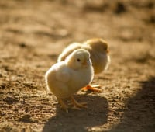
POINT TO THE PICTURE, LISTEN AND REPEAT
CHAIR
CHICK

Slide 3



CHIN
BENCH
CHILDREN

Slide 4
CLASS ASSIGNMENT
COLOUR THE “CH” SOUND WORDS
king
hot
fan
fin mat
watch
bench
children

Slide 5
WRITE THE FOLLOWING WORDS TWICE IN YOUR C.W COPY
Chair
Chick
Chin
Church
Children
Watch
match

Slide 6

THANKING YOU
ODM EDUCATIONAL GROUP

