Slide 1


WELCOME TO SOCIAL SCIENCE
SUBJECT : (GEOGRAPHY)
CHAPTER NUMBER: 1
CHAPTER NAME : OUR ENVIRONMENT

Slide 2

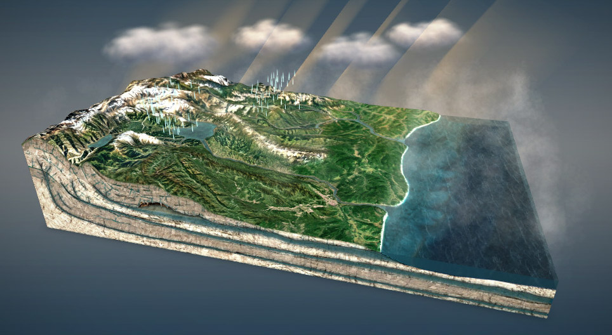
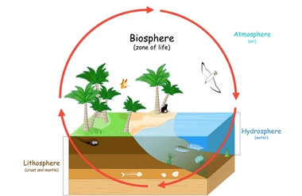
WHAT WE WILL LEAR TODAY???

Slide 3
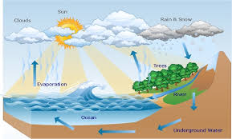



Hydrosphere:- The hydrosphere (from Greek hydro, "water” and sphaira, "sphere" the combined mass of water found on, under, and above the surface of a planet earth.
https://www.youtube.com/watch?v=48KuPTBuYmE

Slide 4
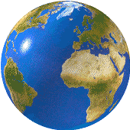

Biological-Environment: Biosphere :- The biosphere is made up of living organisms and the physical environment. The physical environment comprises the non-living components such as the rocky substance of the Earth's crust, water, light, and atmospheric gas. examples of Biosphere tundra, deserts, prairies, ocean, vegetation.
B
A
L
H
https://www.youtube.com/watch?v=6j5iHvYBIcg

Slide 5
Everything in biosphere is interconnected and inter depended:-
For Example:- Forest provide products like timber , fruits , nuts etc.
They also provide a natural habitat for various plant and animals.
Forest help moderate the atmospheric temperature by absorbing CO2 and adding moisture to the air.
Many animals depend on forests and grassland for their food.
Ecosystem: The system formed by the interaction of all living organisms with each other and with the physical and chemical factors of the environment in which they live, all linked by the transfer of energy and material is called an ecosystem.
The system formed by the interaction of all living organisms with each other and with the physical and chemical factors of the environment in which they live, all linked by the transfer of energy and material is called an ecosystem.

Slide 6

1.” water is essential for all living organism maintain their biological water balance.” Justify the statement with example.
2. What do animals and humans adapt to their environments?(close-ended question)
3. What would happen if an animal was not able to adapt to its environment?(open-ended question)

Slide 7
THANKING YOU
ODM EDUCATIONAL GROUP

