Slide 1


WELCOME TO SOCIAL SCIENCE
SUBJECT : (GEOGRAPHY)
CHAPTER NUMBER: 1
CHAPTER NAME : ENVIRONMENT

Slide 2
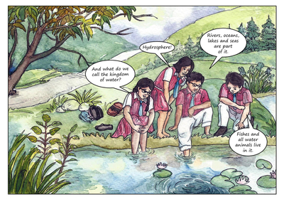
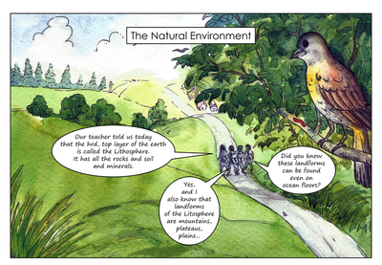
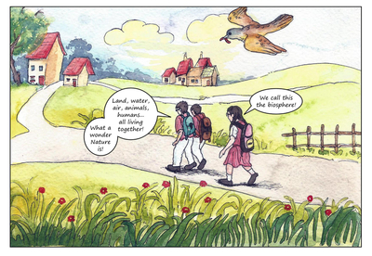
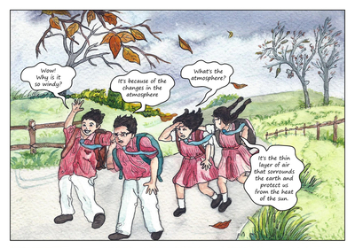
STORY TIME

Slide 3

What we will learn today??
1. Environment
2. Components of Environment
3. Concept and meaning of environment related to geography.
4. Fun time with activity

Slide 4


What is Environment ?
Ans:- “Everything in our immediate surrounding.” so basically in our surrounding we can see is Plants, animals and human beings who always depend on the immediate surroundings and are also Interdependent for their survival.

Slide 5
COMPONENTS OF ENVIRONMENT
Biotic
Abiotic
Environment

Slide 6
Geography is considered as study of Earth’s surface but it also study the Earth’s environment and its Physical and Human-made dimensions.
ENVIRONMENT
NATURAL ENVIRONMENT
HUMAN MADE ENVIRONMENT

Slide 7


Q1.Which of the following is not an abiotic component of the environment?
Insect
Sunlight
Wood water
Q2.Define the term environment.
Q3. “Plants and animals depend on each other”. Justify the statement.

Slide 8
THANKING YOU
ODM EDUCATIONAL GROUP

