Slide 1

CHEMISTRY-X
CHAPTER-3
METALS AND NONMETALS
SUB TOPIC – EXTRACTION OF METALS DEPENDING UPON THEIR REACTIVITY

Slide 2
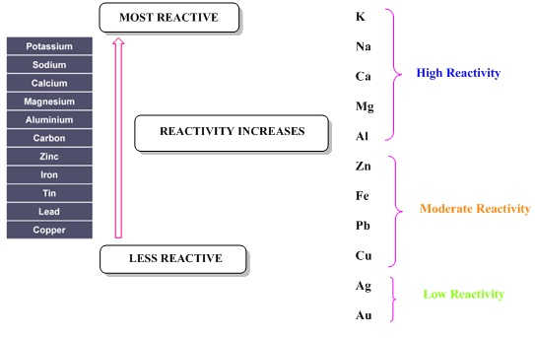
STUDYING MRS

Slide 3


EXTRACTION OF LEAST REACTIVE METALS
EXTRACTION OF LEAST REACTIVE METALS LIKE Cu, Ag and Hg….
[self-reduction process]

Slide 4


EXTRACTION OF MODERATELY REACTIVE METALS
Usually they are available in their Oxide, Carbonate and Sulphide Ores which by either Calcination or Roasting processes get converted into their corresponding Oxides and next getting Reduced in presence of convenient Reducing Agents to convert to their Metals.
M-Sulphides + O2 -> M-Oxides + SO2 (roasting)
M-Carbonates / Bicarbonates -> M-Oxides + CO2 (calcination)

Slide 5
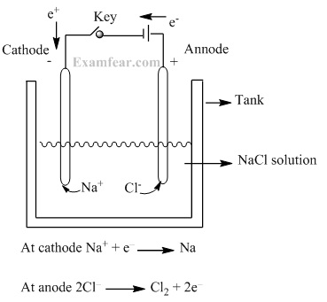
EXTRACTION OF HIGHLY REACTIVE METALS
Usually they are found in their halide form or Nitrate form which is extracted easily by Electrolysis Process. (like Na, K…)

Slide 6
THANK YOU
      ODM PUBLIC SCHOOL

